Slide 1
Angleville Documentation
and Self-Reflection
Written by Rex

Slide 2
Requirements
Must not include minecraft
All your roads and buildings must have geometry related names
Two parallel roads
One intersecting road
One perpendicular road
Eight 3-D building
Five other things

Slide 3
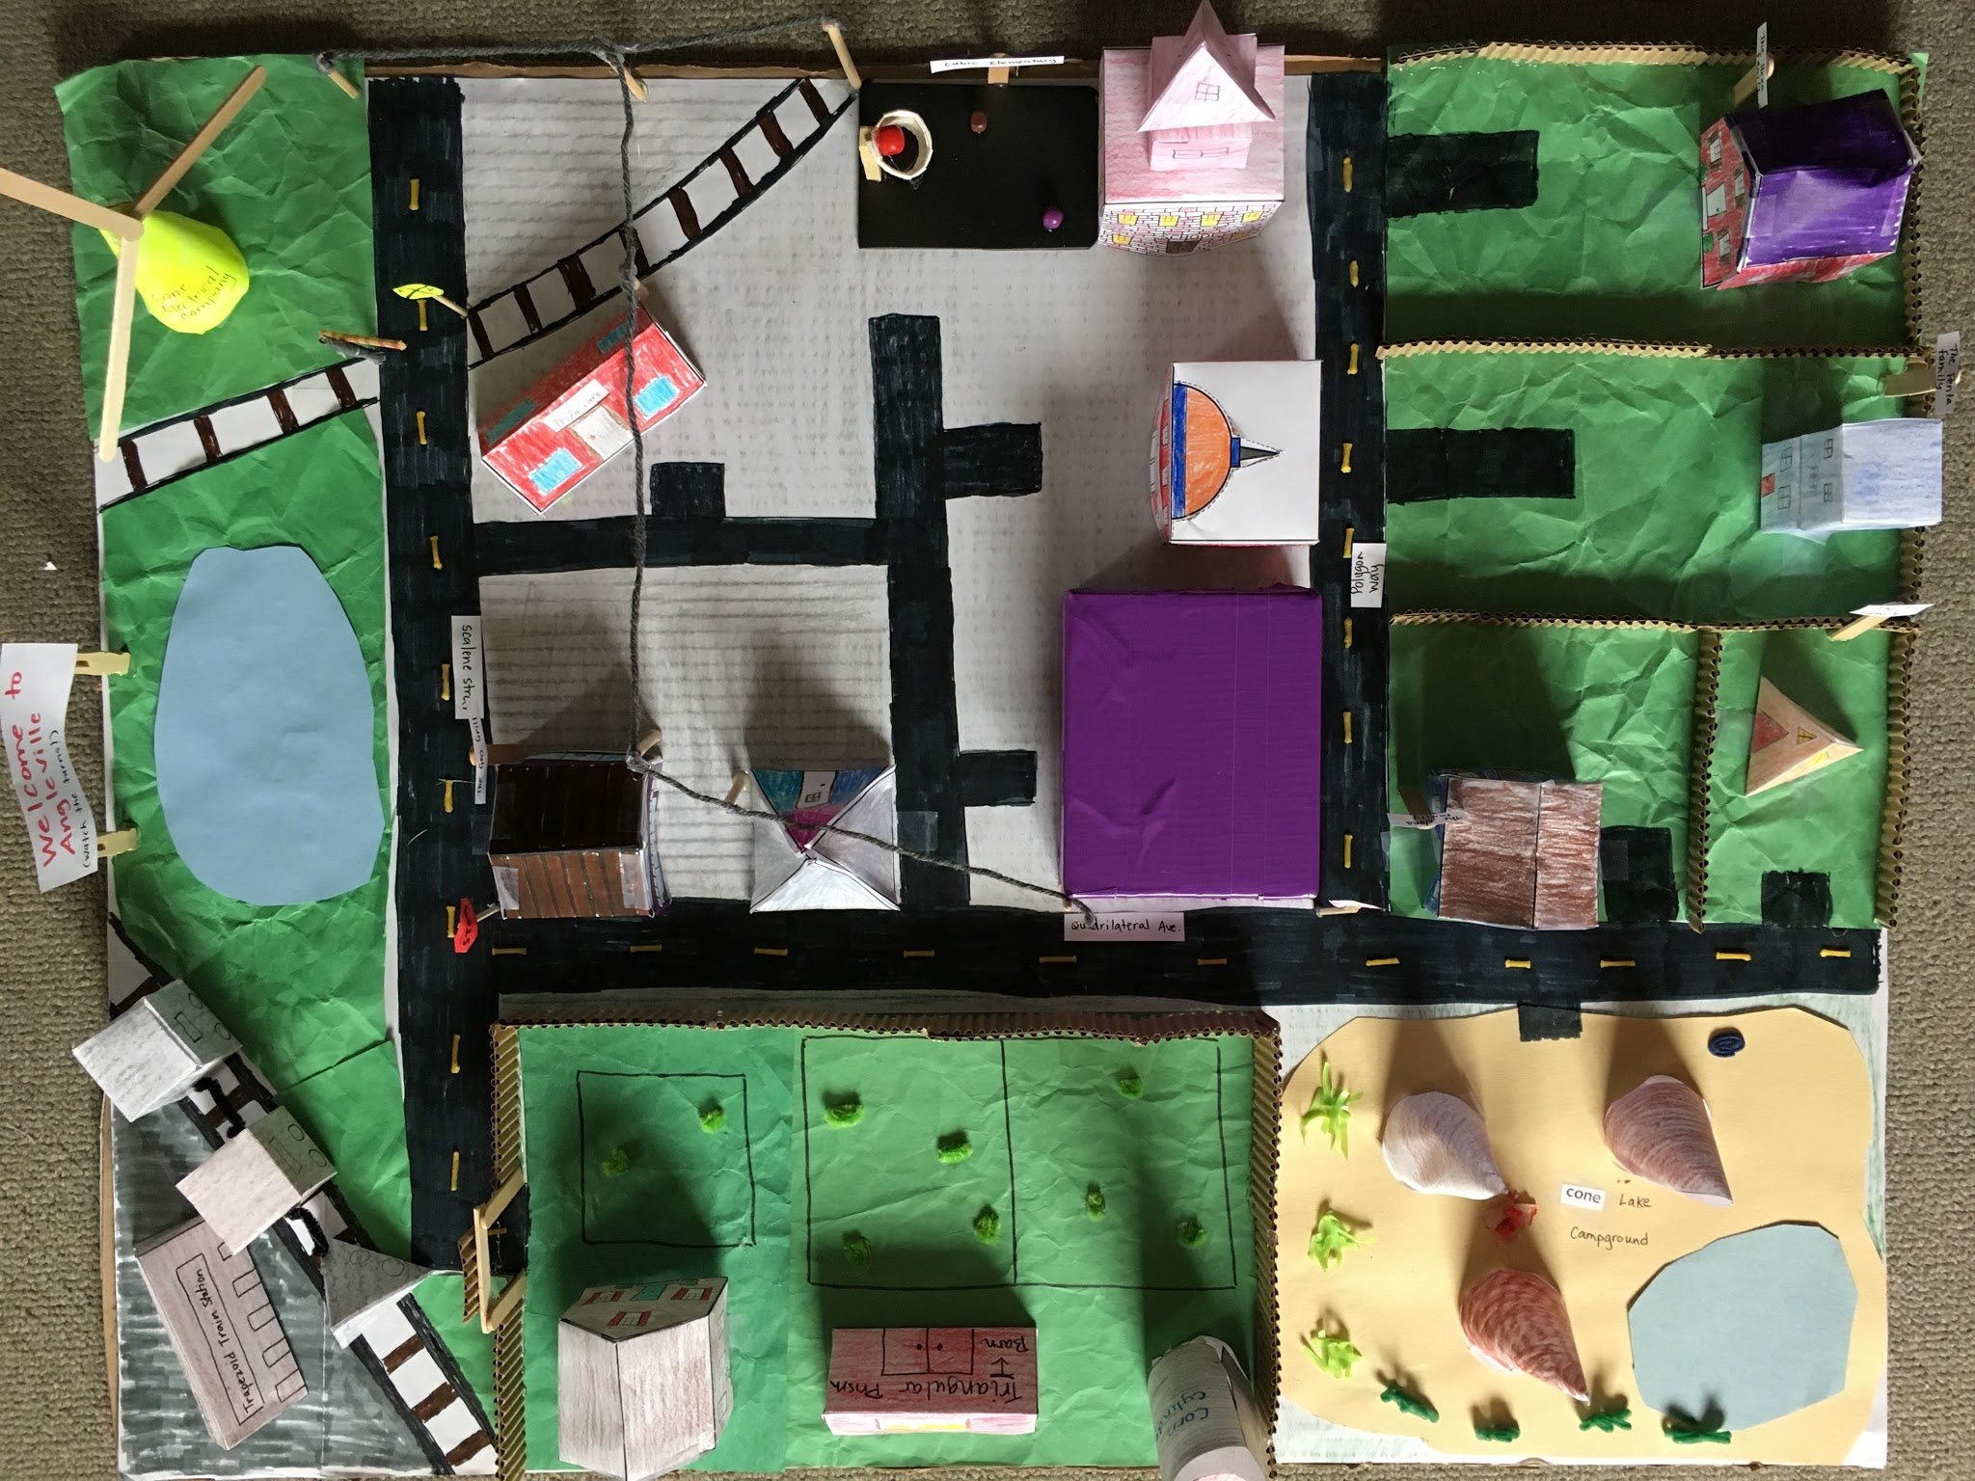
These are the parallel lines as two roads.
These are intersecting.

Slide 4
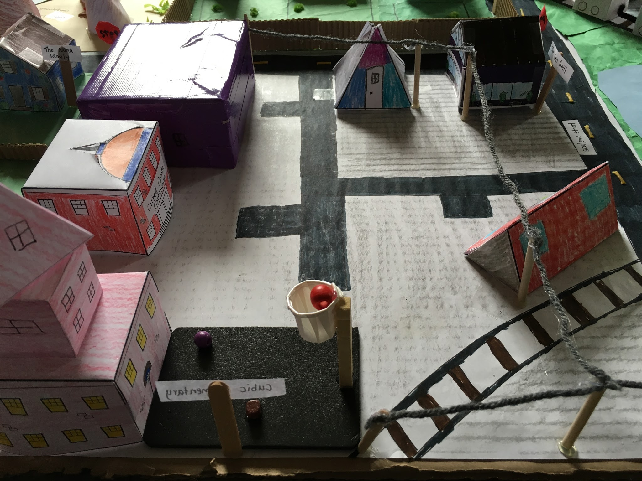
Pyramid market
Cubed county courthouse
This is the biggest place in town because of all the buildings for example, the prism cafe and the geo grill.
Cubic elementary

Slide 5
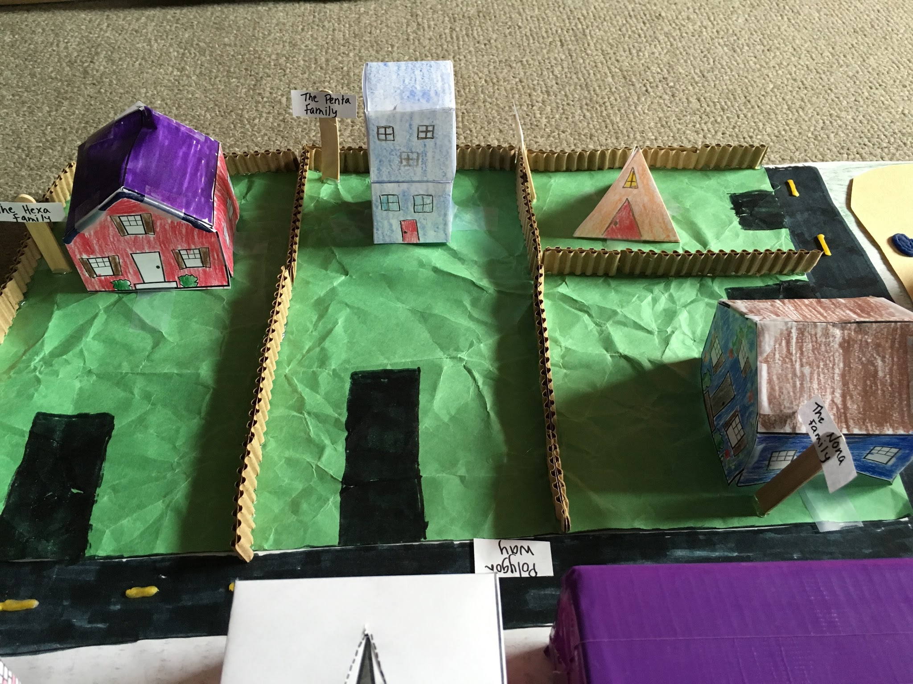
The tri family lives in a pyramid shaped house.
The penta family lives in a two story cube house
The hexa lives in a rectangular prism house with a triangular Prism roof.
The nona family lives in a rectangular prism house with a triangular Prism roof.

Slide 6
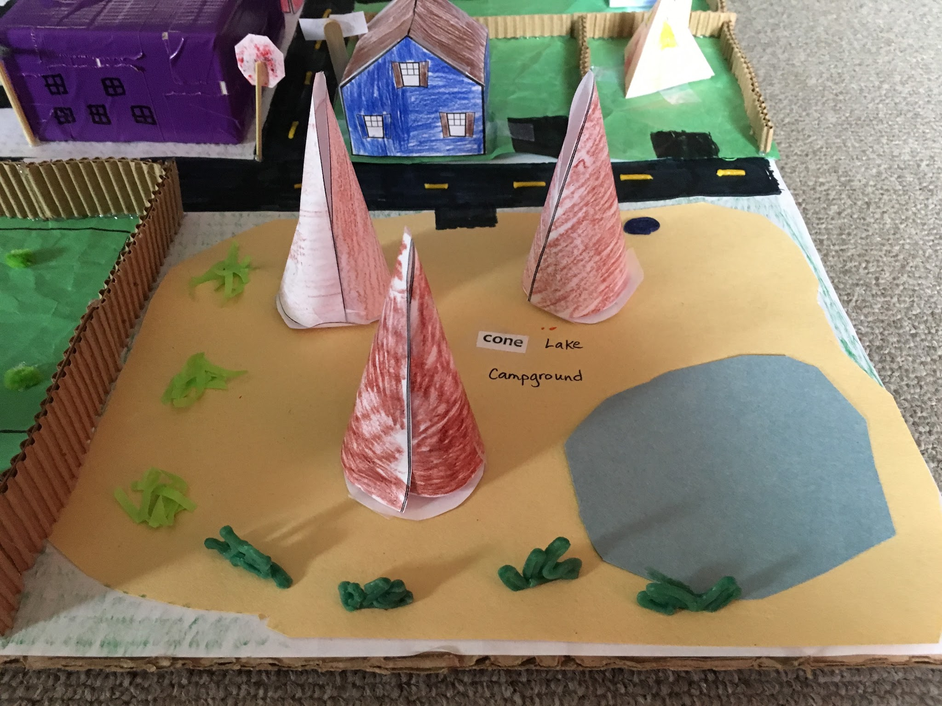
Cone lake is named after all the cone shaped tepees around it.

Slide 7
Question #1 How much did you know about the subject before we started?
Question #4 How do you feel about this piece of work? What parts of it do you particularly like? Dislike? Why? What did/do you enjoy about this piece or work?
Answer #1 I did not know much about geometry but, I did know a lot about shapes.
Answer #4 I feel proud of my work because I worked hard to make it. I feel that my work was well made.
Question #2 In what ways have you gotten better on his topic.
Answer #2 I have gotten better at geometry and have learned a lot of new things about the world of geometry
question#3 Did you meet your standards?
answer #3 I have met my standards and I have followed the rules.

