Slide 2
Requirements:
2 parallel roads
1 perpendicular road
1 intersecting road
8 3D buildings or structures
5 other things included
Town must be colorful
Town must be visually appealing
Town, roads and buildings have to have names the are related to geometry

Slide 3
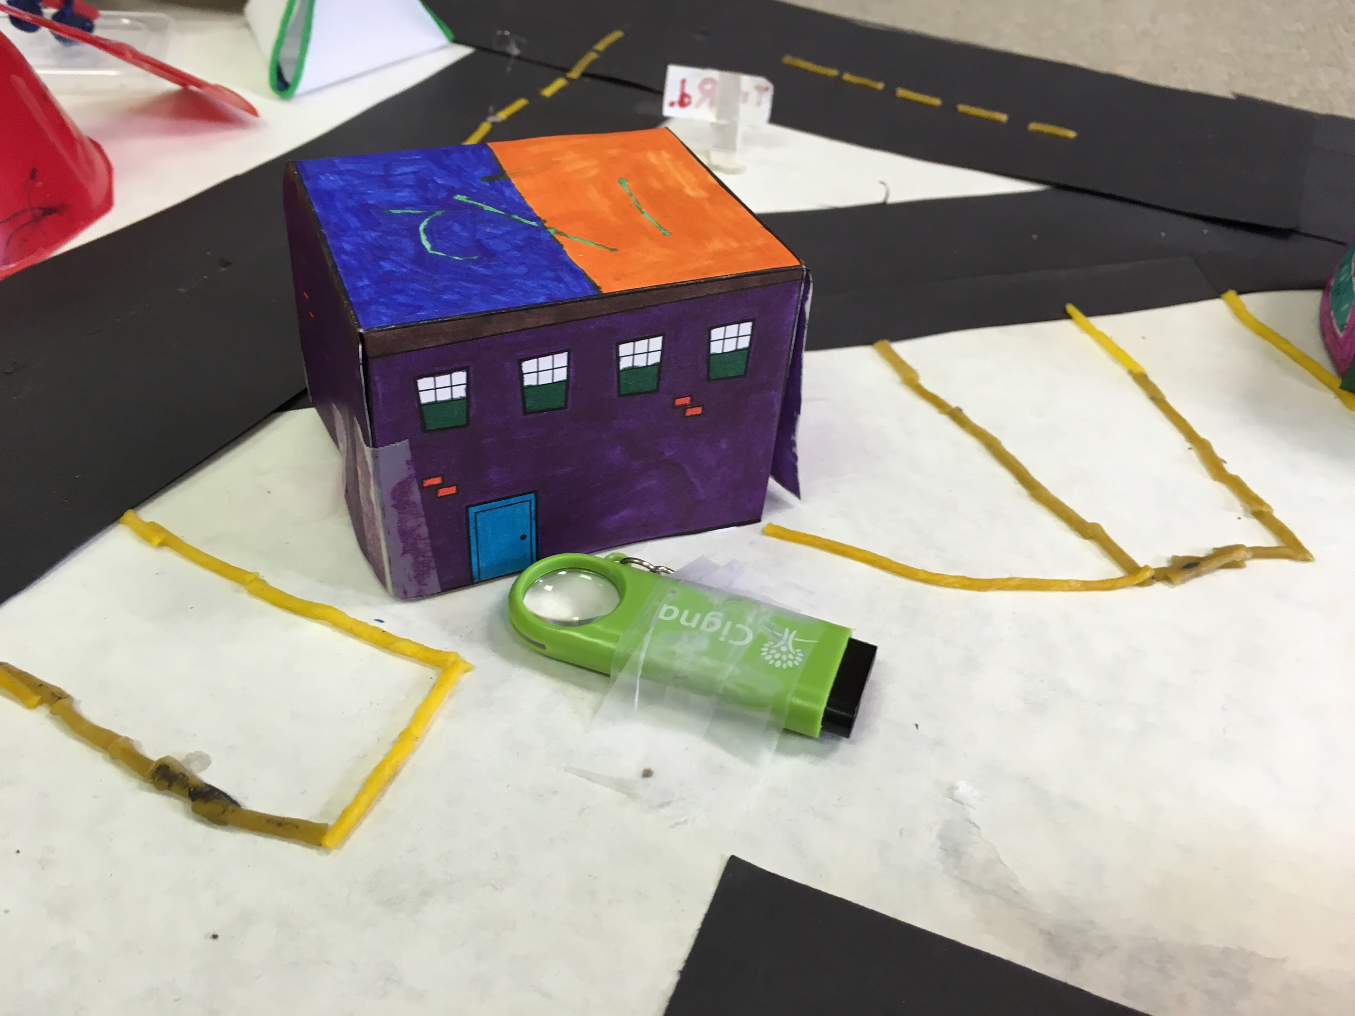
Cube
Name: Tri store

Slide 4
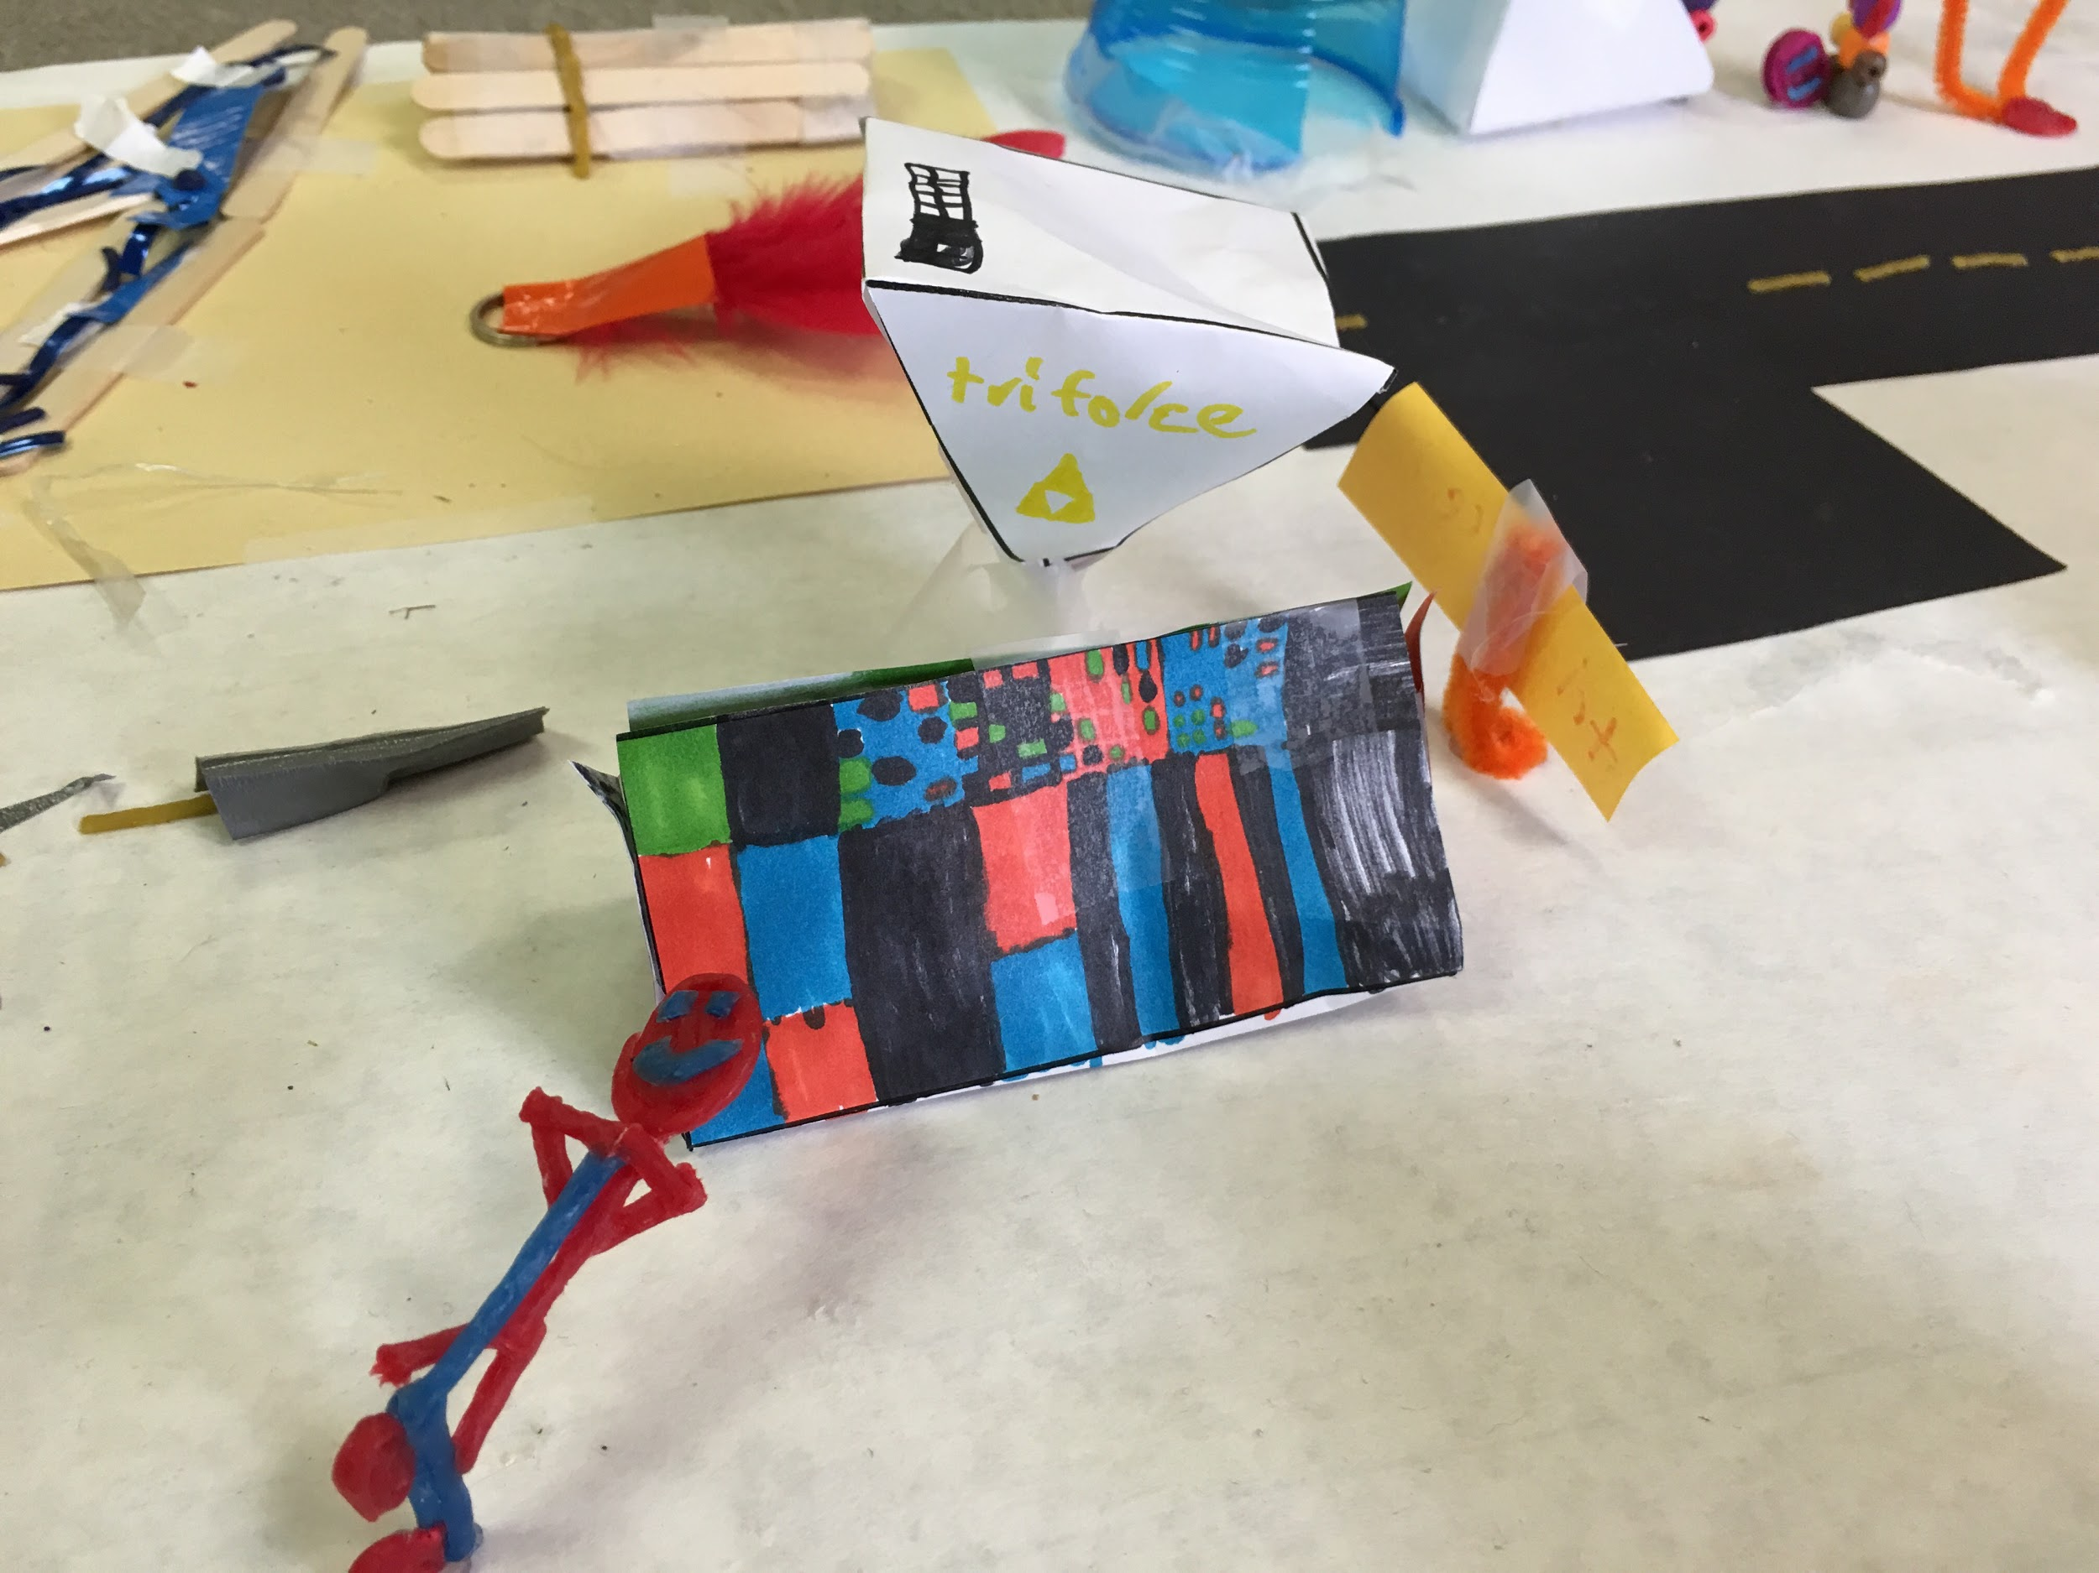
Triangular prism
Name: Tri Comics
Pyramid
Name: Triforce

Slide 5
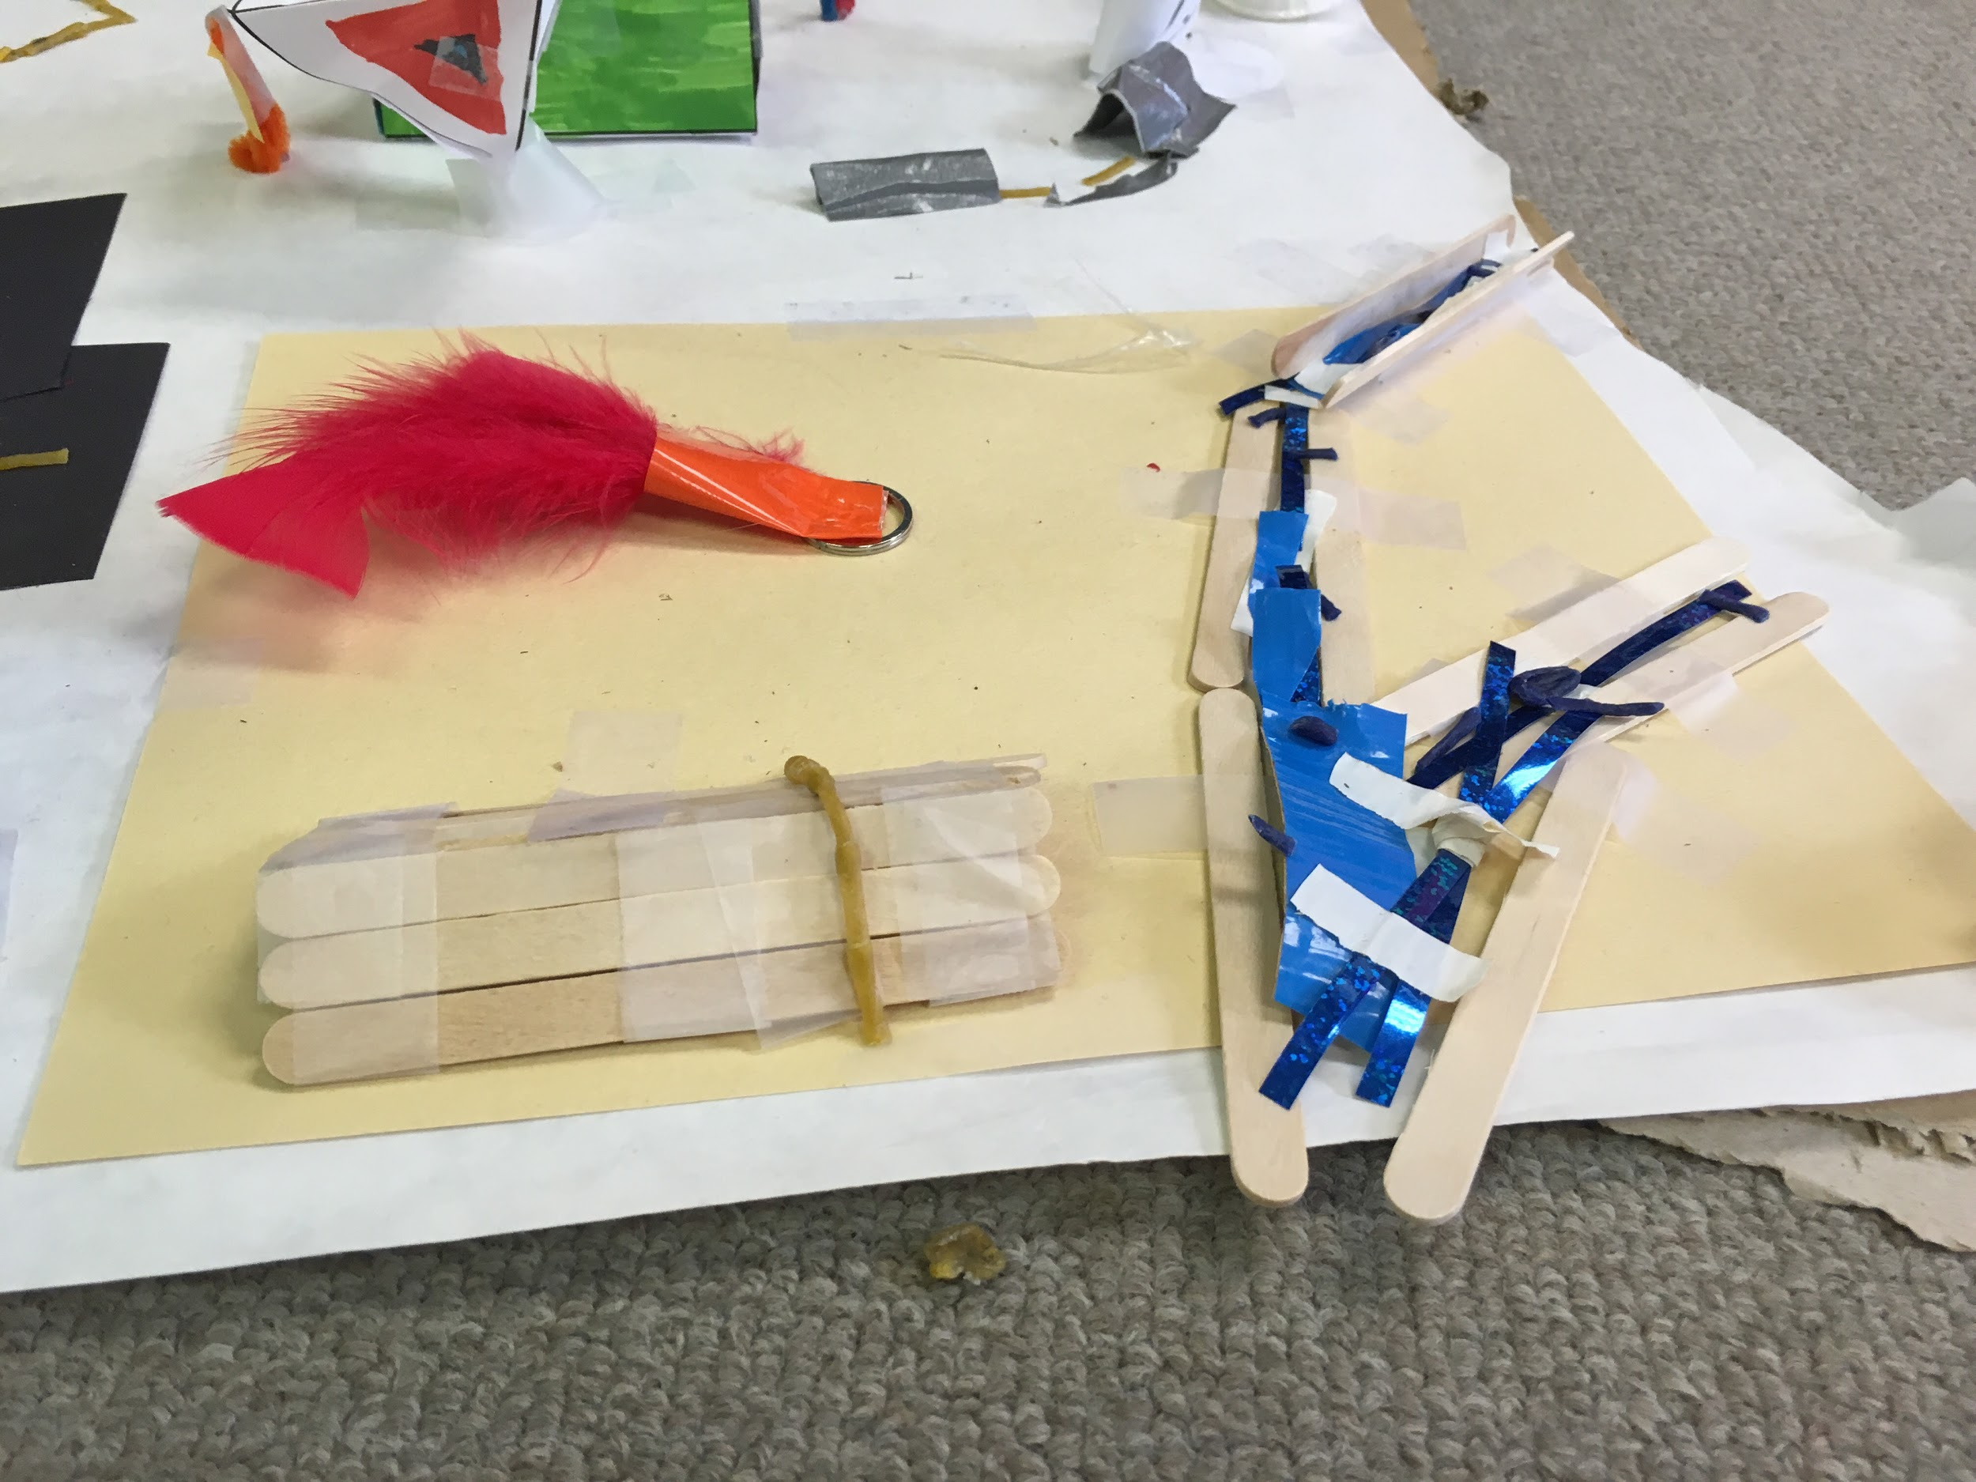
Triangular prism
Name: Hendeca campground

Slide 6
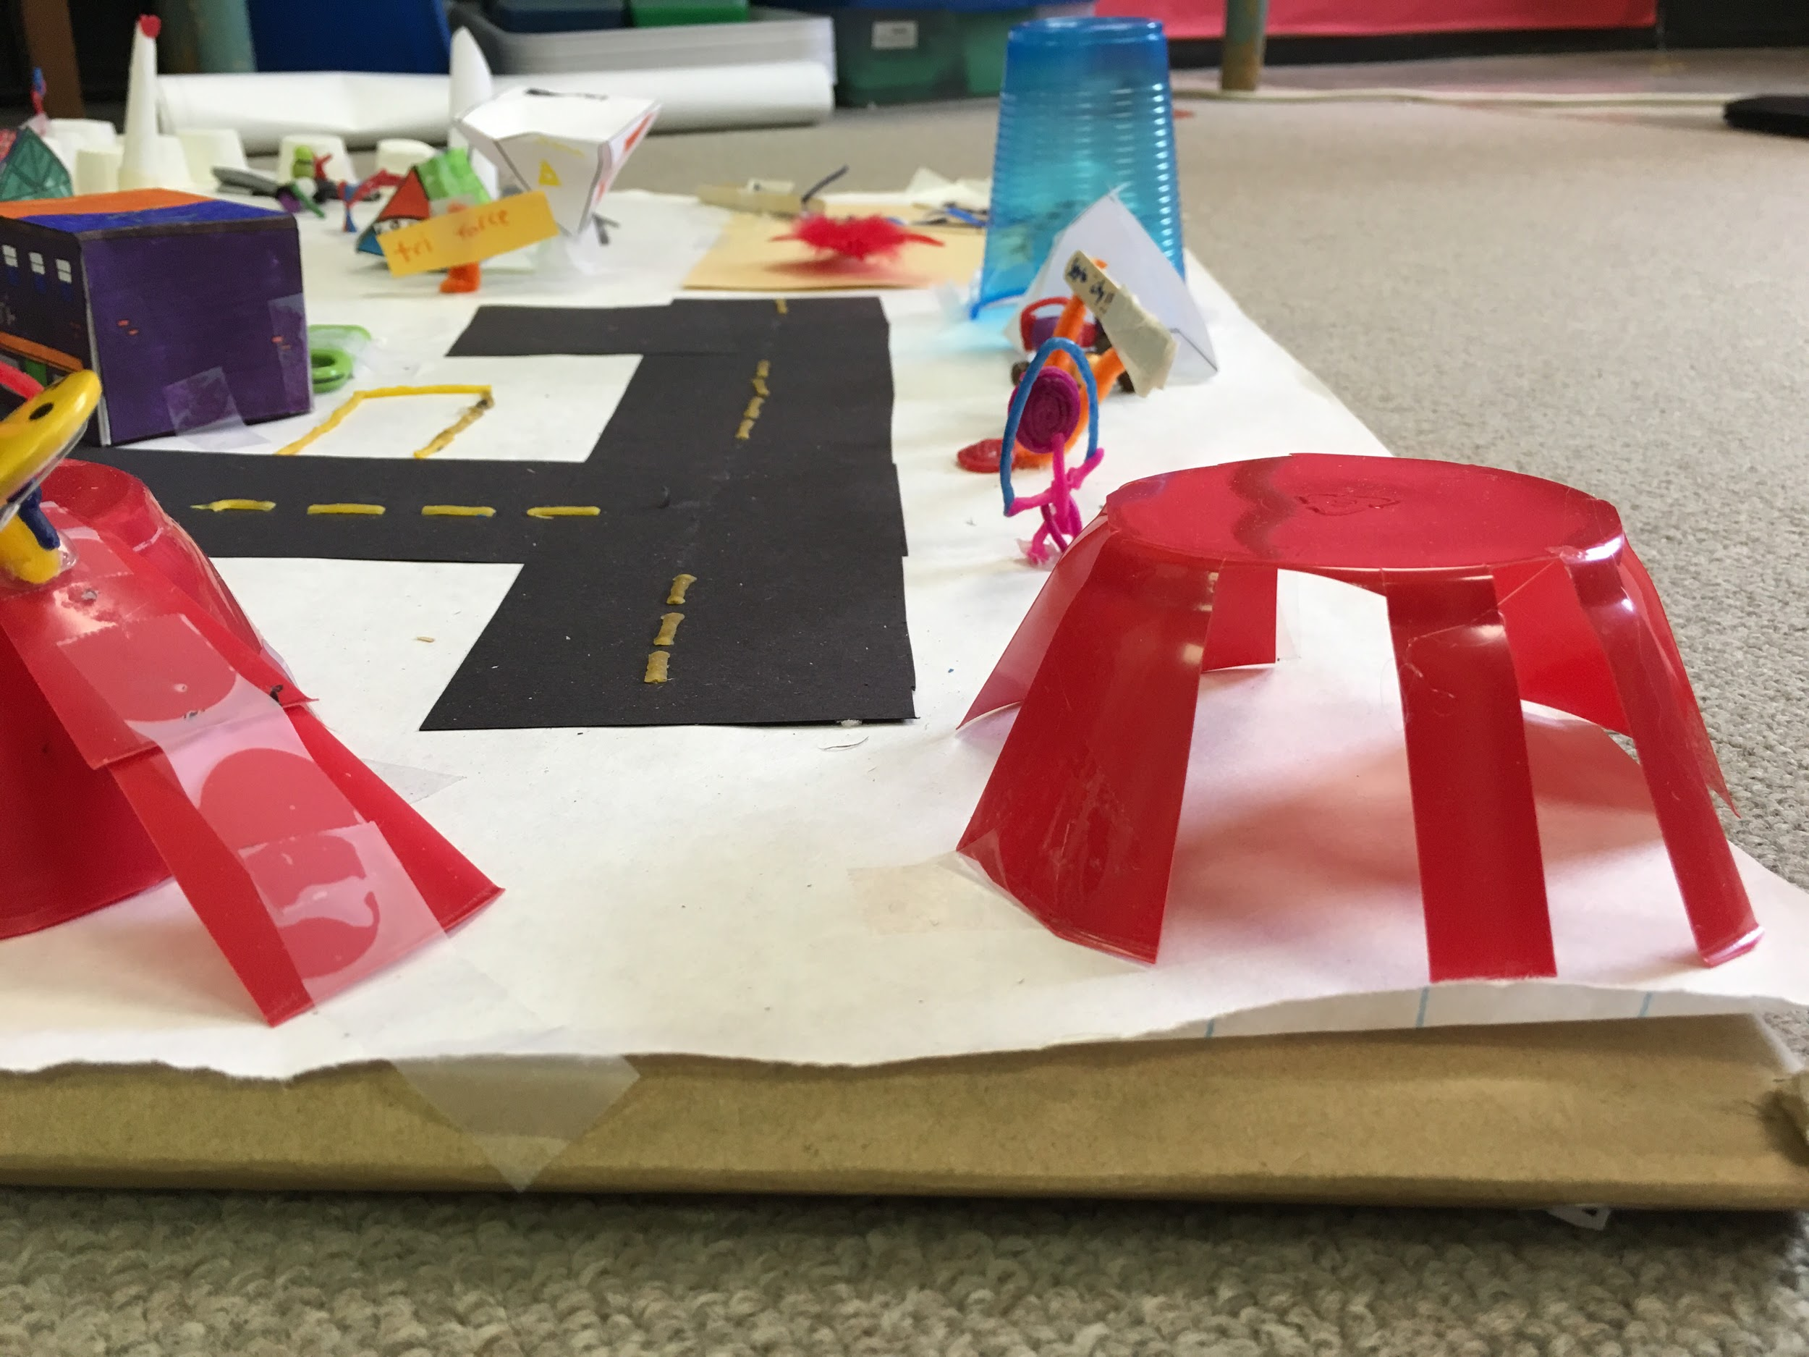
Hemisphere
Name: Reflex park

Slide 7
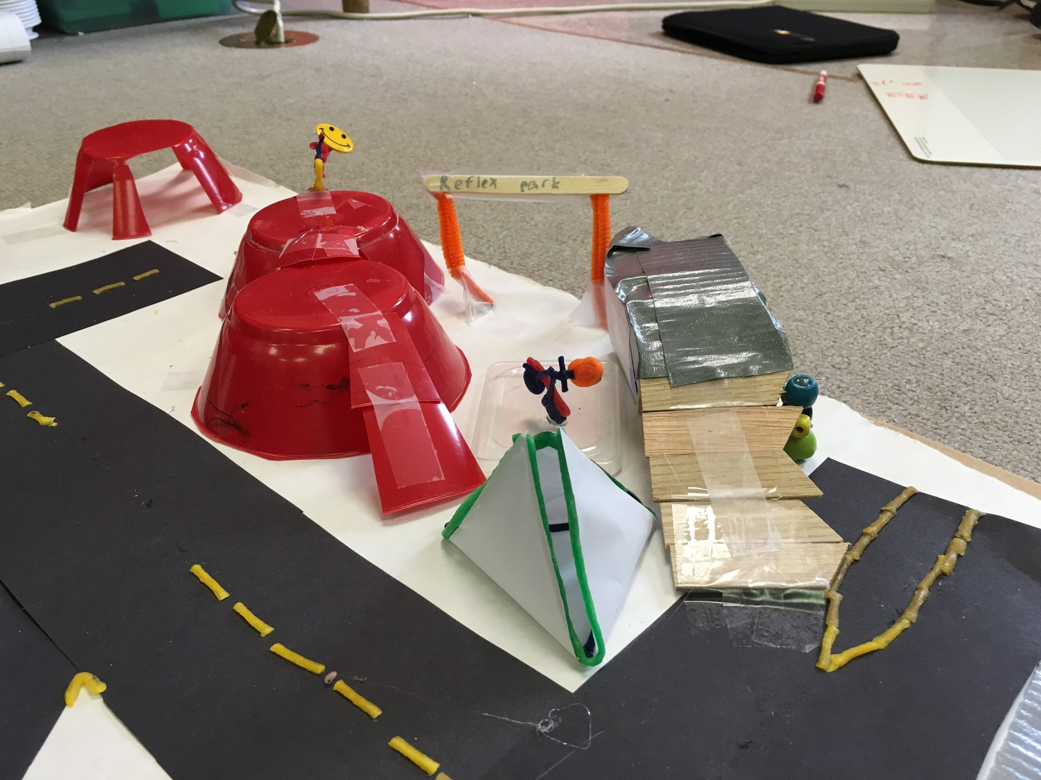
Name: dodeca bridge

Slide 8
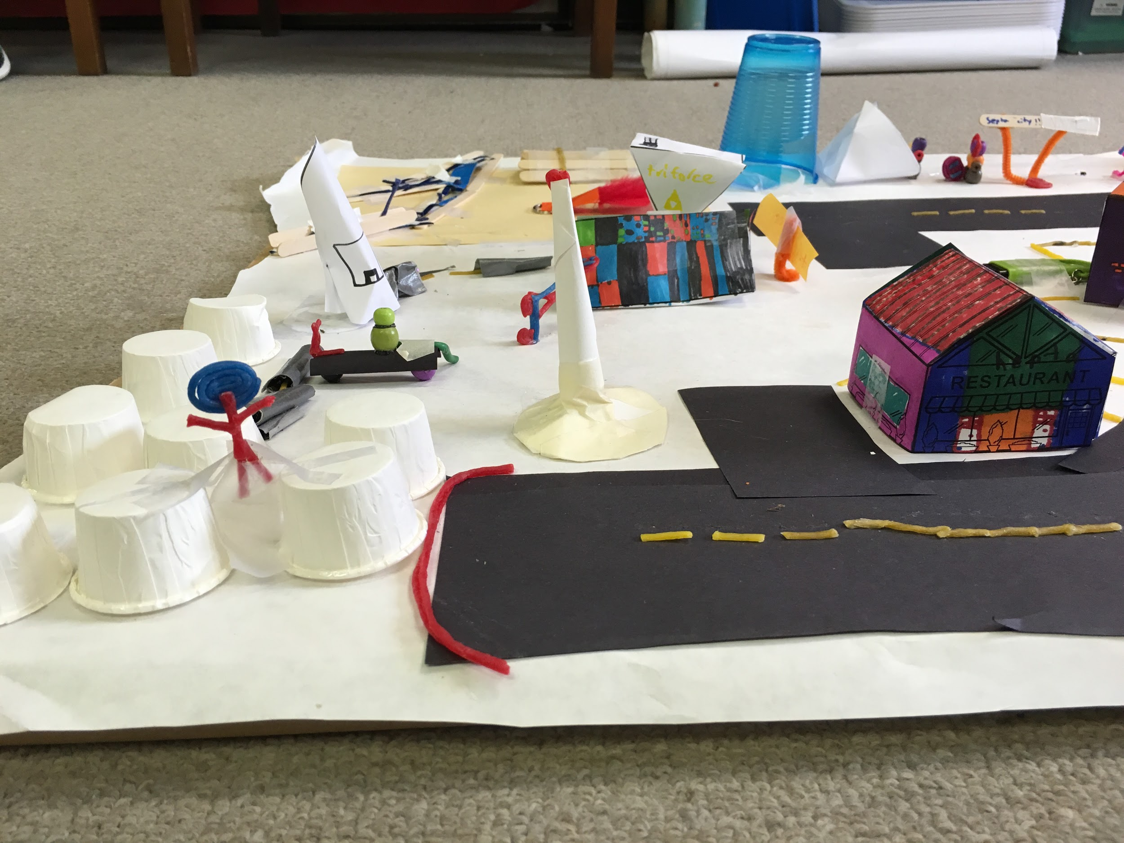
Pentagon
Name: Hepta restaurant

Slide 9
Reflection
Reporter: So Laker, Have you done a similar kind of work in the past (earlier in the year or in a previous grade; in school or out of school)?
Laker: I Have in school and out of school. My classes last Makerspace challenge was to make a game or model that includes fractions. At home I made attachments to a dragon I had from the last Makerspace challenge.
R: Does this work tell a story?
L: Really, no this project doesn't really have a story to it.
R: How do you feel about this piece of work? What parts of it do you particularly like?

Slide 10
L: I feel good about the project. I particularly like the guy with headphones and the Triforce company.
R: If someone else were looking at the piece, what might they learn about who you are?
L: ummm, that I use a lot of tape and hot glue.
R: In what ways did it not meet those standards?
L: Well I have all the requirements.
R: What's one goal you would like to set for yourself for next time?
L: To use less tape and not to burn myself with hot glue.
R: What would you like to spend more time on in school?
L: Probably, all the makerspace challenges.

