Slide 1
Geocity Documentation
&
Self-Reflection
By Brendon

Slide 2
Developer,s Brendon and Kaydence
Key
Requirements
2 Parallel roads/line
1 Perpendicular road/line
1 Intersecting road/line
8 3-D shaped buildings
5 other things included
Town must be colorful -Visually appealing
Town must be named Geometry theme name.
=Yes
= No
= A little

Slide 3
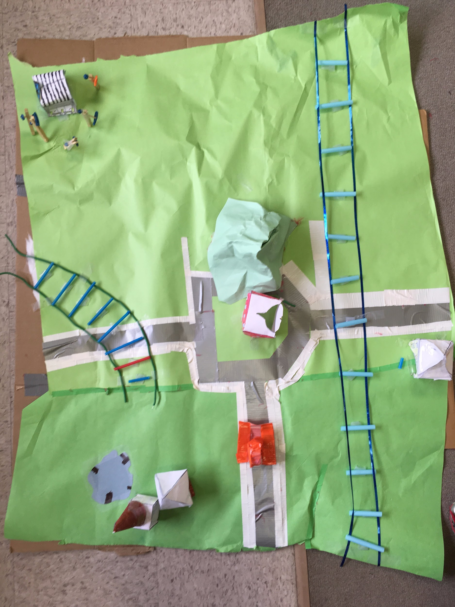
Intersecting is two line segments that cross each other.
5
5 other things
Parallel sidewalks
Intersecting road
Parallel is two line segments that are side by side but never touch.
Perpendicular
Roads
Perpendicular is two line segments that form a 90º angle and they do not have to touch.

Slide 4
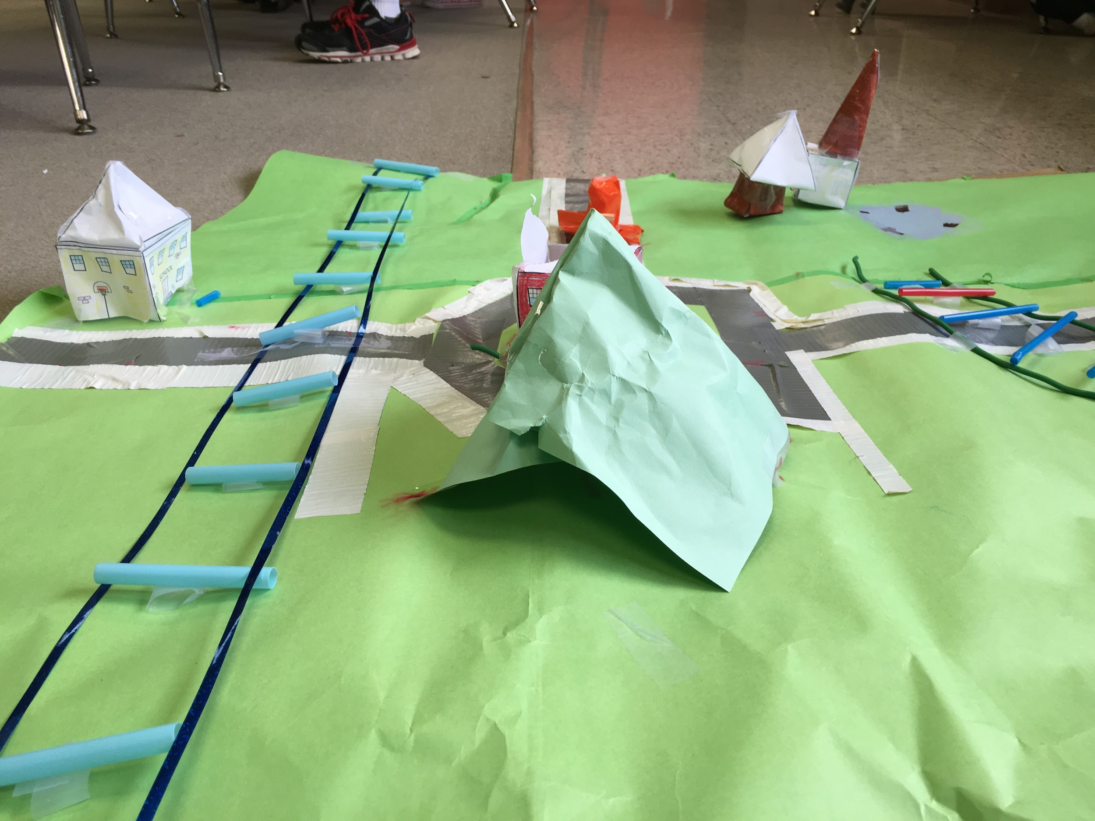
Big green cone

Slide 5
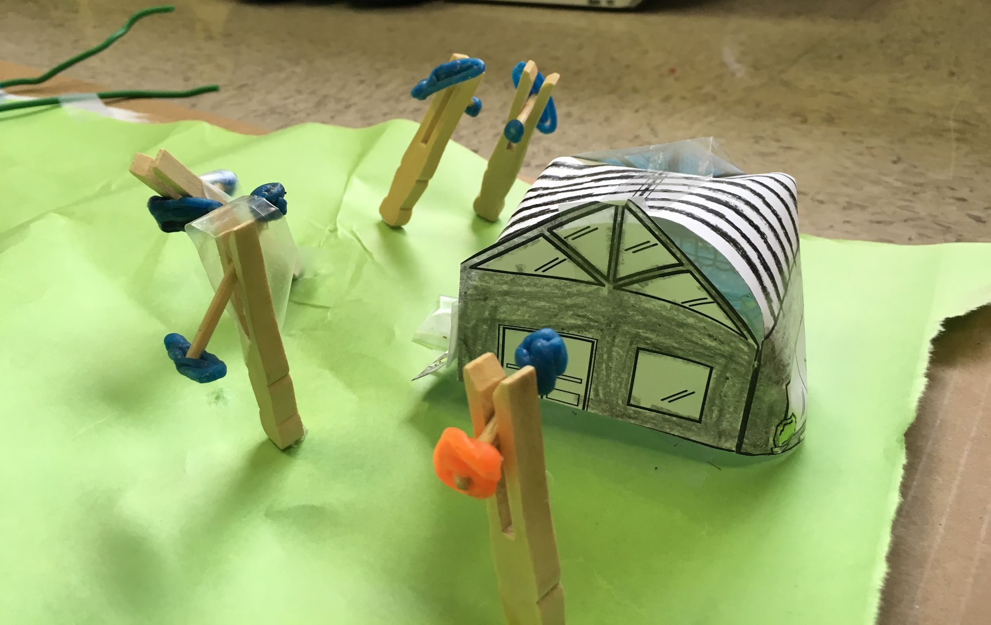
A rectangular prism with a triangular prism
Turbines

Slide 6
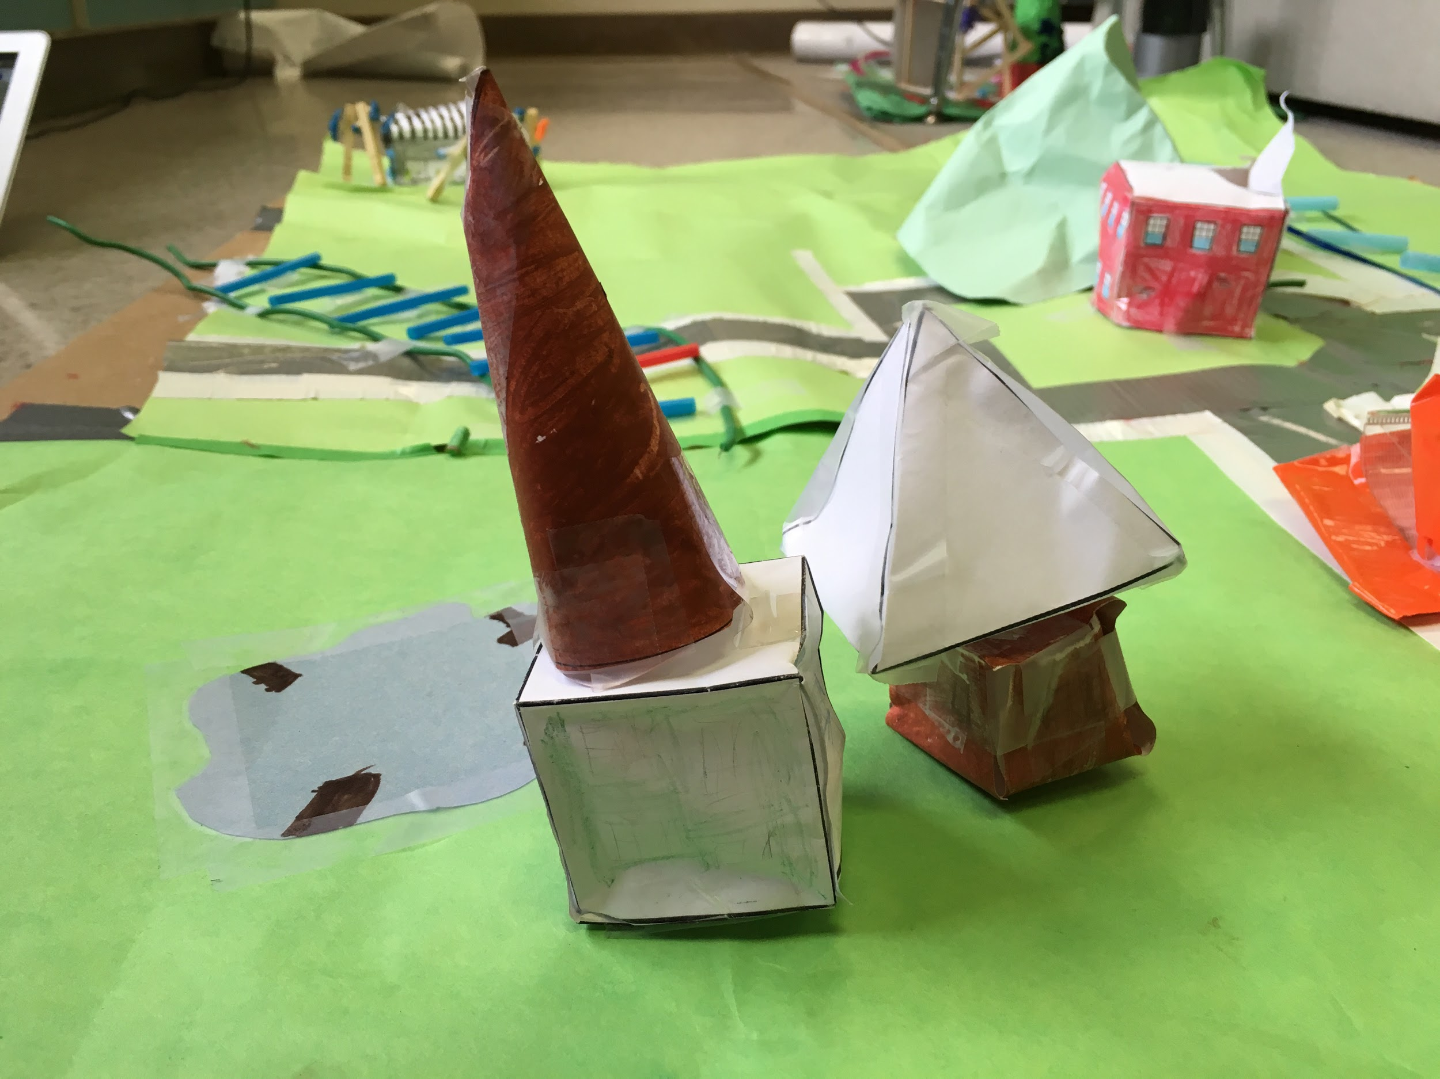
Cone family
A cube With a cone for the roof
Quad family
A cube that has a pyramid

Slide 7
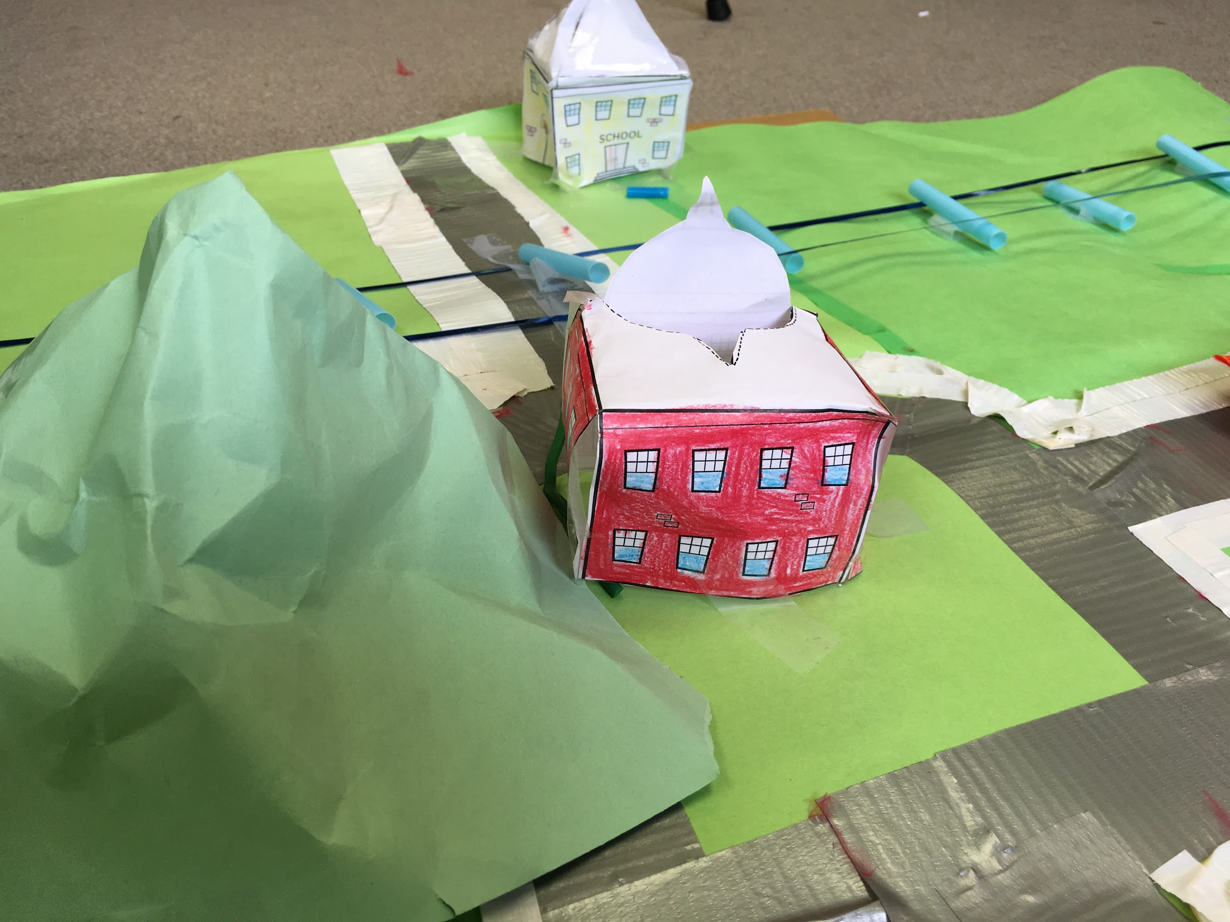
A Rectangular prism and a pyramid
A Rectangular prism

Slide 8
Map of Geoparadise
Penta Power plant
Tetra Mall
Twin edge elementery
Tri Parks

Slide 9
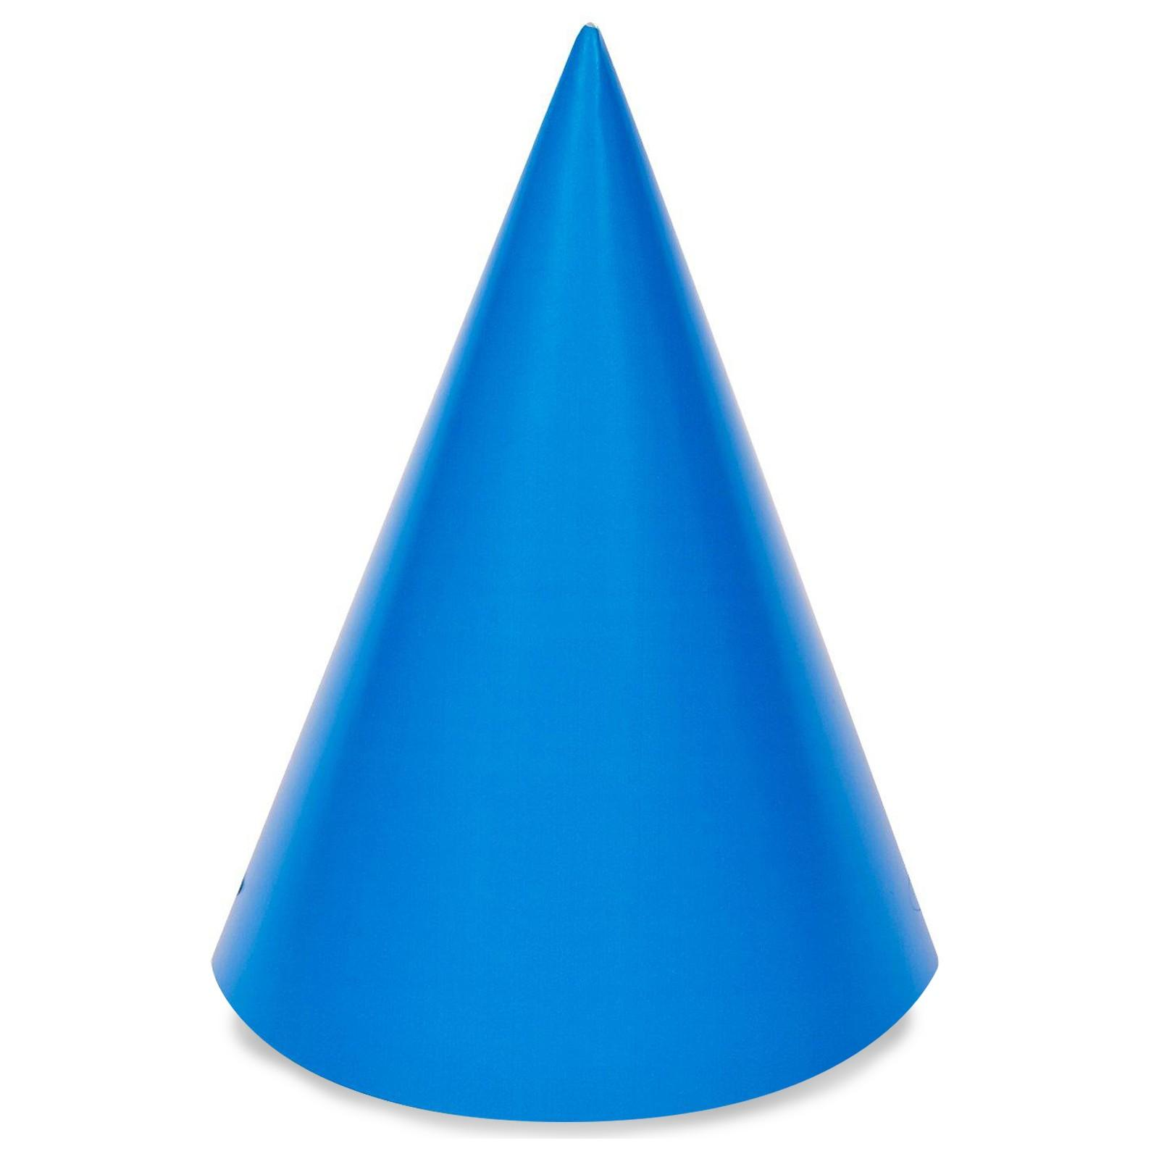
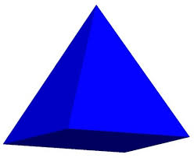
Shapes I used in my town
Cone
Cube
pyramid

Slide 10
Backward-Looking
In what ways do you think you need to improve?
I think next time I should improve on the buildings and roads. I think I should add more roads and buildings.
What resources did you use while working on this piece? Which ones were especially helpful? Which ones would you use again? I worked with cubes, pyramids and cones. I don’t think any of the shapes were super good. I think that they were a little good. Next time, I will use the same shapes.

Slide 11
Inward-Looking
What were your standards for this piece of work?
The standards in this project were 2 parallel roads,1 perpendicular road,1 intersecting road,8 3-D shape buildings and 5 other things.
Did you meet your standards?
I did not meet my standards because we were a little distracted.

Slide 12
Outward-Looking
In what ways was your work or process similar?
It was similar to our fraction bulid because we had to make some things to make them.
What grade would you give it? Why?
I would give my project a B because I finished most of the requirements.

Slide 13
Forward-Looking
What's the one thing that you have seen in your classmates' work or process that you would like to try in your next piece?
Next time, I think that I would put a tower or a skate park or maybe a ice cream shop. Next time I think I should do all the requirements.
What things you might want more help with?
Next time, I would like more help on the planning so I would do more or less buildings.

