Slide 2
Requirements
2 parallel roads
1 perpendicular road
1 intersecting road
8 3D shaped buildings/structures
5 other things included
Town must be visually appealing- colorful
Town, buildings, and roads must be named

Slide 3
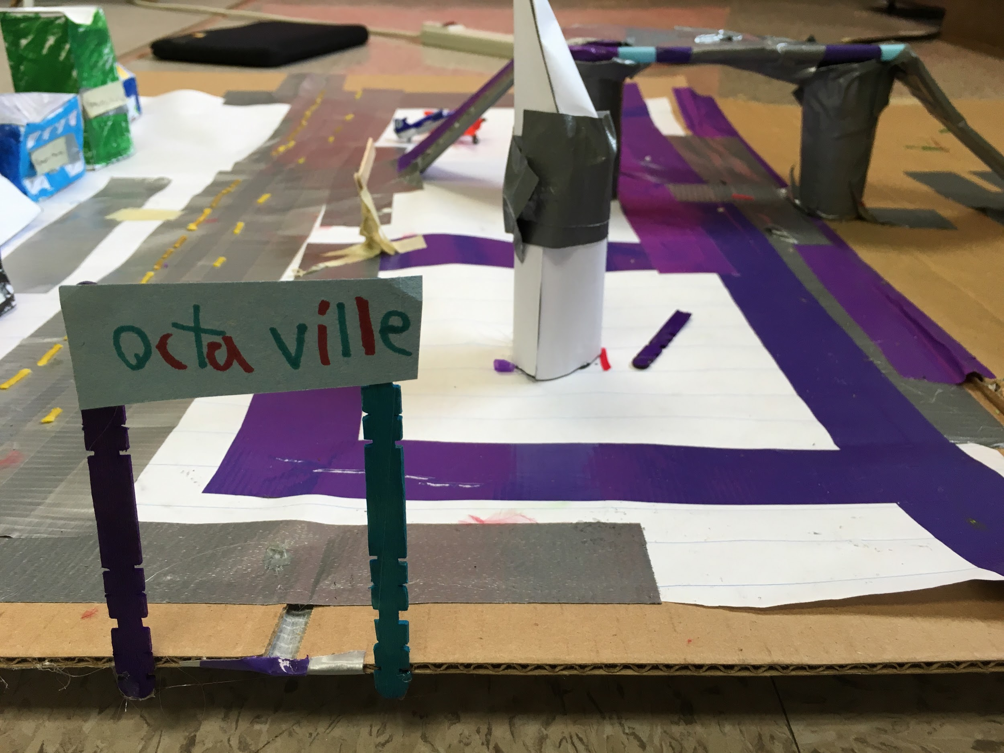

Slide 4
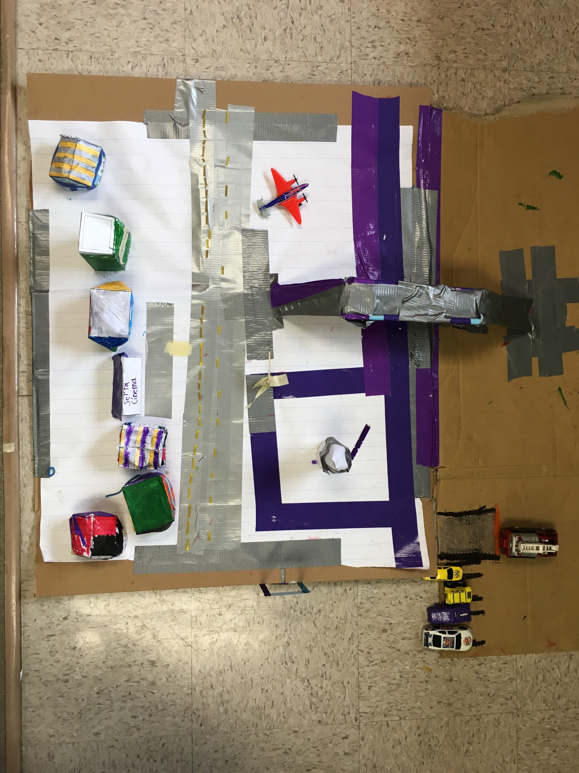
Pentapassway
Pentaport
Parallel road
Perpendicular Road
Parallel road
Angle Ave

Slide 5
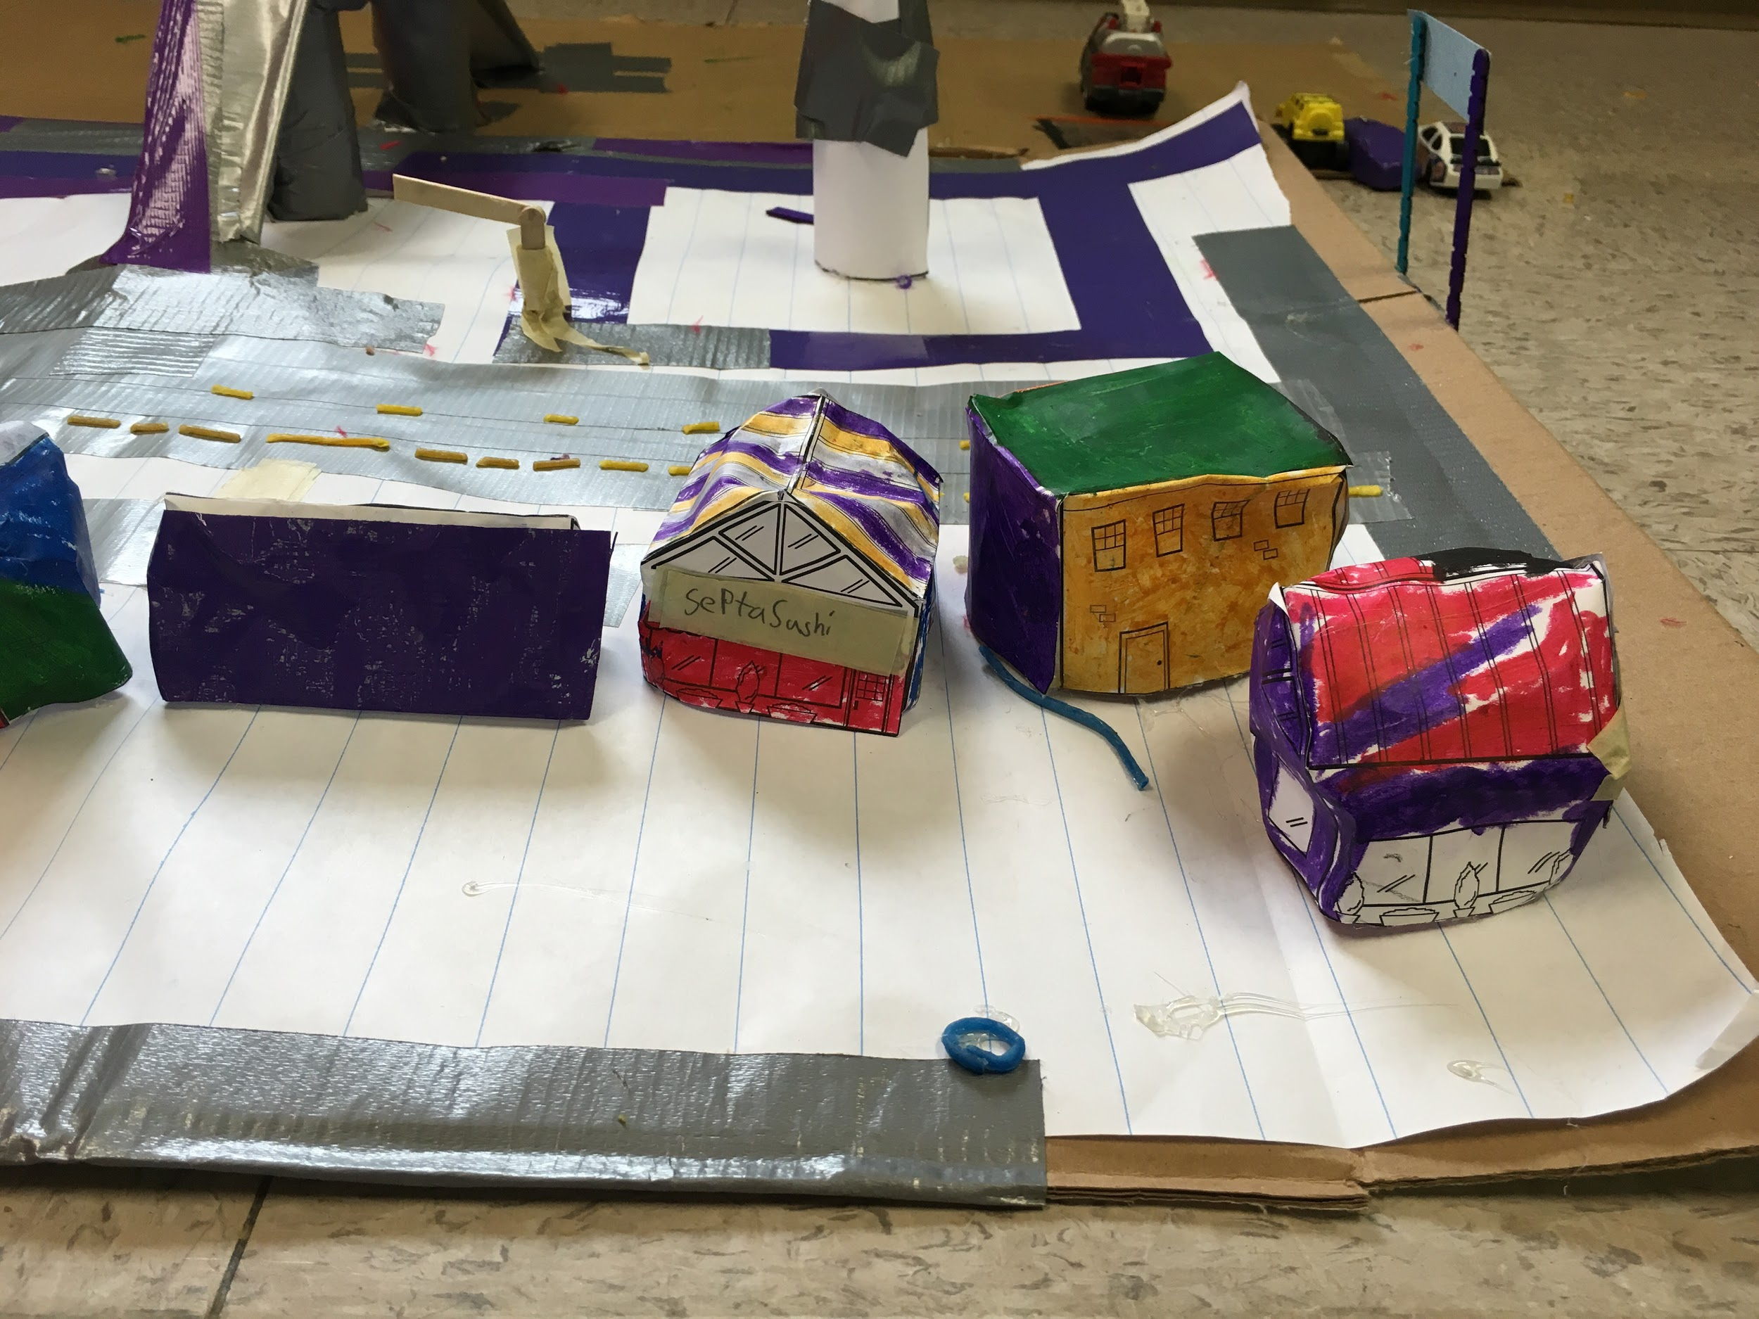
Triget
Septa Cinema
Septa Sushi
Tetra Hut Pizzas

Slide 6
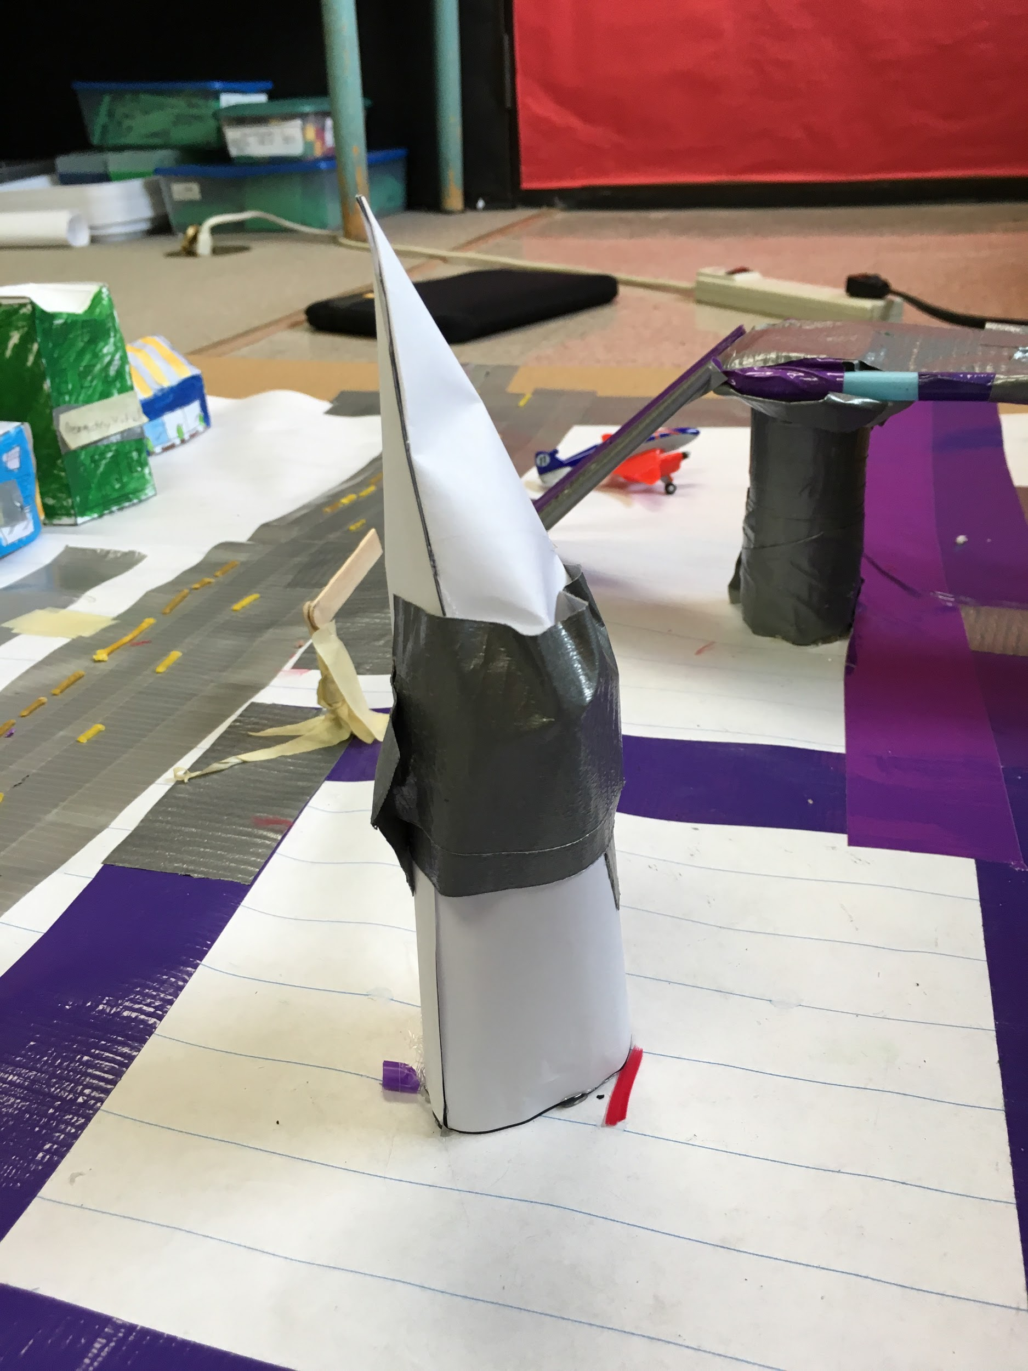
Tetra Tower

Slide 7
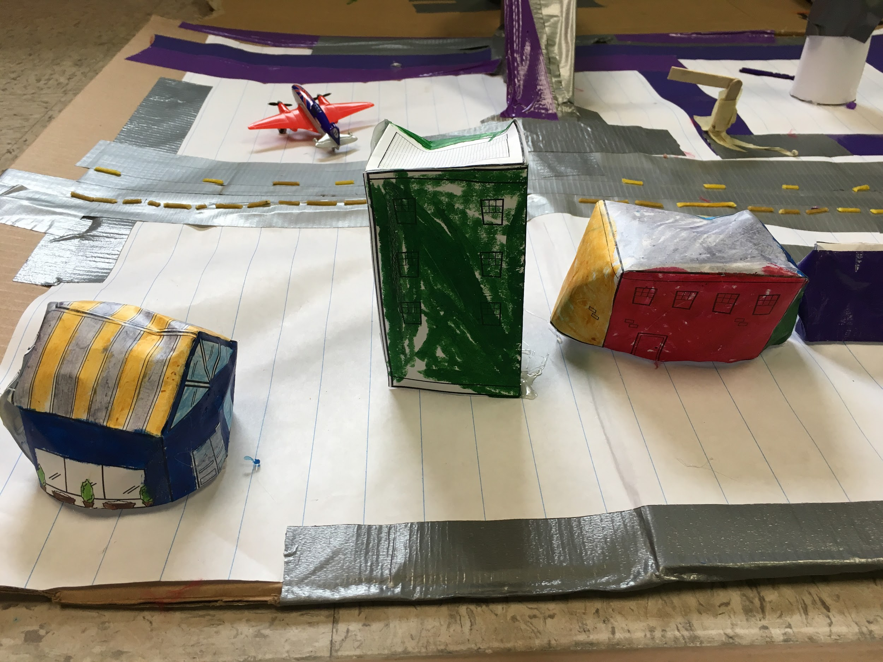
Geometry Hotel
Quad Mart
Pentaway Sandwiches

Slide 8
Self Reflection
Backward Looking
(In what ways do you think you need to improve?) I think I would have improved by adding an Intersecting road. (How much did you know about the subject before we started?) I knew a little bit about this because I did another makerspace challenge before this one.
Inward Looking
(What did/do you find frustrating about it?) I found it a little frustrating because we needed more time and if we had more time we would’ve finished all of the requirements. (Have you changed any ideas you used to have on this subject?) I changed my idea instead of a train track I made a bridge.
Outward Looking
Forward Looking
(What grade would you give it? Why?) I would give it a 3 because there was a thing I didn’t do. (What one thing do you particularly want people to notice when they look at your work?) I want to let them know on how hard I made that bridge.
(What would you change if you had a chance to do this piece over again?) I would add an intersecting road because I forgot to add an intersecting road. (What work would you show to help people understand those things?) I would label more detail on the things I do.

Slide 9
Credits
Green Check
X Check
Title Font

