Slide 1
Geocity Self Reflection
By Elias John Caniglia

Slide 2
Requirements
2 parallel roads
1 perpendicular road
1 intersecting road
8 3-D shaped buildings/structures
5 other things included
Town must be visually appealing
Town must be named

Slide 3
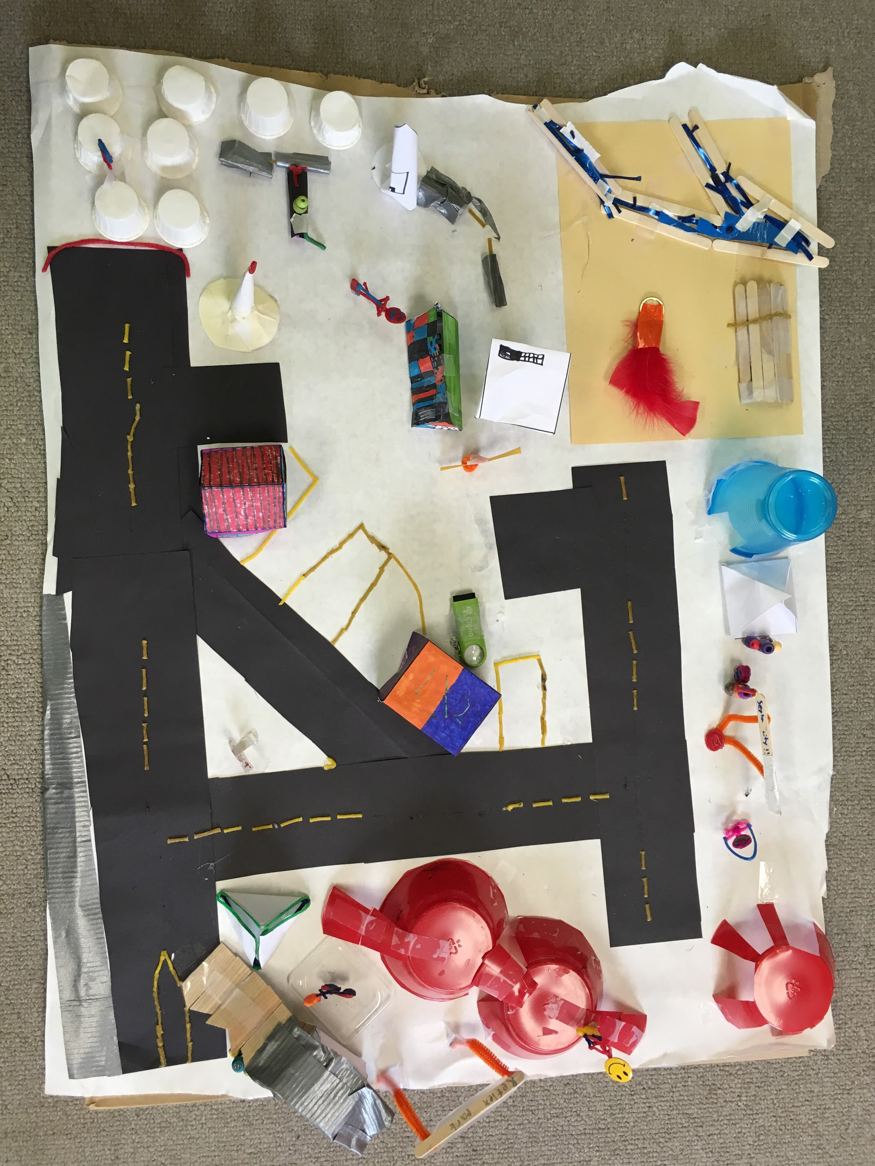
Parallel
roads
Tri-roads
Perpendicular road
Intersecting roads
Septa park

Slide 4
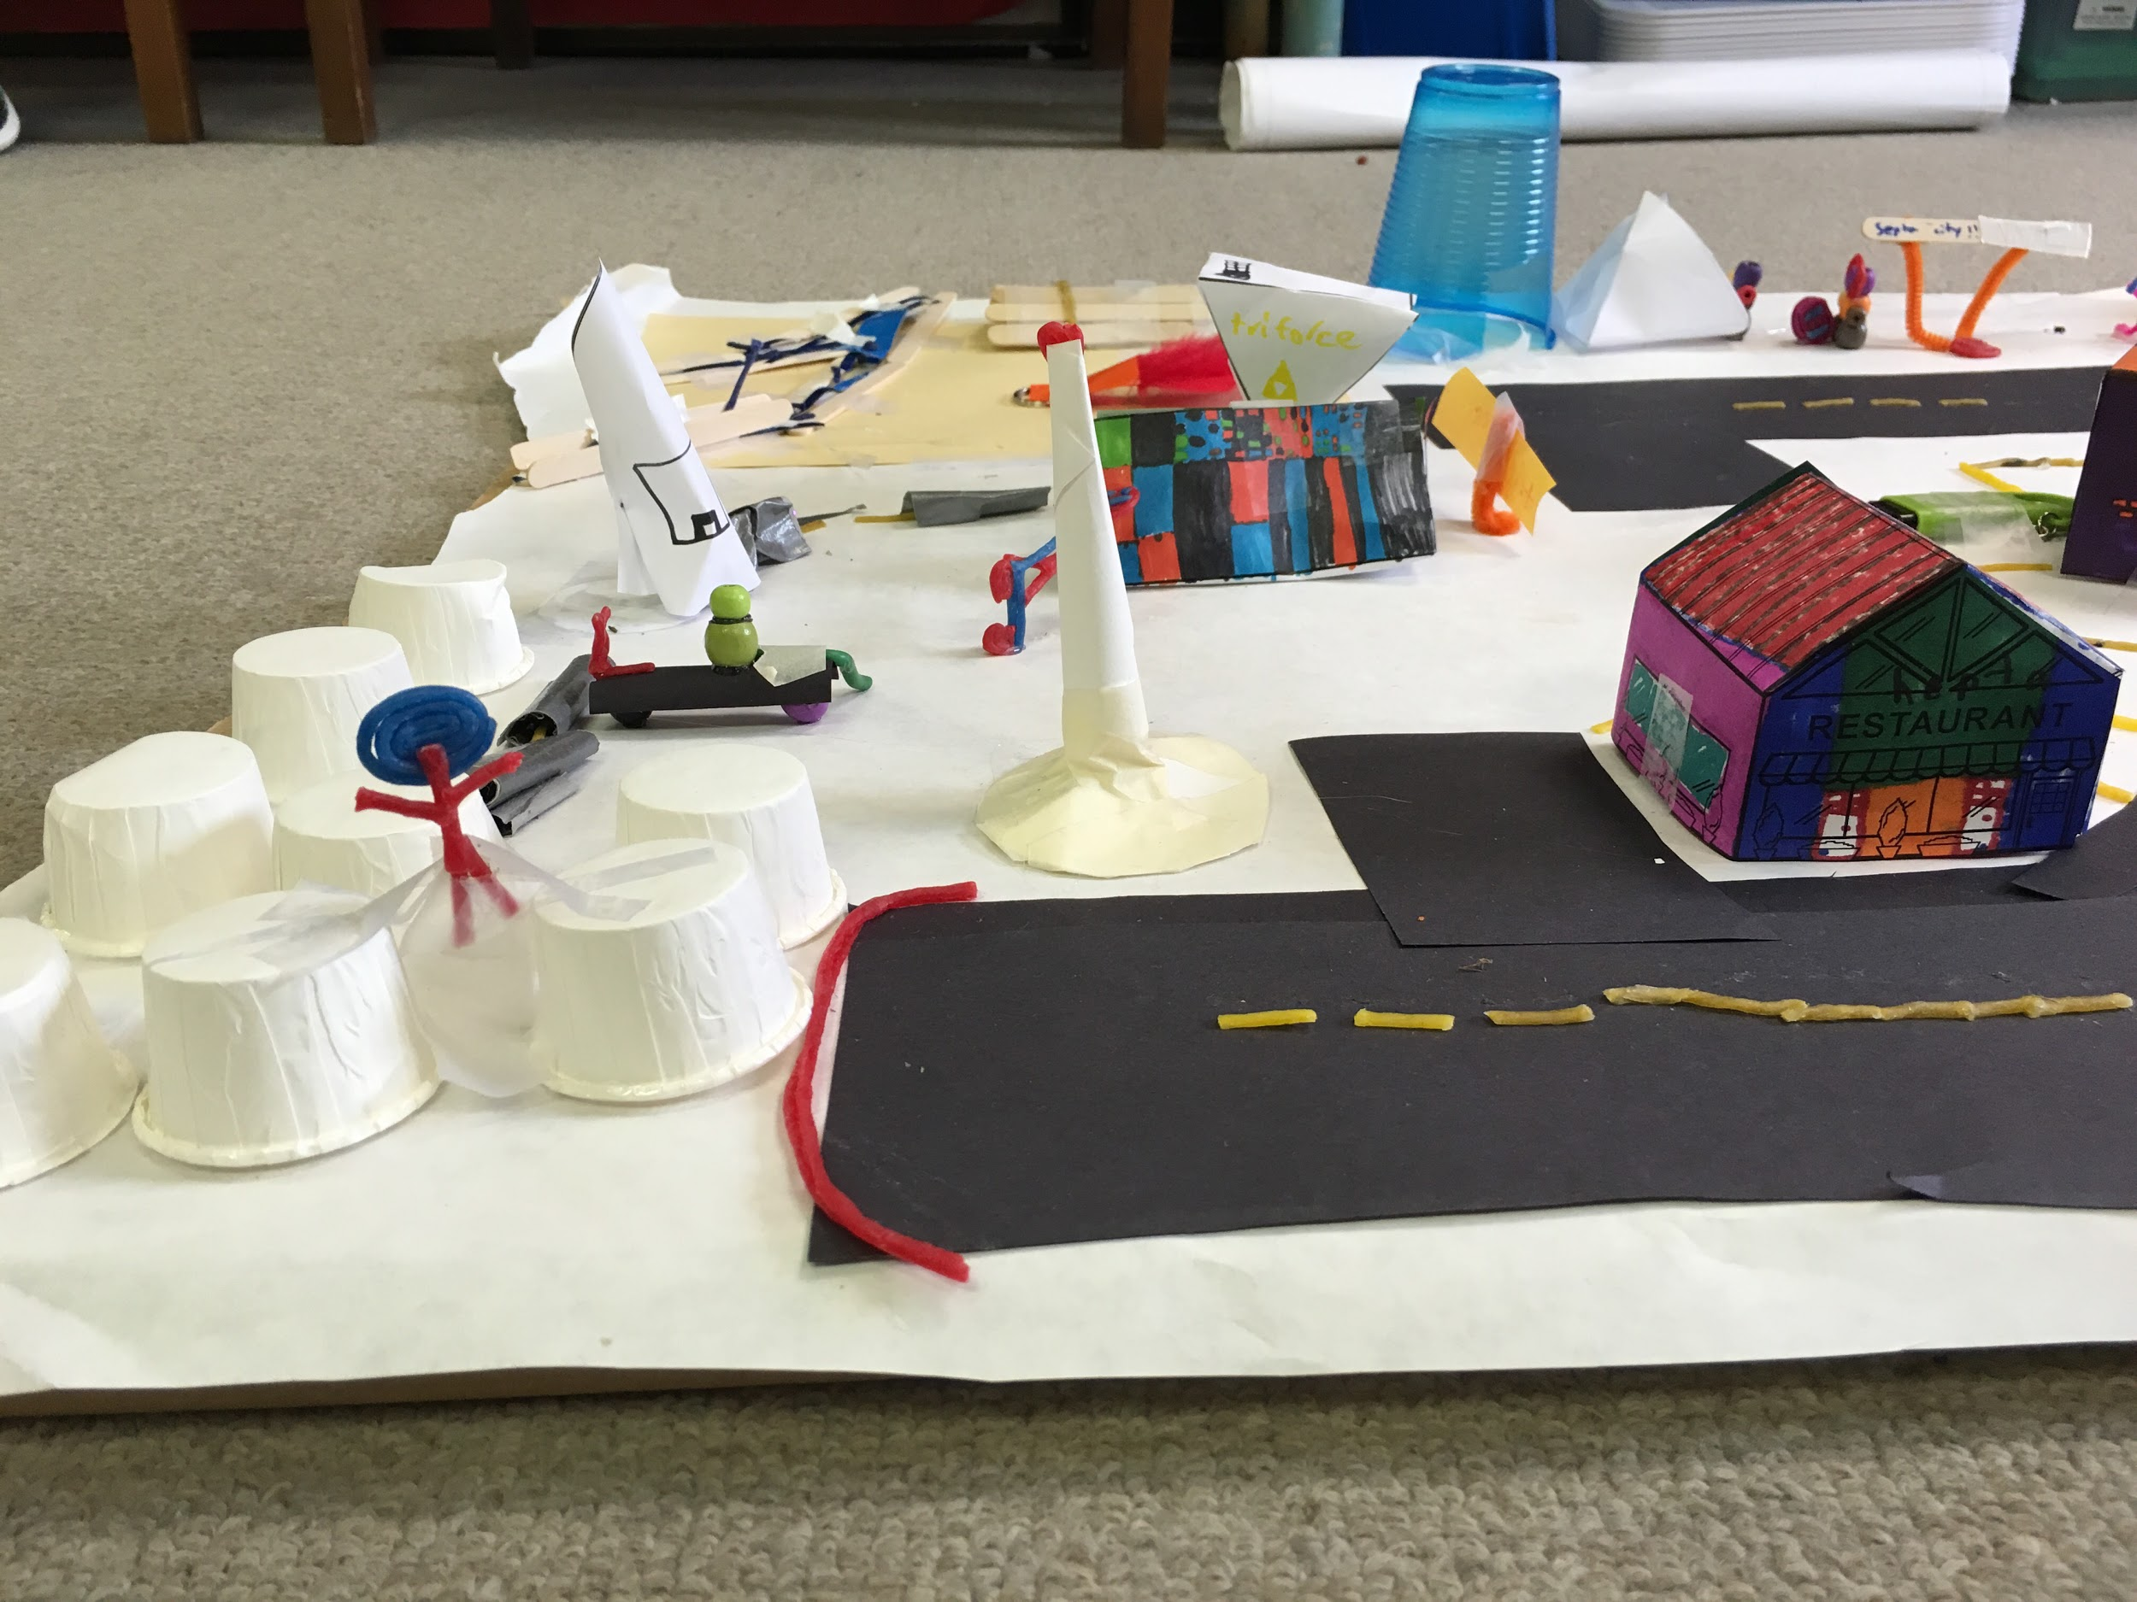
Parking garage (cylinder)
Parkour guy
cylinders
Buildings
Rectangular prism with a triangular prism on top
pyramid
Cell tower
Hepta restaurant
Triangular prism

Slide 5
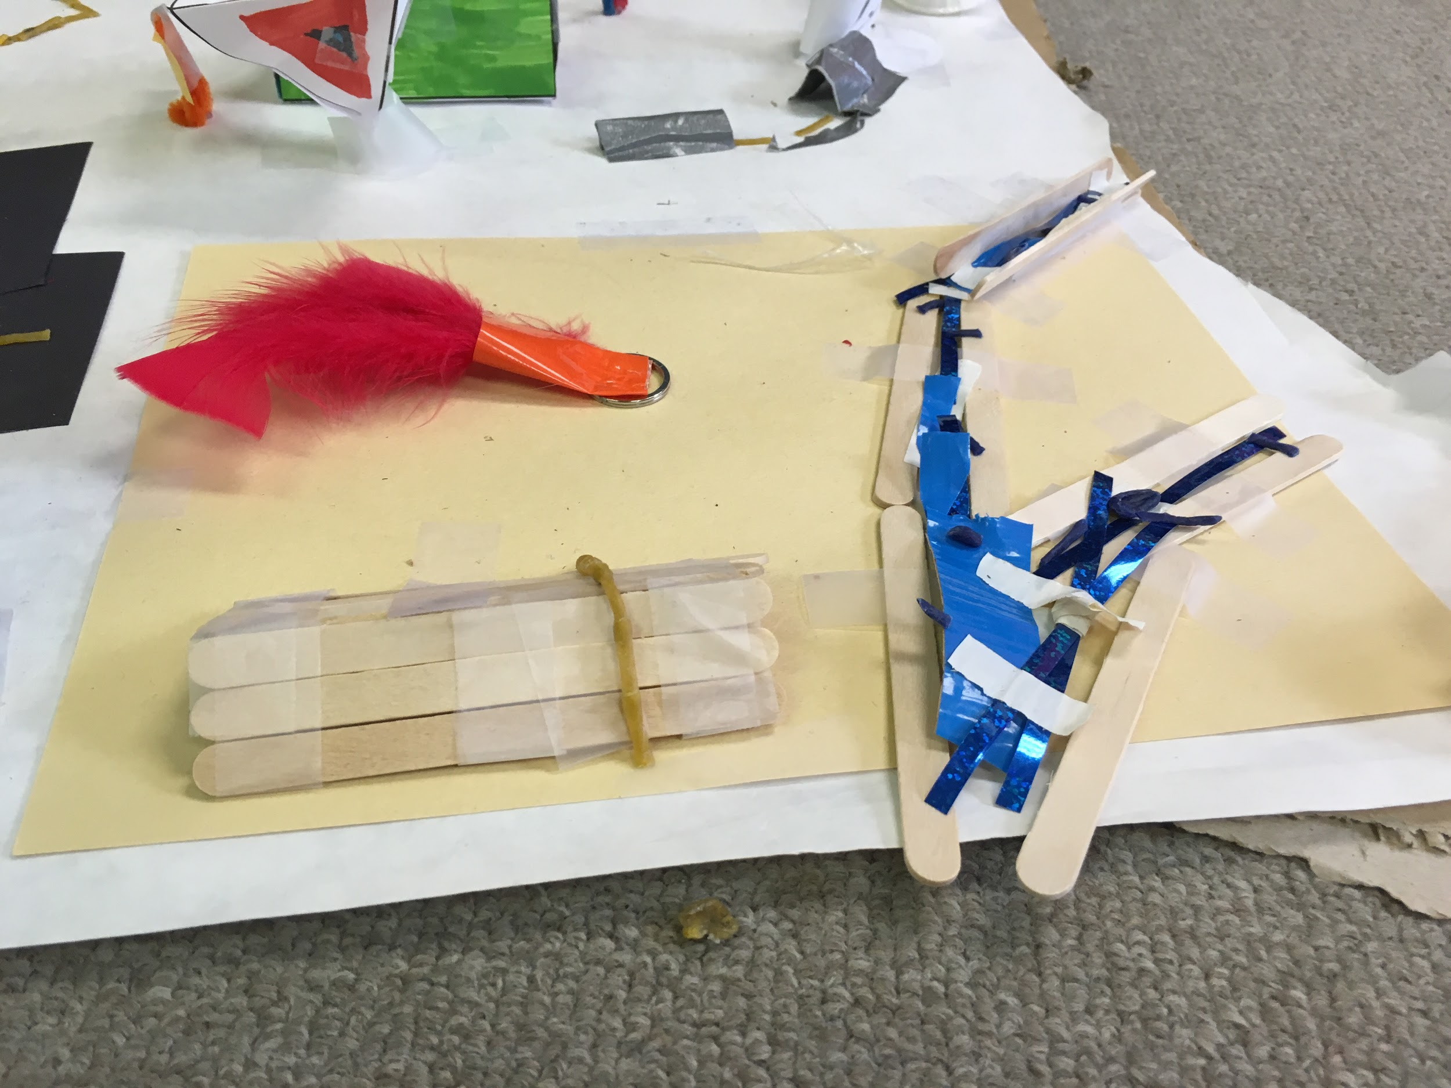
Hendeca campground
bonfire
Triangular prism (tent)

Slide 6
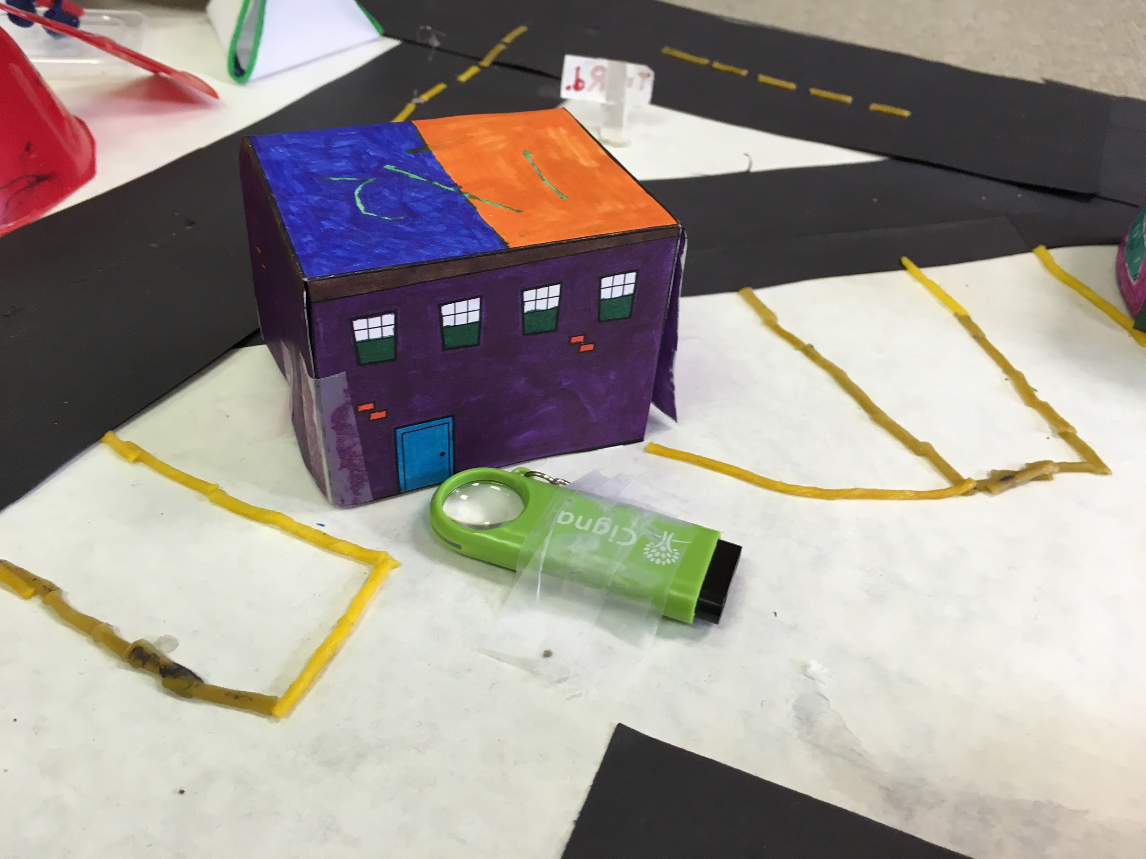
Tri-store (cube)

Slide 7
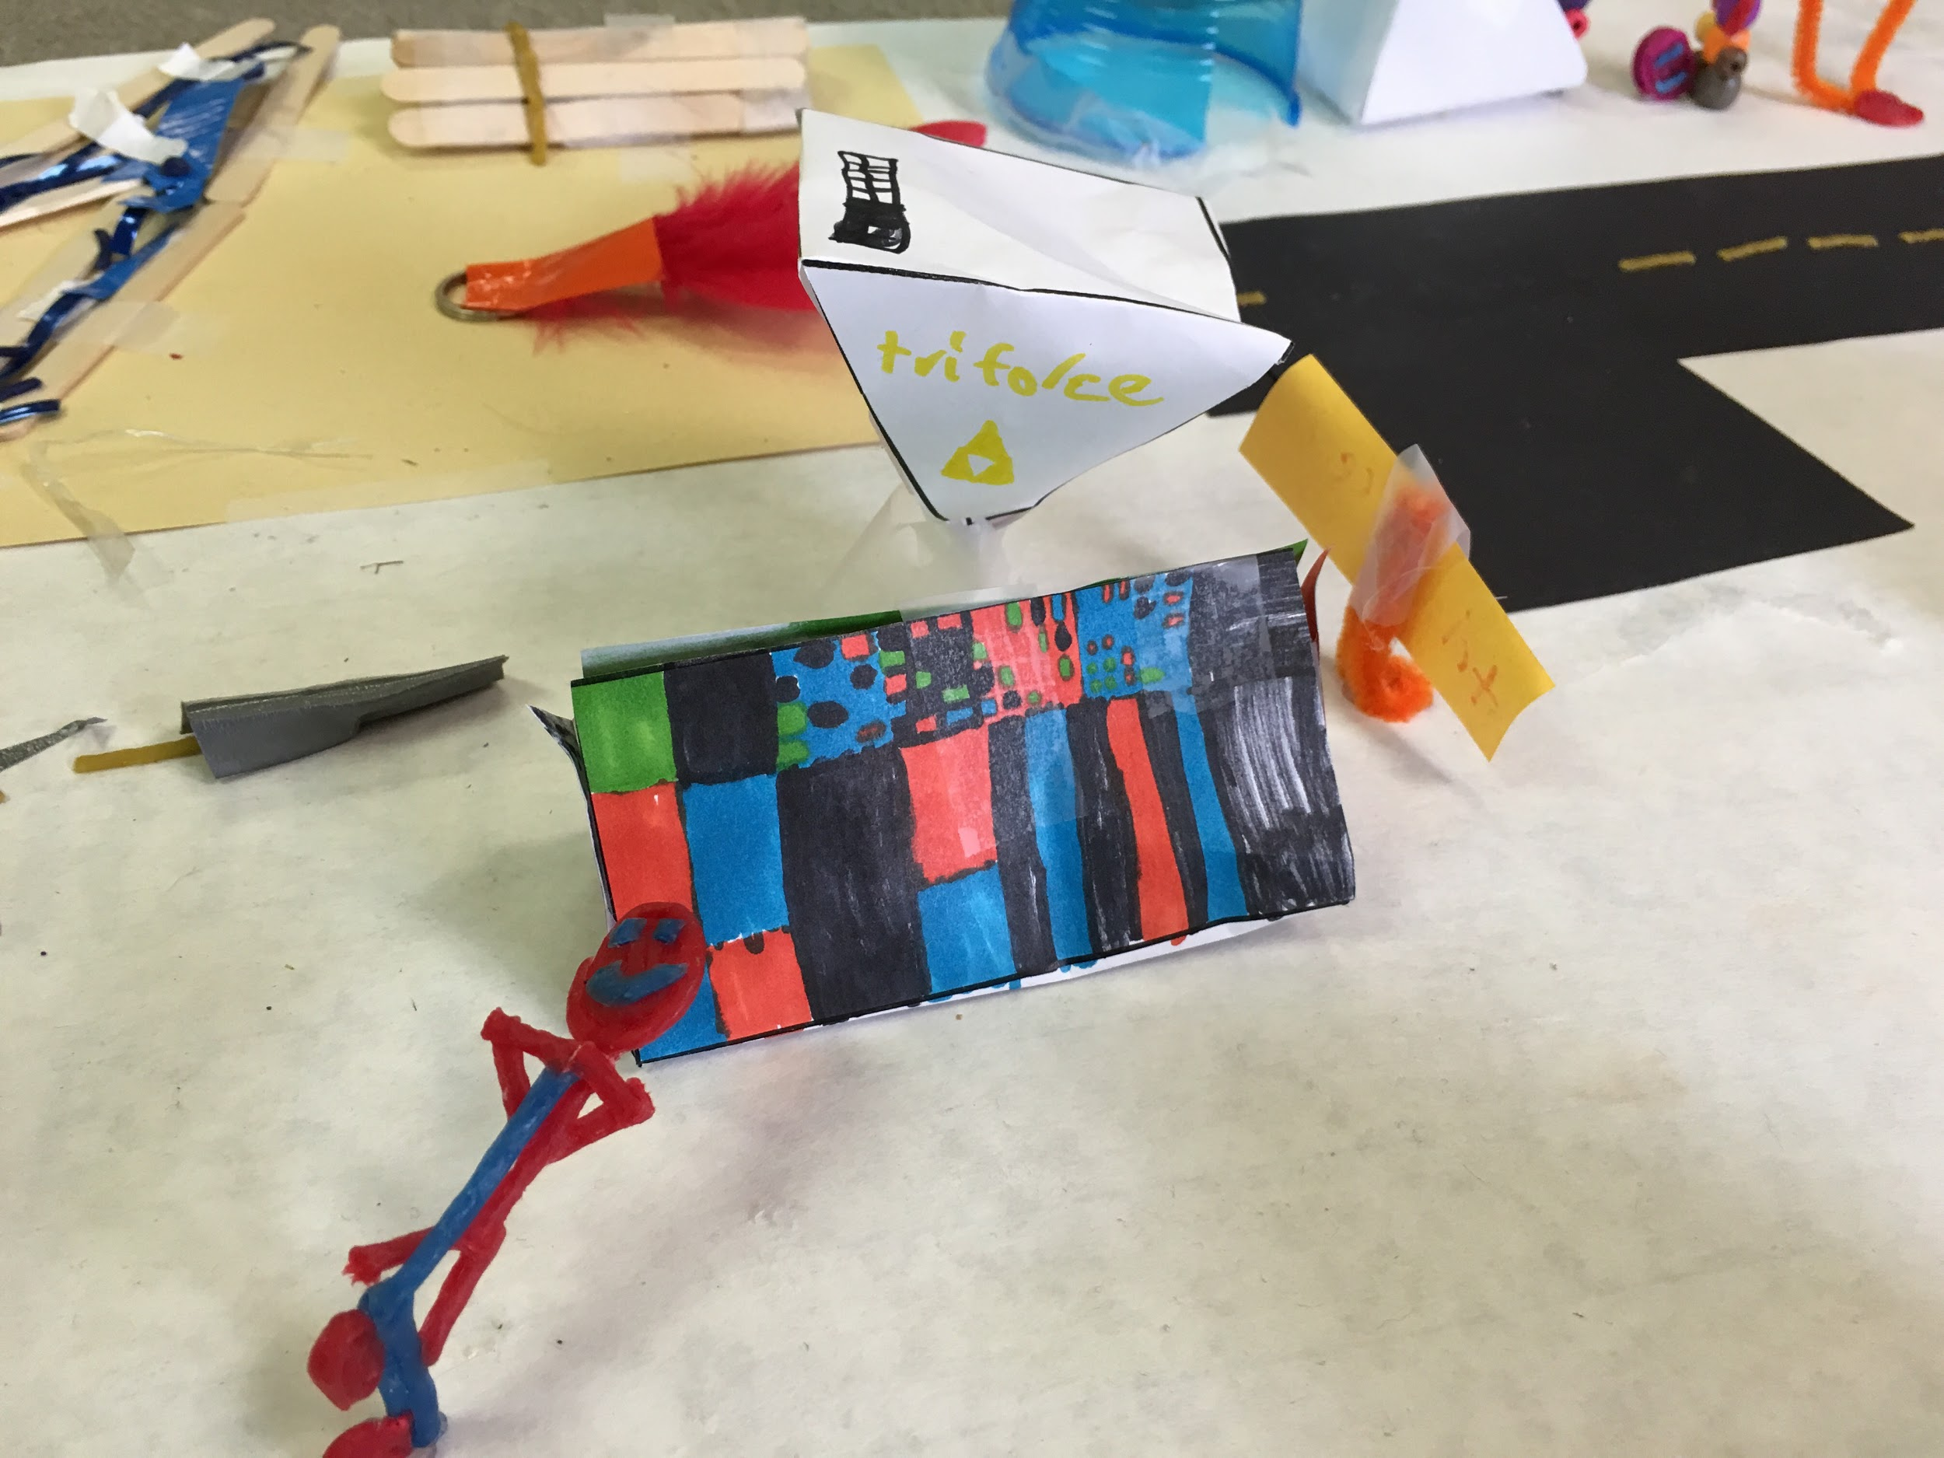
Tri-force (pyramid and triangular prism)
Scooter guy

Slide 8
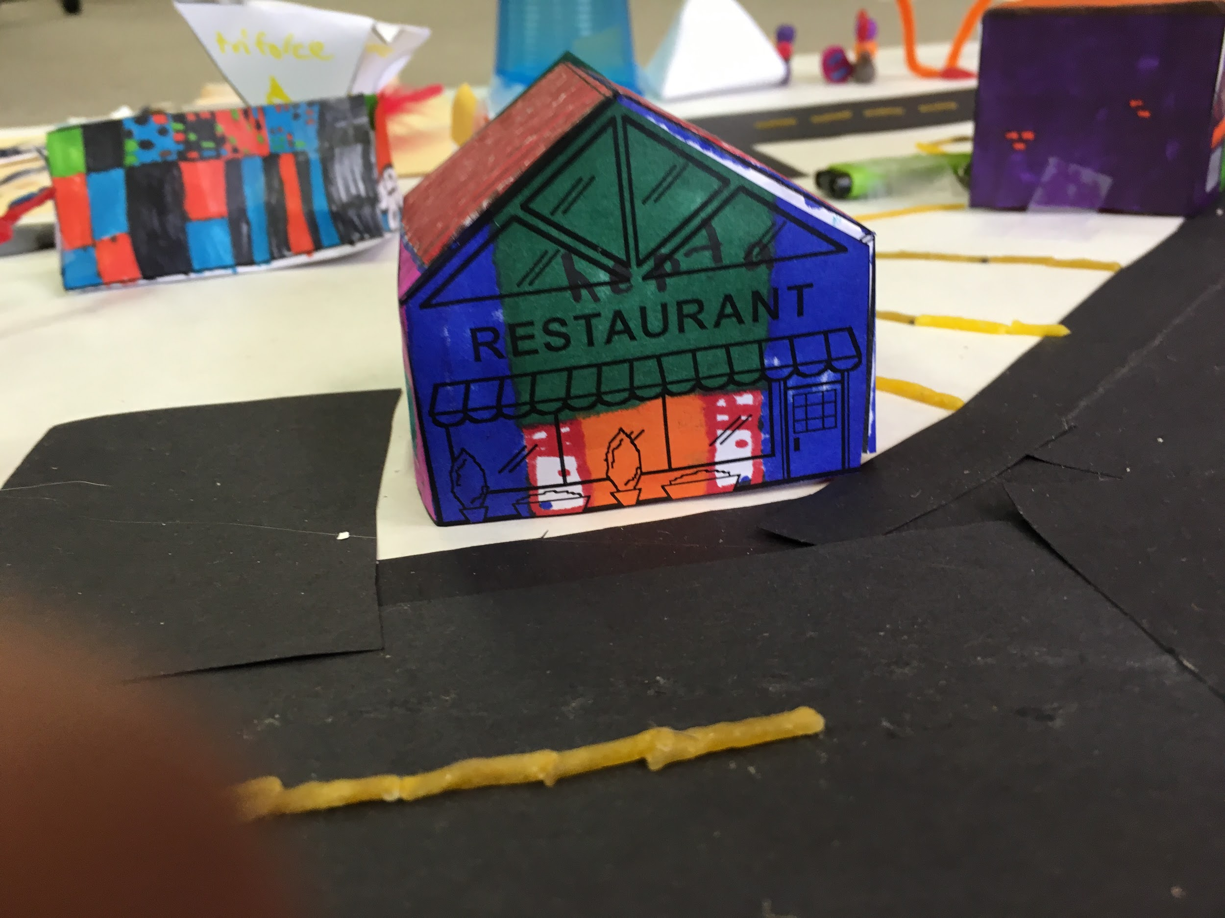
Rectangular prism with a triangular prism on top

Slide 9
Self-Reflection
Backward-Looking
Have you done a similar kind of work in the past (earlier in the year or in a previous grade; in school or out of school)? Yes, I have. We did our fraction makerspace challenge and I was in third-grade.
How much did you know about the subject before we started? A lot because Mrs.Devora taught us a bunch of geometry to get us ready for this Makerspace Challenge.
Inward-Looking
What did you learn about yourself as you worked on this piece? That I can remember a lot of math things and it’s really pretty easy to do a bunch of math things.
Did you meet your standards? Yes, I did, I have: 2 parallel roads, 1 perpendicular road, 1 intersecting road, 8 3-D shaped buildings/structures, 5 other things included, Town must be visually appealing, Town must be named
Outward-Looking
Did you do your work the way other people did theirs? No, I did not because all of our cities are unique in different ways.
What grade would you give it? Why? I would give my city a 9 out of 10 because there wasn't much building and we kind of got of hand with the clear tape.
Forward-Looking
One thing I would like to improve upon is ... Is that we wouldn't have as much clear tape.
What would you change if you had a chance to do this piece over again? So that we wouldn't have as much clear tape and have more buildings.

