Slide 1
Graham’s Million Dollar Math Portfolio

Slide 2
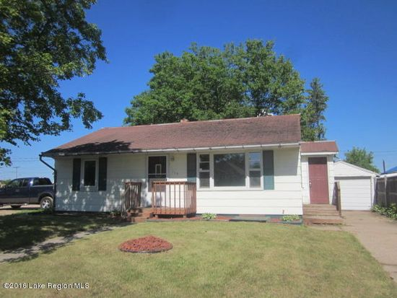
I want this house because I like the paint a lot and it looks like some of the items that I like in my life.

Slide 3
I want this 2017 Ford Mustang because it is just like a sports car. It is awesome.

Slide 4
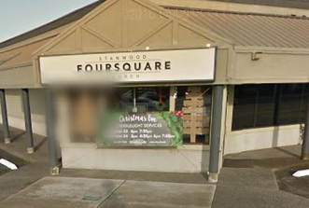
I want to donate to this organization because I go there and I like it there. It is fun to play and get candy there. That is why I want to donate 500,000 dollars to this organization. Price that I am paying $500,000 dollars and no cents.

Slide 5
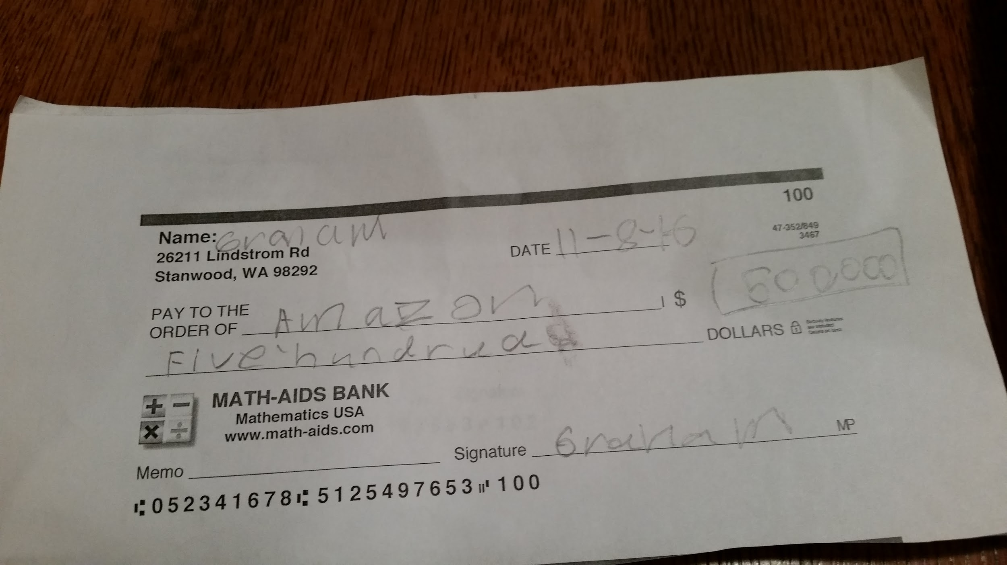
I want to buy this because it is cool, awesome and I like it.

Slide 6
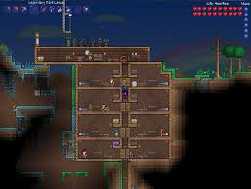
Terraria
I want Terraria because I like the game and I like the graphics. They are cool.

Slide 7
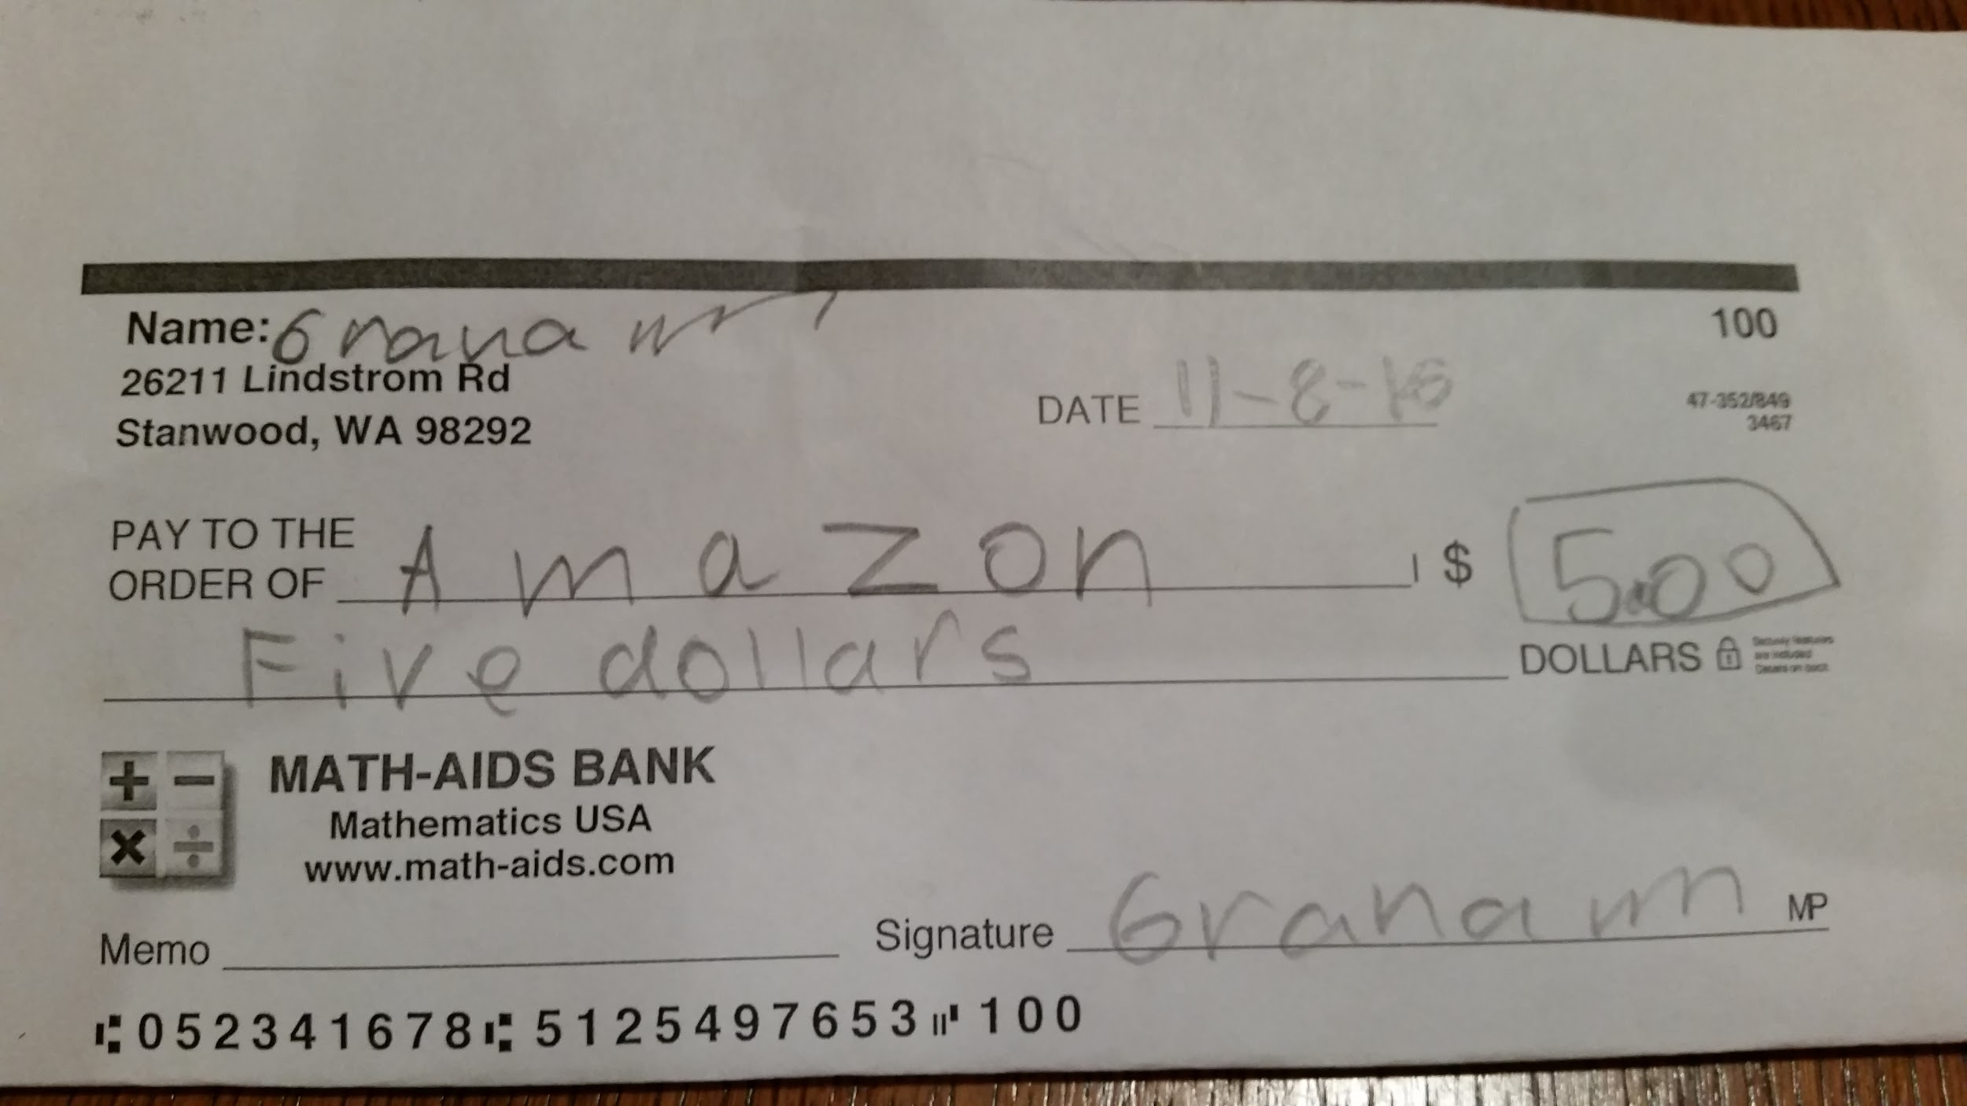
I want this dash button because it cool.

