Slide 1
Icosa Island Documentation
And Reflection
By: Thomas M.

Slide 2
Requirements
2 Parallel Roads
1 Perpendicular Road
1 Intersecting Road
8 3-D Shaped Buildings/Shapes
5 Other Things Included
Town Must Be Colorful
Roads/Building/Town Has To Have A Name(s)

Slide 3
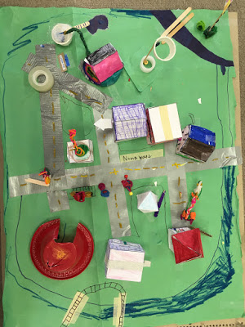
Intersecting Road:
Cross But Can Not
Be 90º
Parallel Roads: If Infinite Would Never Meet
Perpendicular
Road: 90º From Each Other. Don’t Have To Touch.
Key
Red: Roads
Intersecting Road
Perpendicular
Road
Parallel Roads

Slide 4
1: Polygon Pools
2:Tri Church
3:Acute Elementary
4 Straight Family
5:Tetra Family
6:Septa Store
7: Hendeca Hospital
1
2
3
4
5
7
6

Slide 5
Reflection:
What grade would you give it? Why?
Ok, in report card style, a “3”. It didn't have all the buildings secure.
Did you meet your standards?
Yes. The roads had the parallel lines and the rest of the lines, the buildings had the rest!
How much did you know about the subject before we started?
Not much, I thought geometry was just shapes. I was SO wrong.
What will you change in the next revision of this piece?
MAKE IT MORE REALISTIC. It had this color there and this one here!
One thing I would like to improve upon is:
If I had a chance to do it again, I would work on one road at a time, one building at a time, and one extra at a time.

Slide 6
More Reflection:
What resources did you use while working on this piece? Which ones were especially helpful? Which ones would you use again?
Tape and Sharpie. Great for making it colorful and keep the building in one piece.
In what ways did you do it differently?
We did roads, buildings, extra.
What did/do you find frustrating about it?
It was hard to color the buildings. It took a day to color the smallest building.
I4fgdfghdxdfgfdt7
‘}+\]

