Slide 1
Nona York City DOCUMENTATION & REFLECTION
By Jaren

Slide 2
Requirements
KEY
X=Did not do
O=In some places
✓=Done/Inserted
2 Parallel Lines
1 Perpendicular Line
1 Intersecting Line
8 3D Shaped Structures
5 Other Things
City MUST be Colorful
City/Buildings/Roads MUST have a geometric name

Slide 3
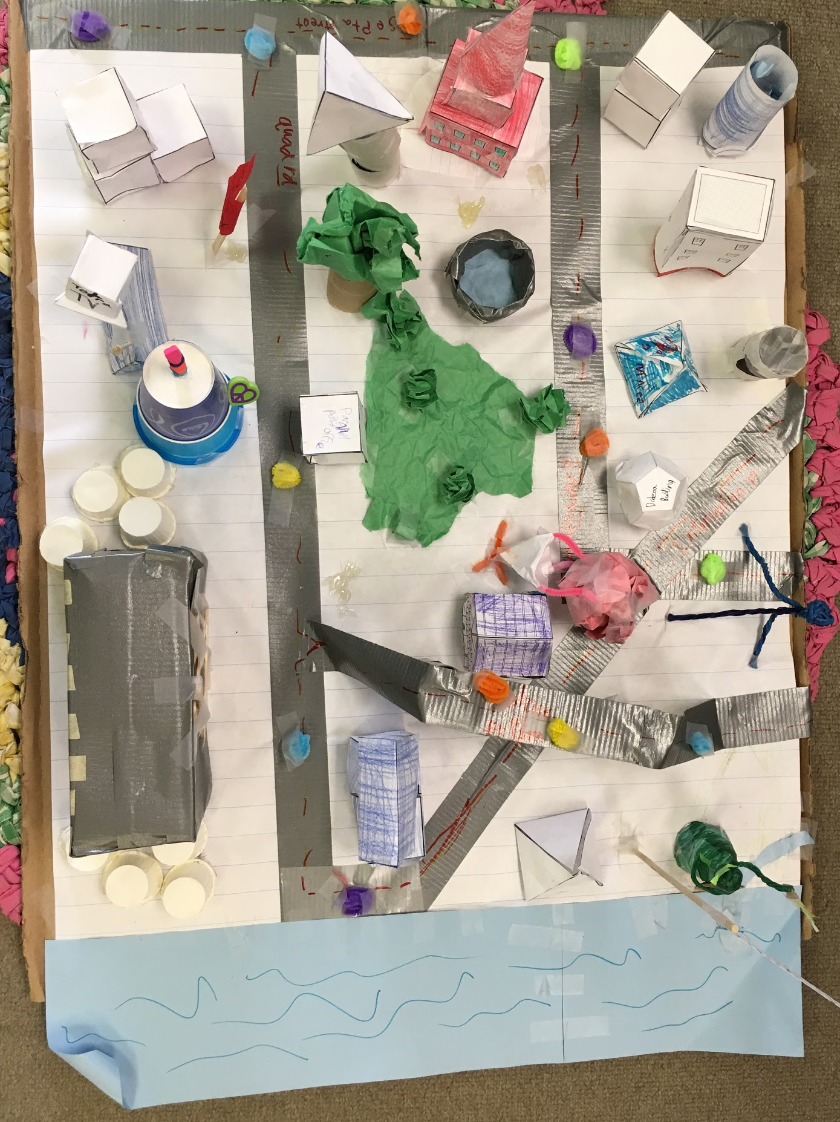
O=Intersecting roads
⏢=perpendicular roads
工=parallel roads
□=3D shaped buildings
▢=other things
Intersecting line= two lines that cross
Perpendicular line= two lines that cross in 90º angles
Parallel line= two lines that never meet.
3D shape= a shape that has length, width, and height.

Slide 4
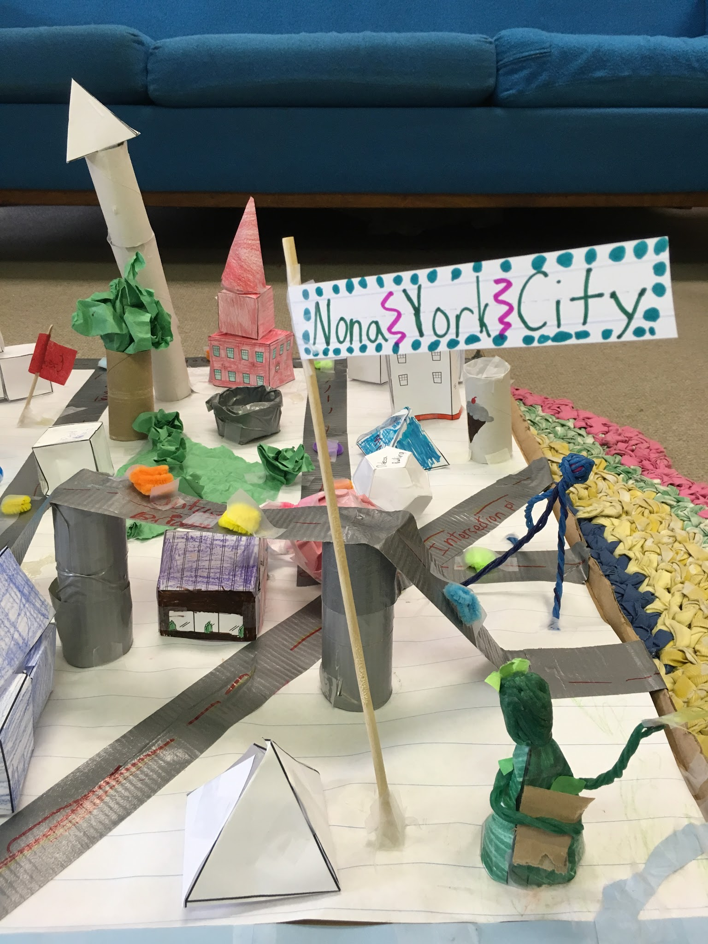
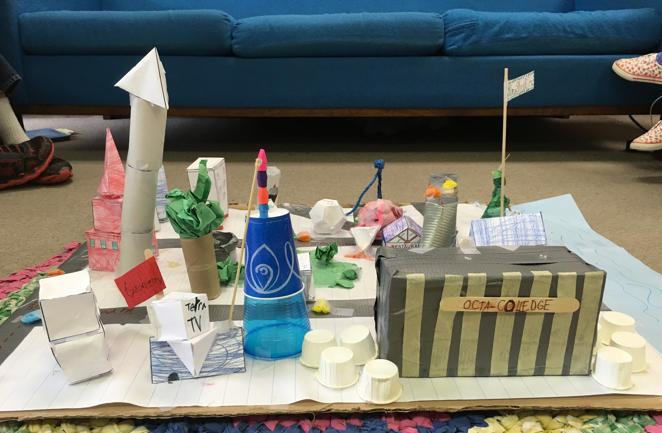
Nona=9 Tetra=4

Slide 5
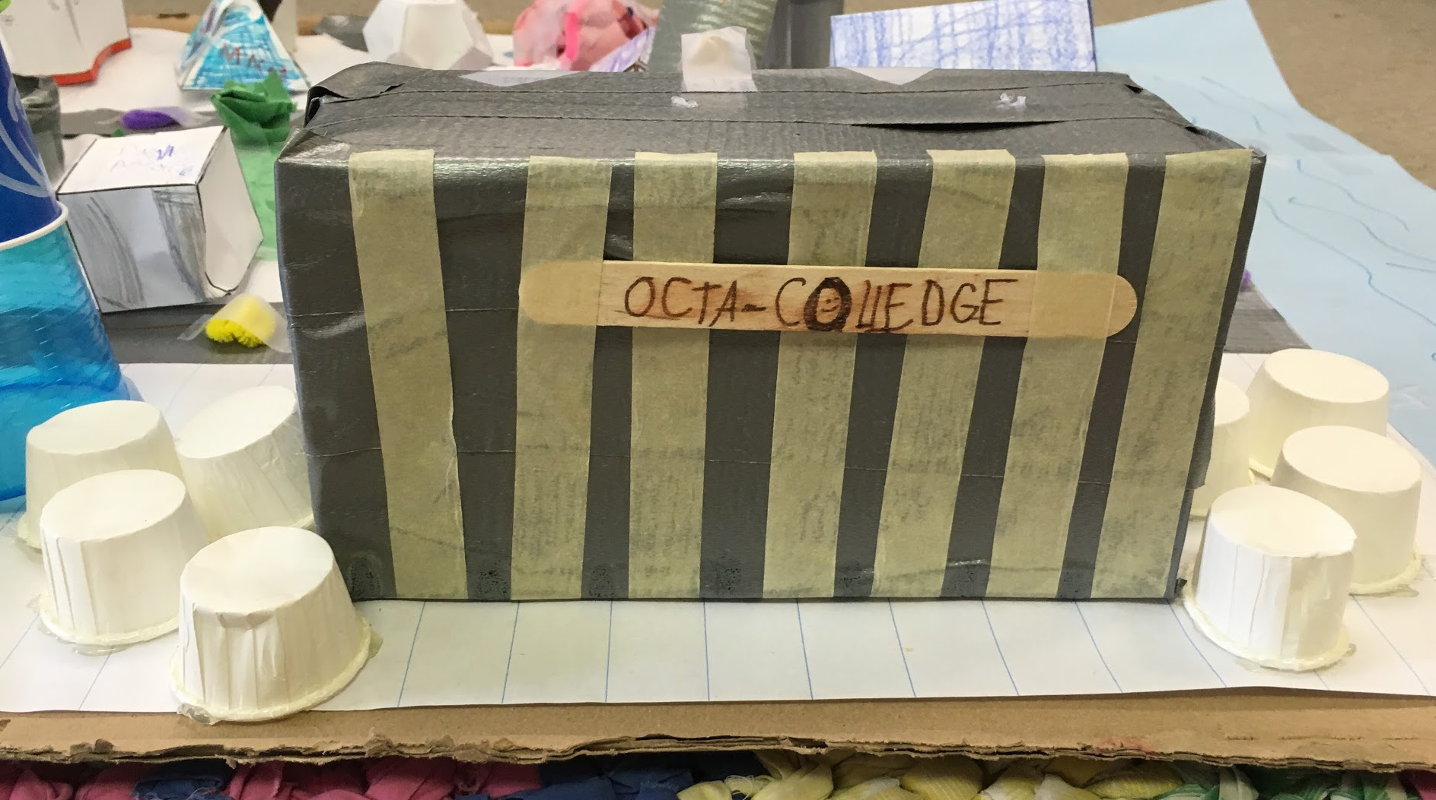
octa=8

Slide 6
Reflection
1. How much did you know about the subject before we started?
A lot. I knew area and perimeter, A LOT of shapes, “X” “Y” and “Z” axis, Angles, geometric words, and the types of triangles.
2. In what ways do you think you need to improve?
Attention. I was wandering off not staying focused.
Q&A
Backward-Looking:

Slide 7
Reflection
1. What were your standards for this piece of work?
2 Parallel Lines 1 Perpendicular Line
1 Intersecting Line 8 3D Shaped Structures 5 Other Things City MUST be Colorful City/Buildings/Roads MUST have a geometric name
2. Did you meet your standards?
Yes. Al you saw at the start, none have an “X”.
Q&A
Inward-Looking:

Slide 8
Reflection
1. What grade would you give it? Why?
A+! It was a very creative experience.
2. In what ways did it not meet those standards?
Color. I thought that it woud be the easiest part, I was wrong.
Q&A
Outward-Looking:

Slide 9
Reflection
1. What might you want next year's teacher to know about you (what things you're good at)?
ART! MATH! Those are the things that I am GREAT at!
2. What would you change if you had a chance to do this piece over again?
I would probably work on it by myself. That way I wouldn't get into any fights.
Q&A
Forward-Looking:

