Slide 1
Spending Portfolio
By: Karina P.

Slide 2
Item and normal price | Rounded price | Total
#1 pokemon cards $21.99 | $20.00 | $20.00
#2fairy door $45.99 | $50.00 | $70.00
#4157 Watson Walk, Camano Island, WA 98282 $419,000.00 | $420,000.00 | $420,000.
#Pusheenicorn Stuffed Plush Unicorn, 13" $18.99 | $19.00 | $420,019.
# Kawaii Cupcake with Mustache $16.99 | $17.00 | $420,036
Skagit Valley College $4,200 | $16,800 | $436,836
2017 Prius $24,685 | $25,000 | $461,836
Hawaii $1,248 | $1,300 for 7 people is $9,100 | $470,936
Fiji $1,455 | $1,500 for 15 people is $22,500 | $493,436
donations to marine animals $400,000 | $400,000 | $893,436
Rest for savings account $5065.64
This makes no cents. Not even dollars!
62
00.2

Slide 3
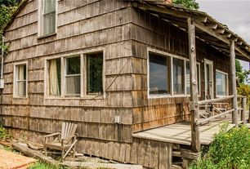
I want this house because…
the house has 2 beds, 1 bath, 1 sq ft and
There are lots of facts to this house look at them all:Lot: 0.72 acres Miscellaneous Built in 1957 123 days on Zillow Views since listing: 7,434 All time views: 7,570 41 shoppers saved this home Price/sqft: $420,000 MLS #: 971786. FEATURES : Attic Deck Fireplace Flooring: Hardwood Unfinished. basement View: Water. Waterfront.

Slide 4
Why I’m doing Donations to marine animals
To help marine animals ’cause I love animals and when I grow up I want to be a vet and when i retire i will be a dance teacher. Donation money $400,000.
11/8/
16
secure3.convio.net/tmmc/site/Donation
400,00
Four hundred thousand
00.

Slide 5
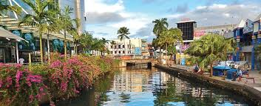
Taking a trip
16
https://www.google.com/destination?q=trip+to+fiji
22,500
00
Two hundred thousand two thousand five hundred
$22,500 for 15 people to go to Fiji, Suva. Where my dad grew up. I have never gone to Fiji or at least for what I remember.

Slide 6
TO BE CONTINUED. . .
LATER ON…

