Slide 1
Geoparadise Reflection
By kaydence

Slide 2
What should be on our build
2 parallel roads
The buildings must be colorful, visually appealing and it must have a math/ geometry name.
1 perpendicular roads
1 intersecting road
8 3D shaped buildings/structures There are 8 other things we can include but don’t have to.
Extra roads
Cars, trucks or highways
Traffic lights/signs
rail road
Abu station
River, lake or stream

Slide 3
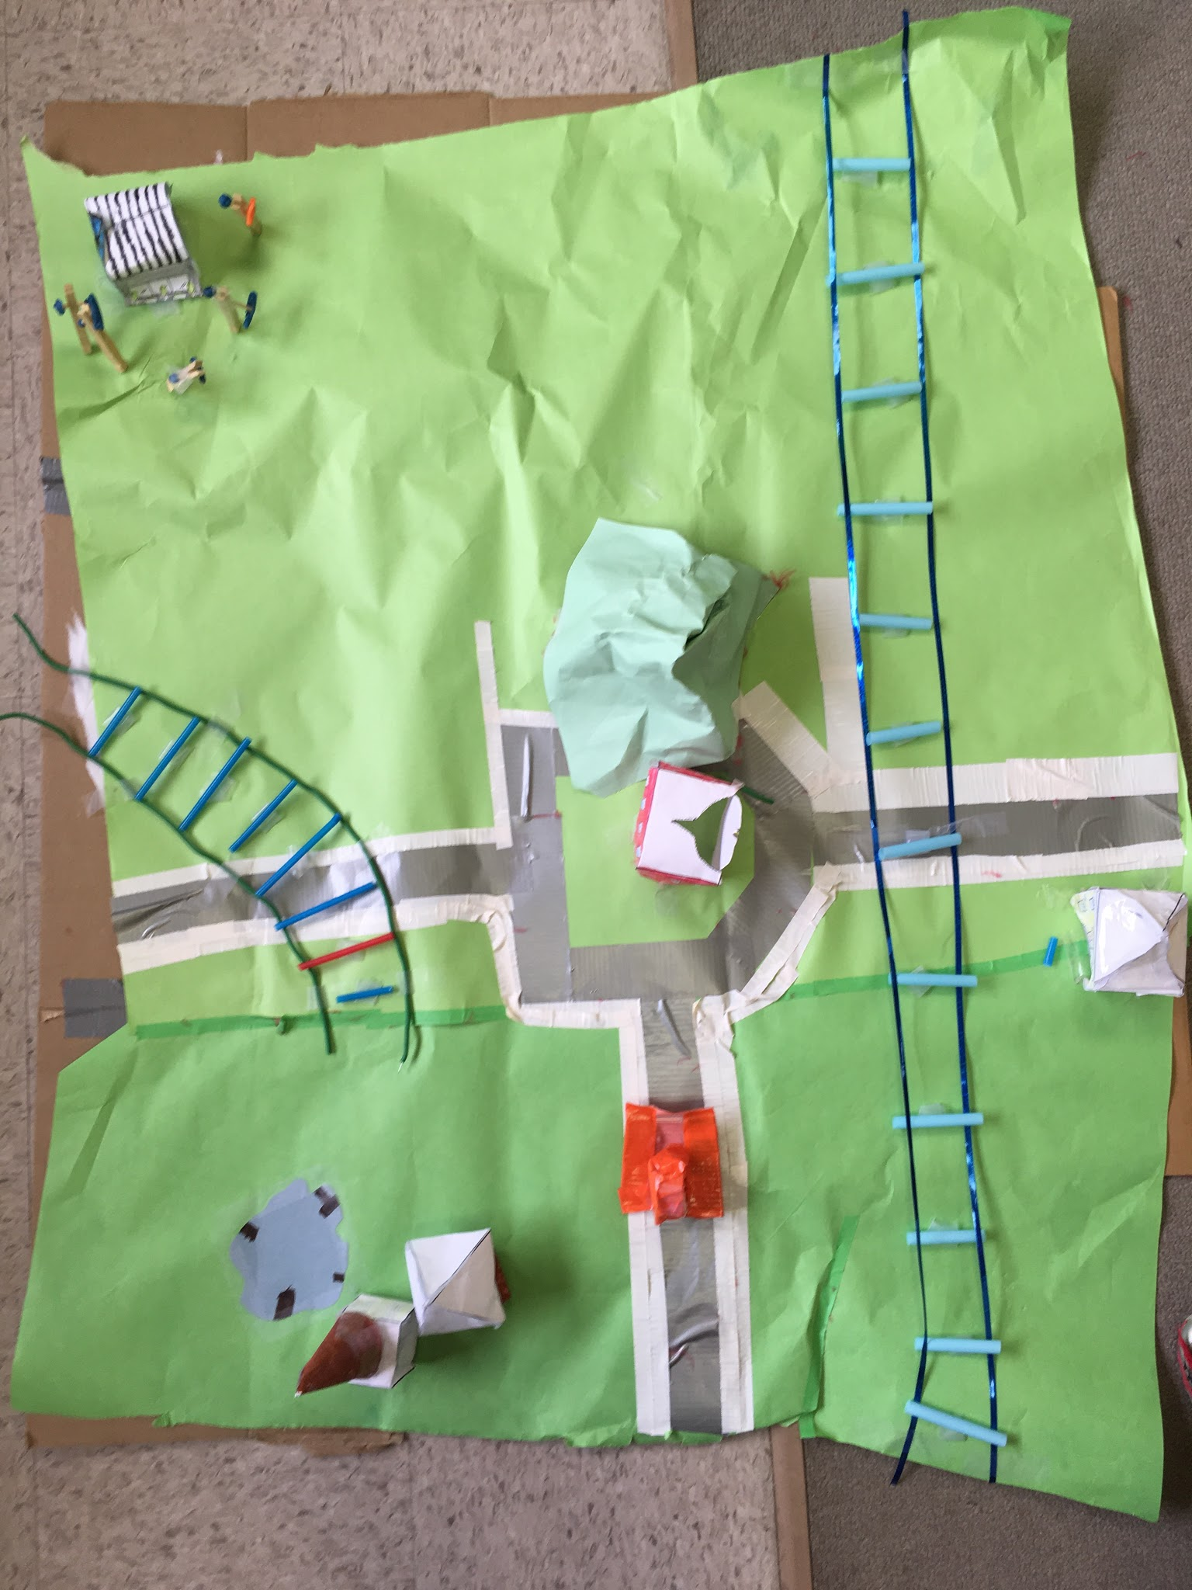
Birds eye view
pond
house’s
Train track
Power plants
Town hall
mall
car
The train tracks sides are parallel

Slide 4
house’s
Quad family’s house
Cone family’s house

Slide 5
Train tracks
tracks
Intersecting train track

Slide 6
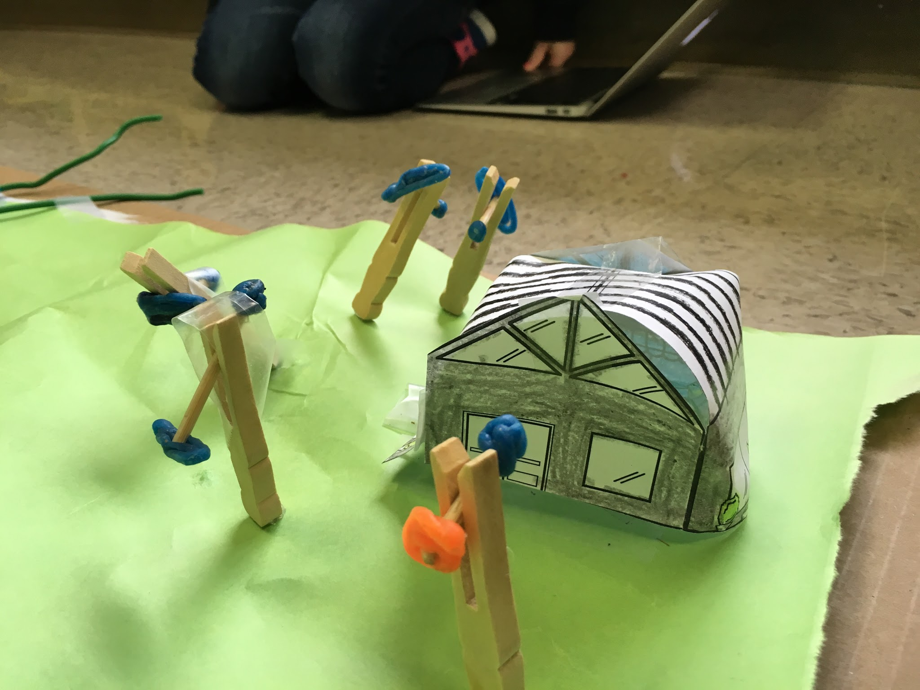
Power plants
Perpendicular power plants

Slide 7
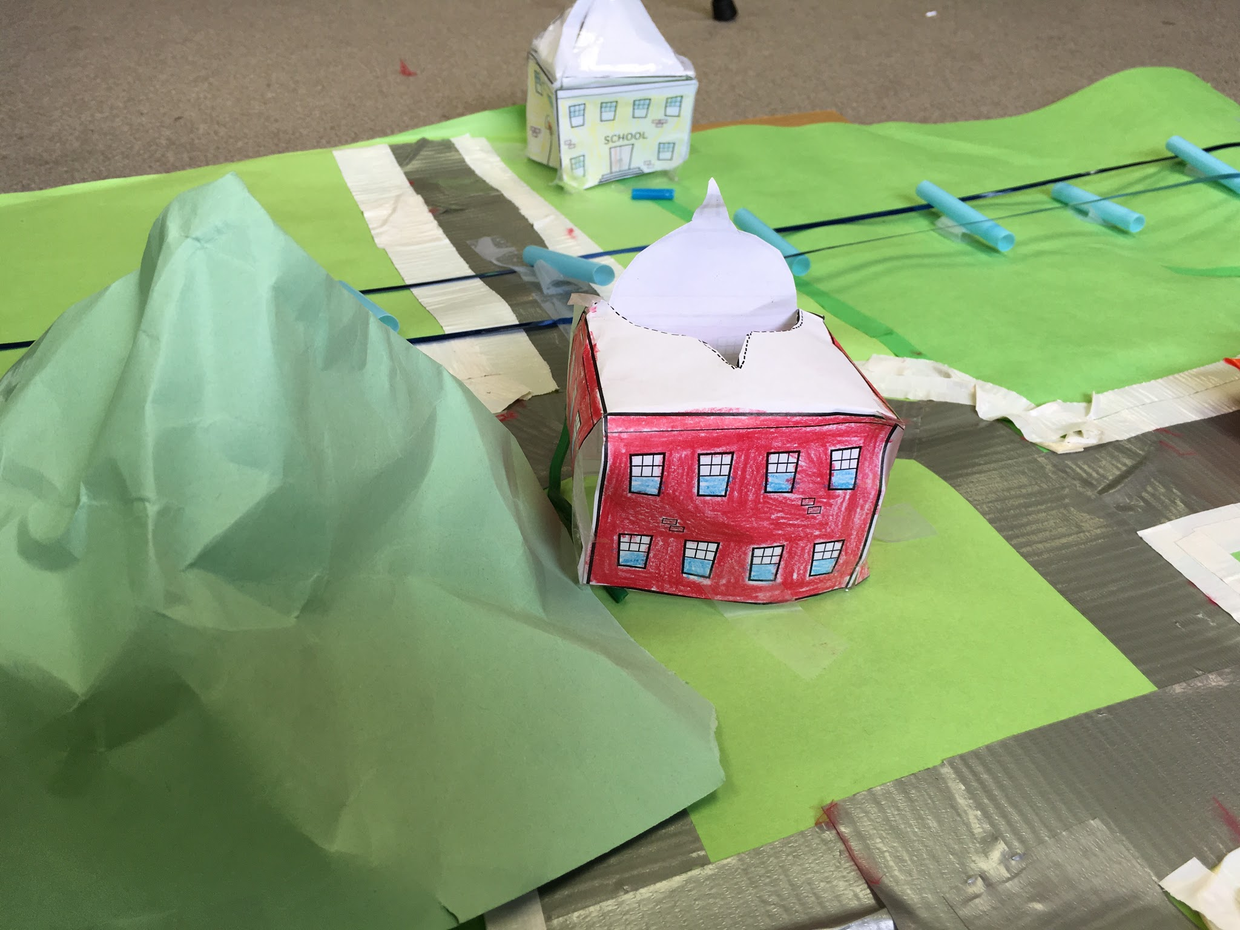
Tri hall
Twin edge school

Slide 8
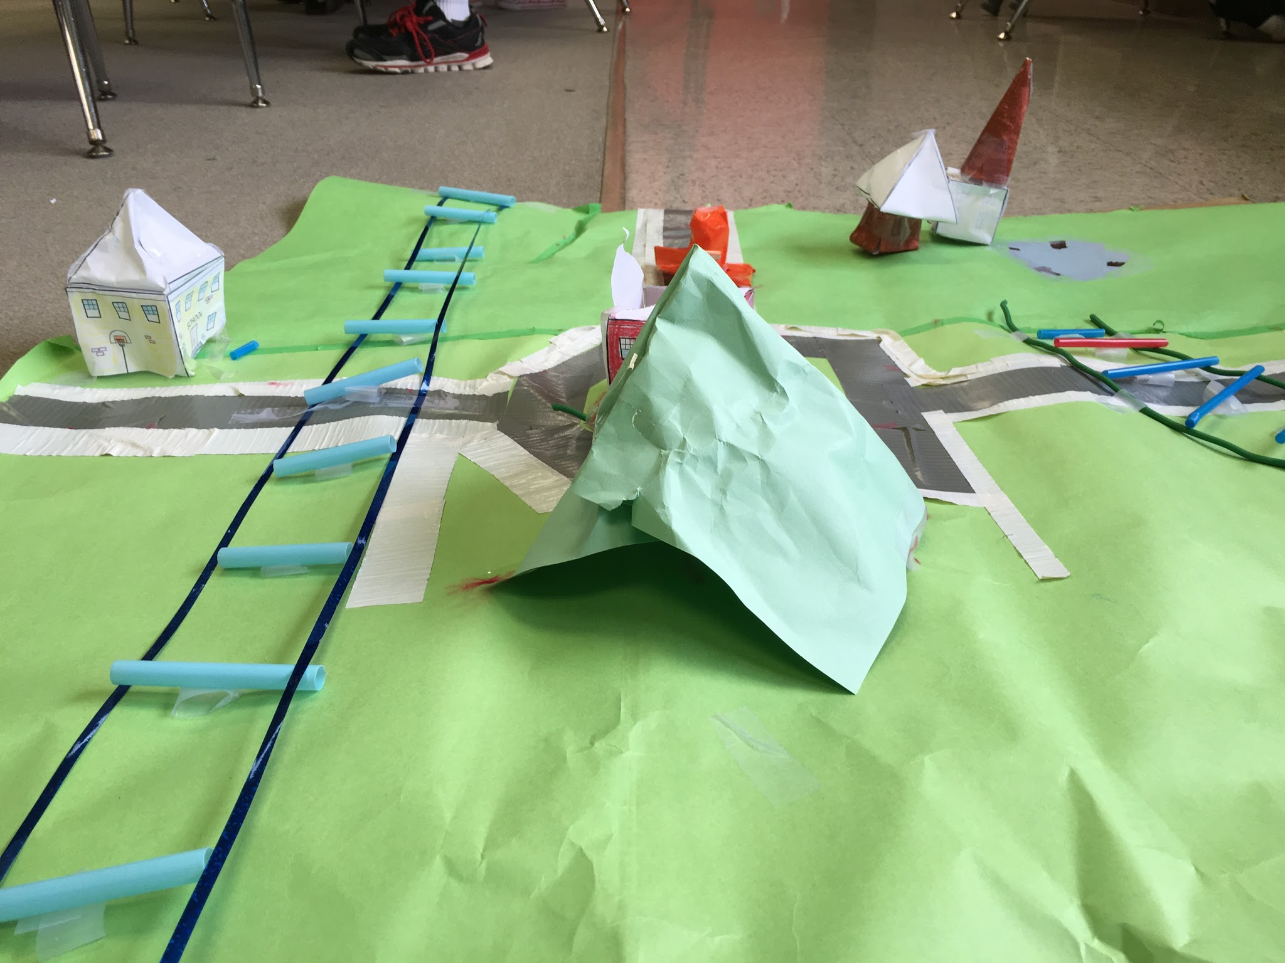
Side view
Perpendicular road and train track

Slide 9
My reflection
Q: In what ways have you gotten better at this kind of work? A: I have gotten better at this work by doing it often, it’s also by putting more buildings.
Q: Does this work tell a story? A: no there is not a story because I did not want a story because it would be too much work.
Q: What did/do you find frustrating about it? A: I find frustration in working on this project because it is hard work to do all the buildings, roads and the names for everything.
Q: What does that tell you about yourself and how you learn? A: this project tells me that I can make lots of art works and teaches me to focus on what you need for builds.
Q: What grade would you give it? Why? A: I would give my geo city a number from one out of ten a nine because it wasn’t exactly perfect.

