Slide 1
Geocity Documentation and Reflection
Septacisco
Septacisco
Septacisco
By: Marc Y.
By: Marc Y.

Slide 2
Requirements
: I did finish it.
2 Parallel Roads
1 Perpendicular Road
1 Intersecting Road
8 3-D Shaped Buildings/Structures
5 Additional Things (extra buildings, cars, extra roads, traffic lights, etc.).
Build must be visually appealing.
: I almost finished it.
: I did not finish it.

Slide 3
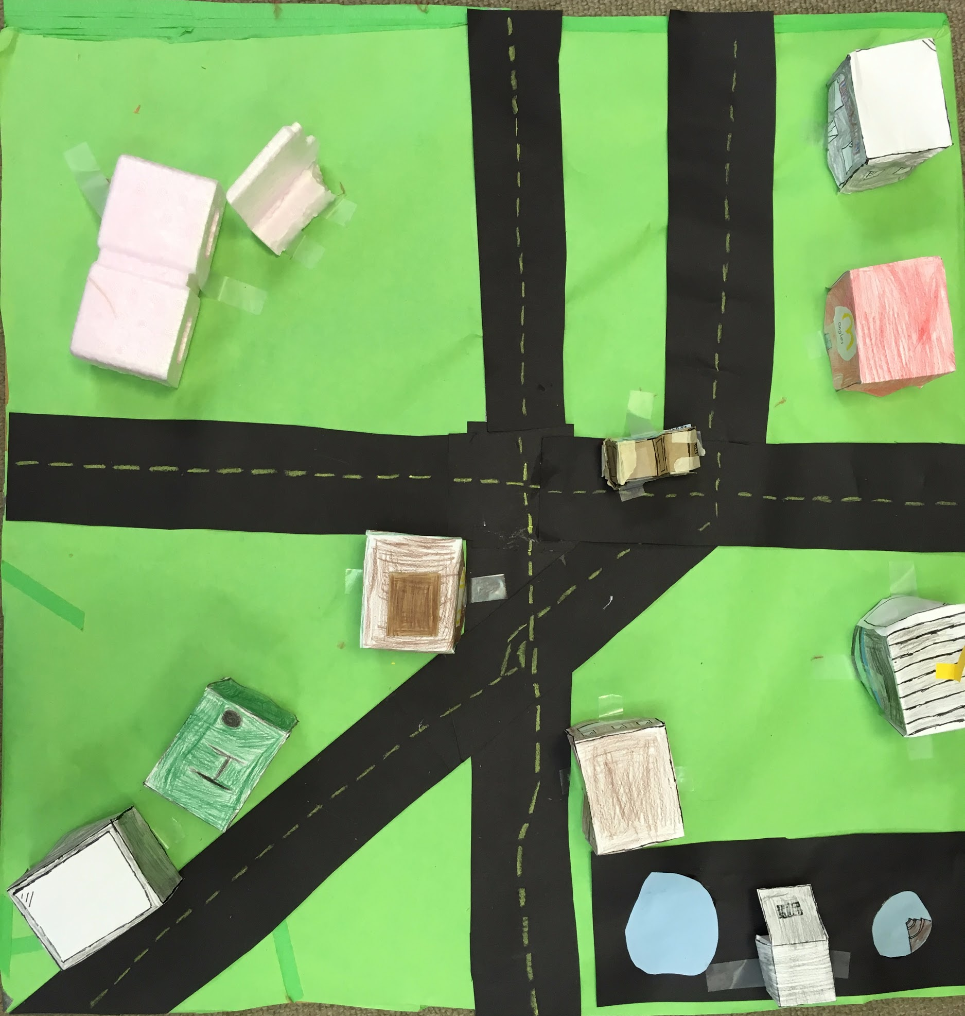
Parallel:
Two lines that go the same distance from each other, and never touch.
Intersecting:
Two lines that cross each other.
Right Angle:
A 90° angle.
8
7
3
6
Powerplant
2 4
Angles Inn
1
Microsepta 5
iHepta
McDangles
Penta Playground
Parallel Roads
Acute Av.
Rays Rd.
Intersecting Road
Right
Cubic Av.
Right Angle Rd.
Angle

Slide 4
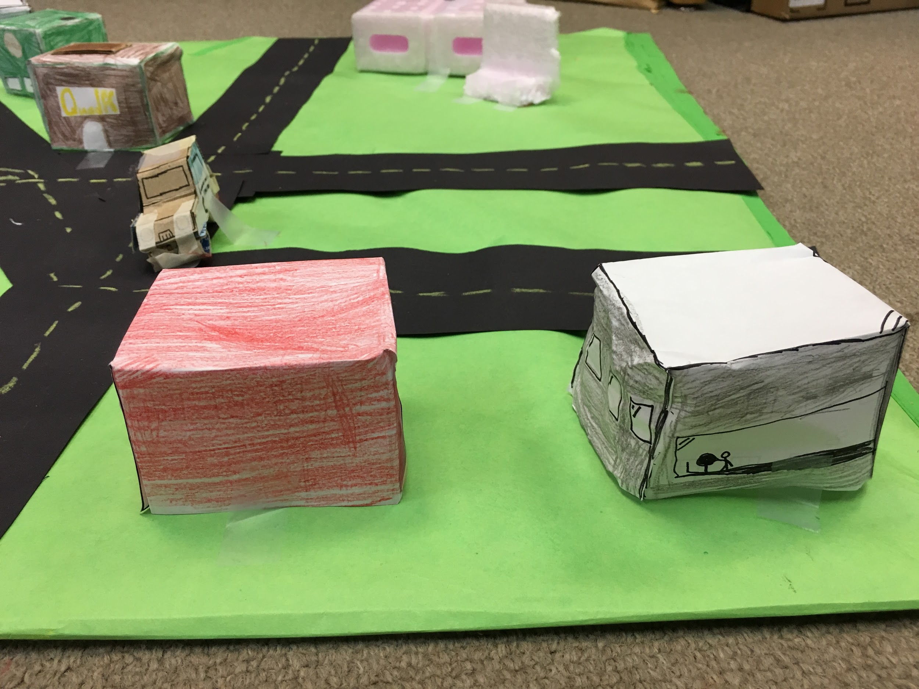
Buildings
McDangles
iHepta
1 3D Building 1 3D Building
(Rectangular Prism) (Rectangular Prism)

Slide 5
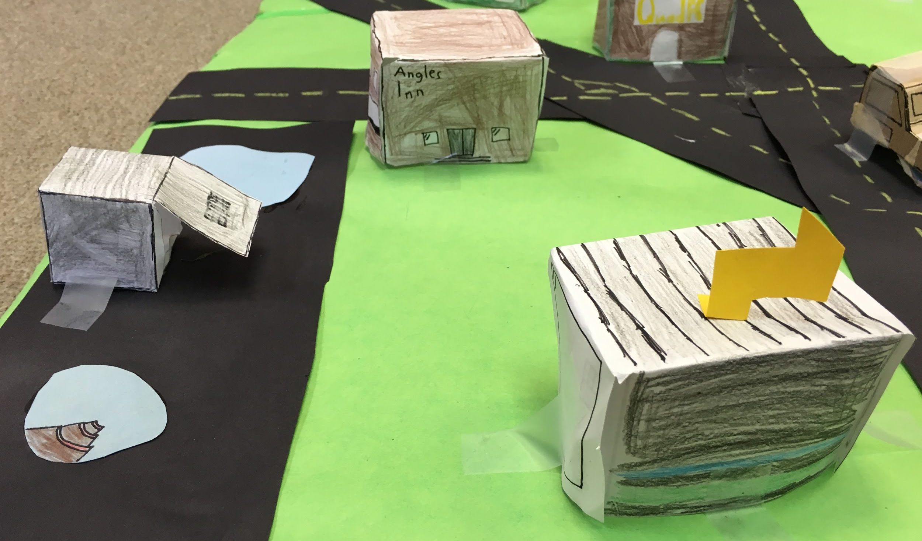
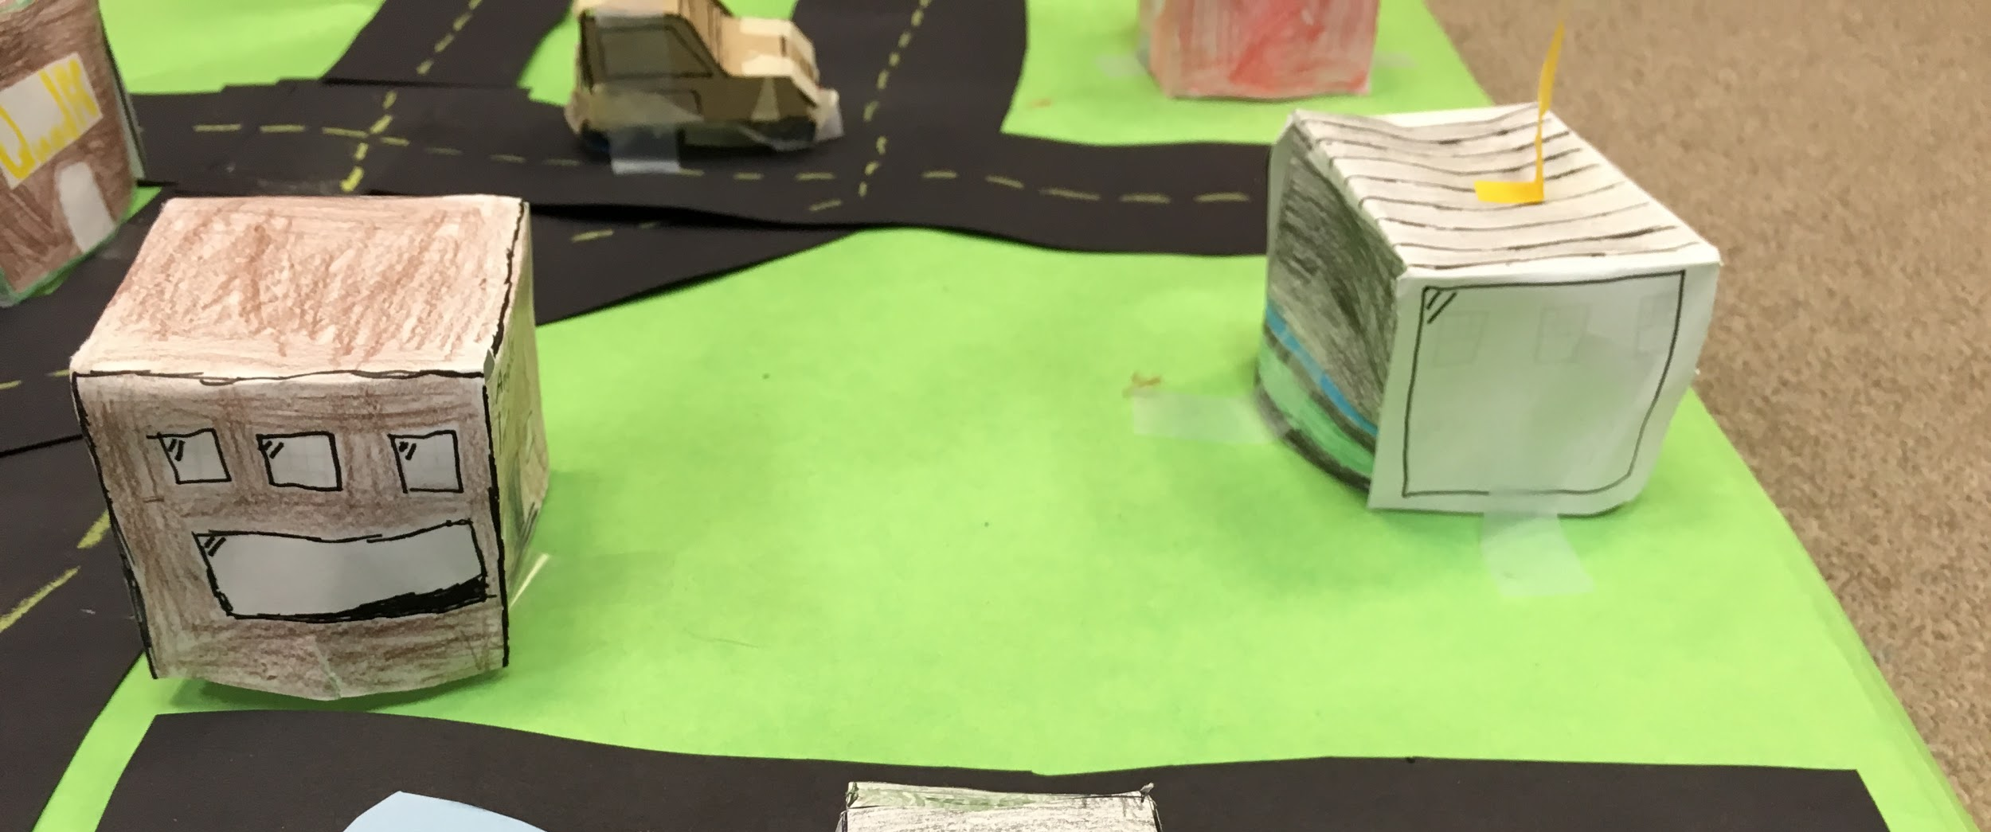
Buildings
1 3D Building
1 3D Building
(Rectangular Prism)
(Rectangular Prism)
Angles Inn
Powerplant

Slide 6
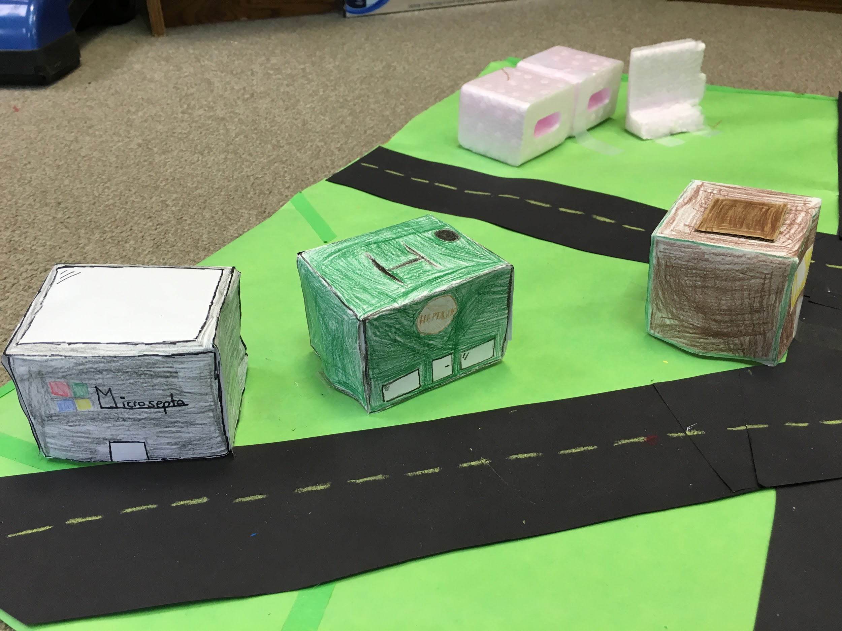
Buildings
1 3D Building
1 3D Building 1 3D Building
(Rectangular Prism)
(Rectangular Prism) (Rectangular Prism)
Microsepta
Heptaggens
QuadFC

Slide 7
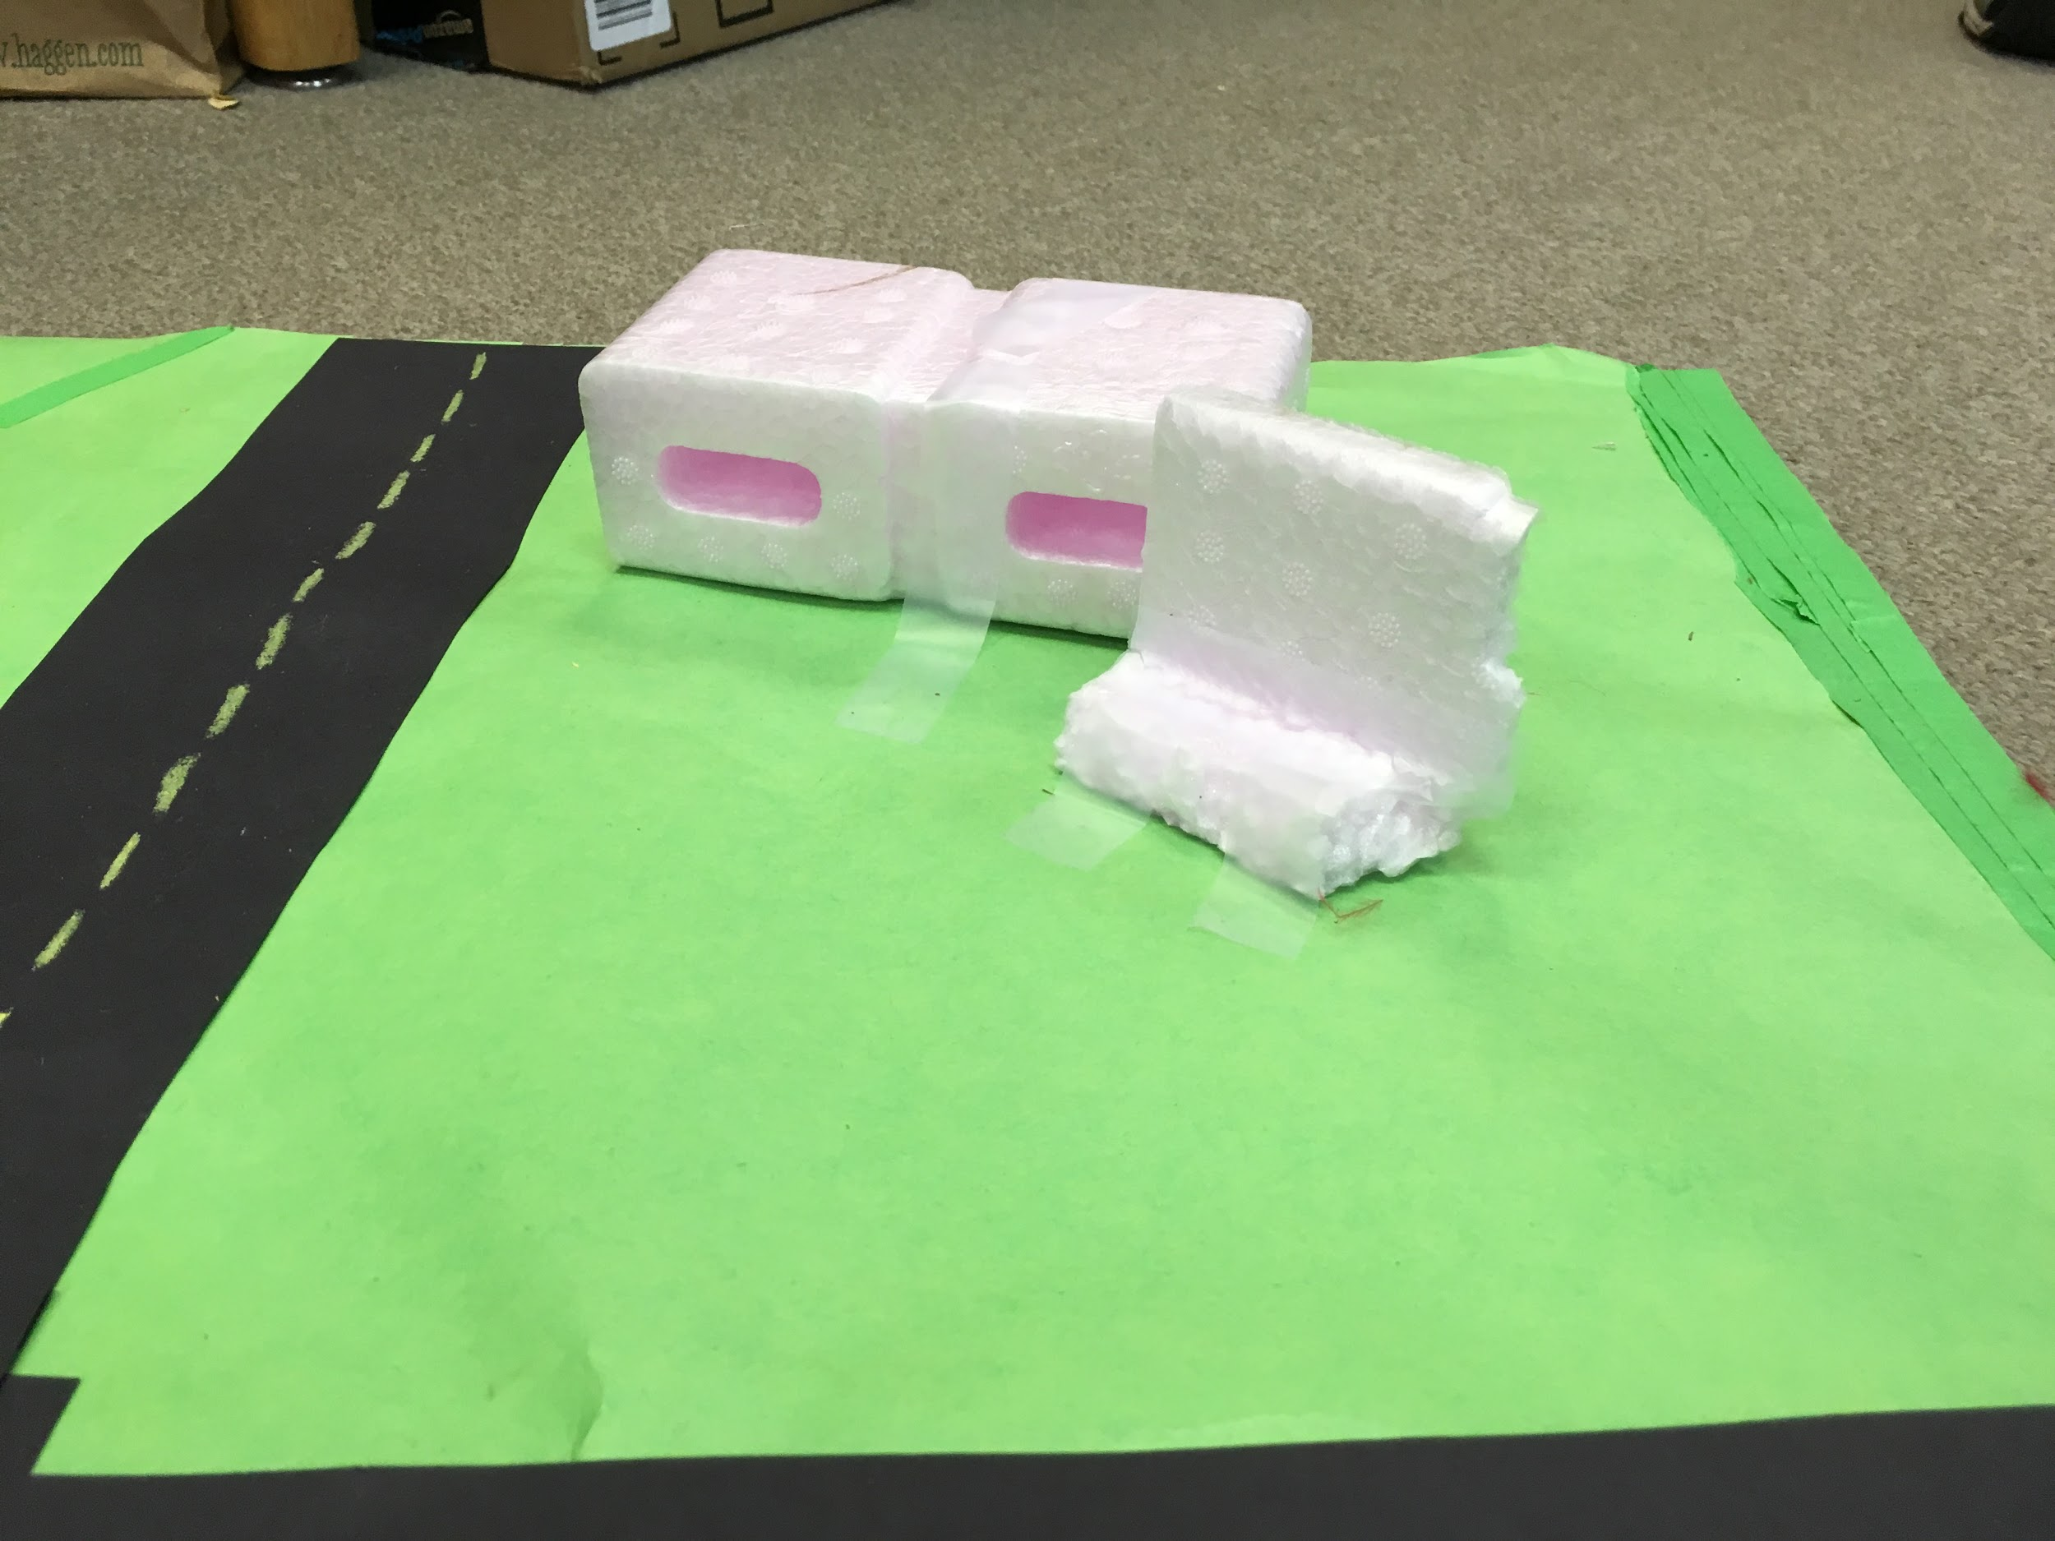
Addition Structures
1 Addition Structure
1 Additional Structure
Penta
Playground

Slide 8
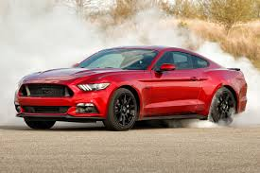
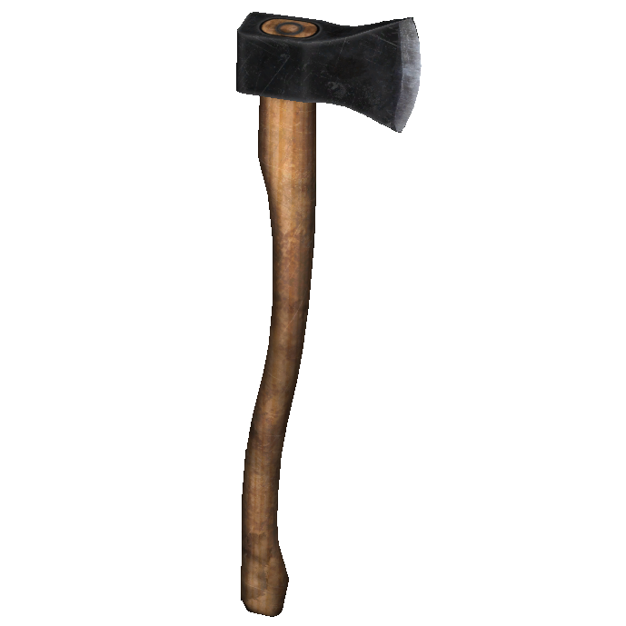
Additional Structures
Car
1 Addition Structure

Slide 9
Reflection Key
Yellow: Backward Looking
Green: Inward Looking
Purple: Outward Looking
Blue: Forward Looking

Slide 10
Reflection
How much did you know about the subject before we started?
I didn’t really know what geometry was, I knew that it had something to do with shapes, and I knew it was a thing. So I didn’t know much about geometry before we started.
In what ways do you think you need to improve?
I wasn’t really focused most of the time. I was pretty focused but not enough for me to enjoy myself. I was always stressing out about things like if we were going to finish the project in time, and if our buildings were visually appealing, even though I should’ve been focused on making my buildings and getting everything finished.
What was especially satisfying to you about either the process or the finished product?
My first is just getting the product finished, as I was stressing out about it, I was glad we actually finished. My second is just the roads. I used pastels for the roads, and I am really proud of the idea, because it looks almost like dry paint on an actual road. The roads, to me, are one of the most visually appealing things out of our build.

Slide 11
Reflection
What did/do you find frustrating about it?
Staying focused was a big reason why I was frustrated. There were so many distractions around me, and I couldn’t stay focused on finishing one building, so it’s lucky we got our 8 buildings finished before we finished working on our Geocity.
What grade would you give it? Why?
A 2 would be a good grade in my opinion. 2 is two below 4, meaning we did not complete two of the things on the requirements list. Also, 2 is the amount of requirements that we did not complete, so in my opinion, 2 is the most accurate answer.

Slide 12
Reflection
In what ways did it not meet those standards?
It was almost visually appealing, but I had to miss school on the last day we were working on it, and when I came back, there was tape just stuck on the build, and the car I made was just cardboard and tape, and wasn’t visually appealing. That is why I think we did not make our build visually appealing, and why we ended up not meeting the standards.
What would you change if you had a chance to do this piece over again?
Probably the cars, or buildings. We only had one car, that did not look good, and it was just cardboard and tape. The buildings were almost good, only if all of them were different shapes, but our buildings were all rectangles, and I was not really happy about that.

Slide 13
Reflection
As you look at this piece, what's one thing that you would like to try to improve upon?
I’ve already said this so many times, but I will say it again, I want it to be visually appealing. I think that is the biggest problem with our build, that it’s not as visually appealing as I wanted it to be. We tried, but we didn’t have enough time to finish our build and make it actually finished the way we wanted it to be. I really thought this was going to be where our project was visually appealing, but in my opinion, I think we failed our goal by just a small amount.

Slide 14
Credits
Check and X Symbol (Slide 2) found on: http://www.shutterstock.com/s/check+symbol/search.html

