Slide 1
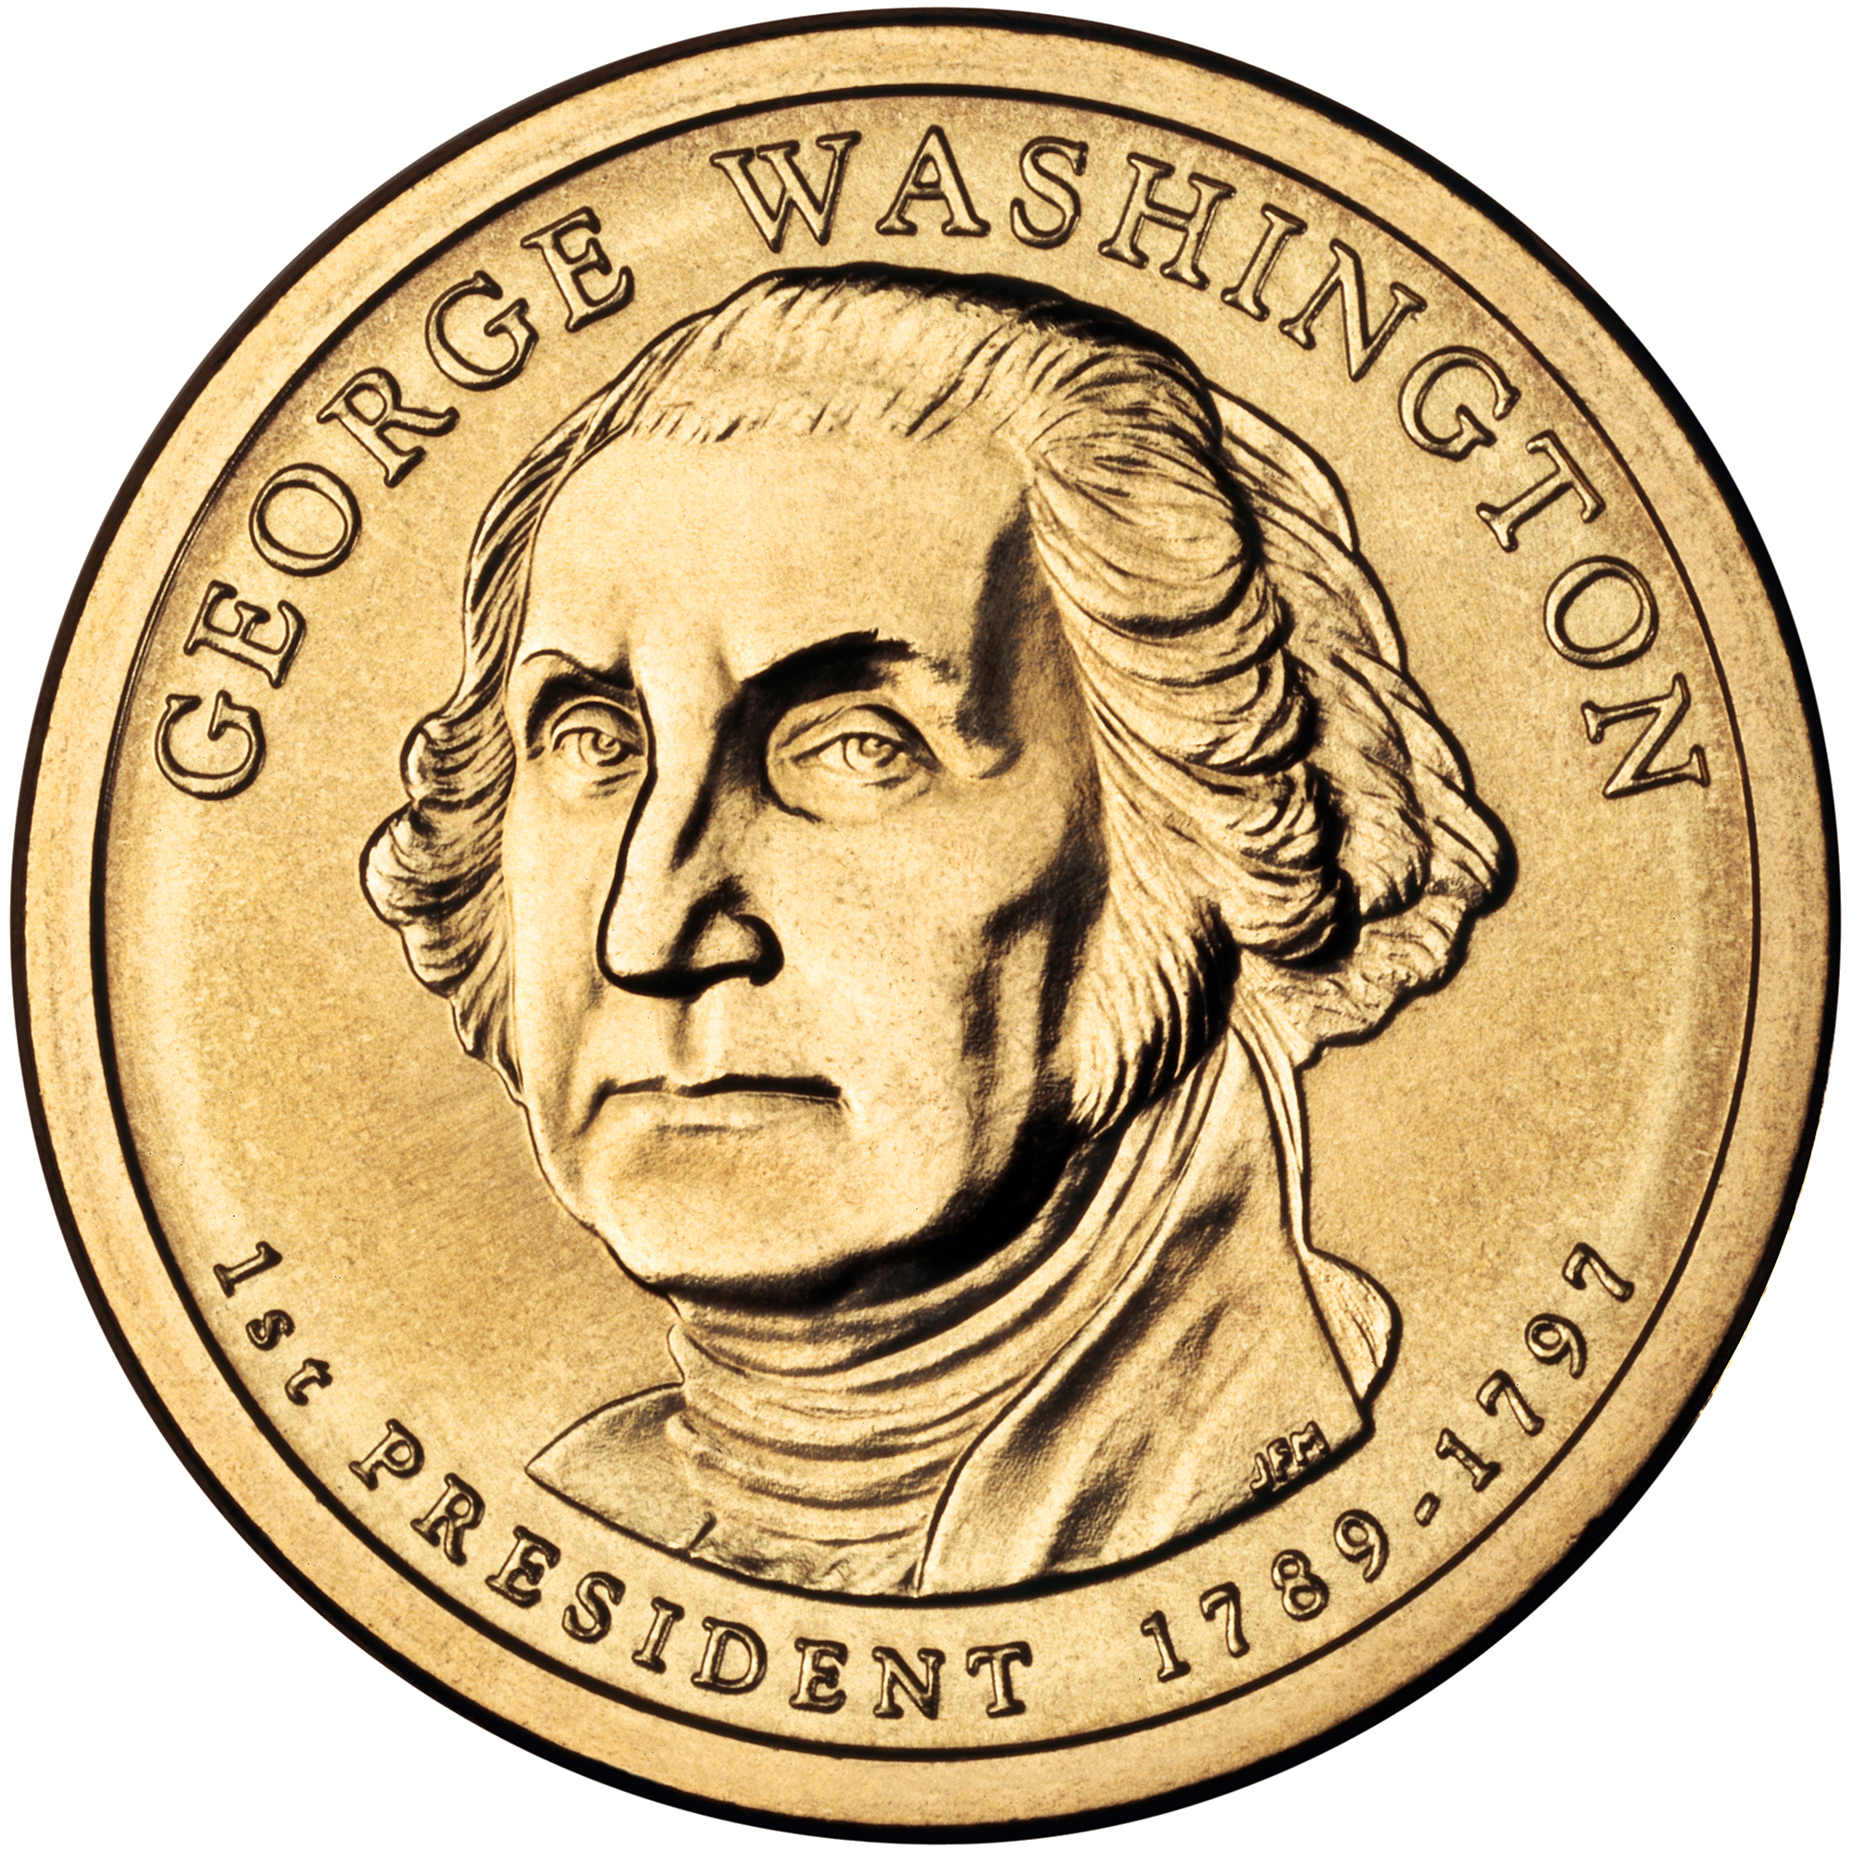
With help by Mrs.Devora
YAY!
This is Silas’s spending portfolio
I love milllon dollar math
Notes:
HELLO!

Slide 2
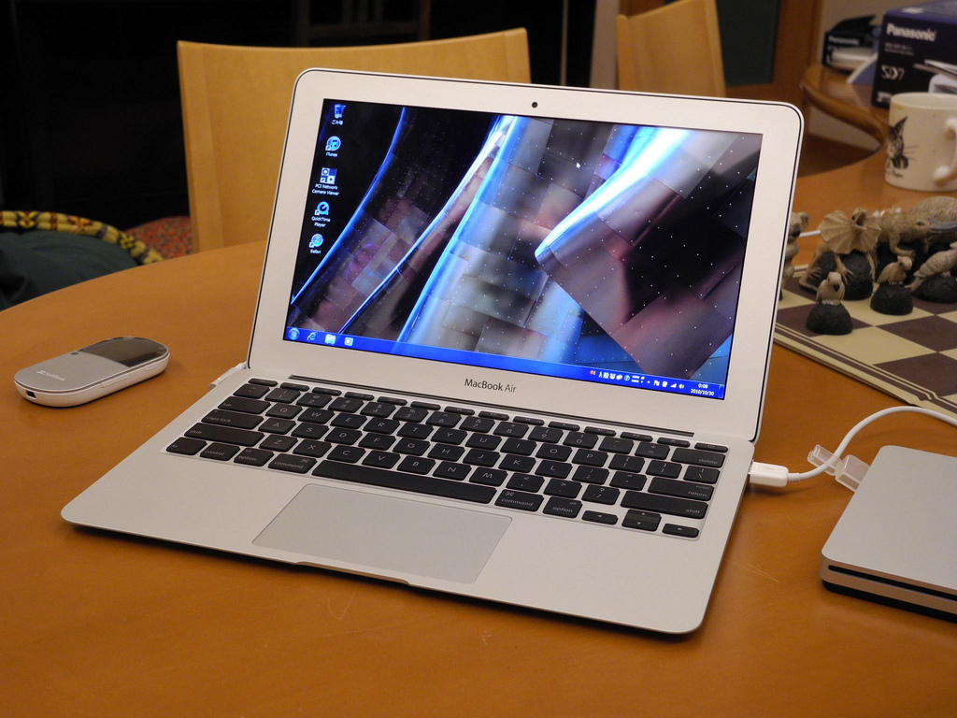
A fun thing I got.
Apple MacBook Air it’s 25.00
101
11-8
16
Amazon
540.00
Five hundred forty dollars and
00

Slide 3
This is going to be mario kart 7-->
This looks fun that's why got it.

Slide 4
My Donation Donation is to Casa.
I'm Donating 380,526.00 to Casa
102
11-8
16
Casa
380,526.00
Three hundred-eighty thousand, five hundred twenty-six dollars and 00
Notes:
THIS IS MY DONATION.

Slide 5
Lot’s more.
$20.00 for a Nintendo Selects: Mario Party: Island Tour
$13.50 for a Minecraft - Xbox One
$140.00 for a Nintendo Selects: Luigi's Mansion: Dark Moon - Nintendo 3DS
103
11-8
16
amazon.com
173.50
One hundred seventy three dollars and

Slide 6
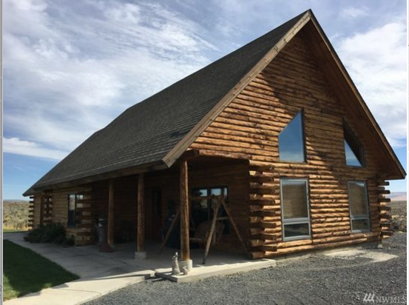
My house.
545 Sagebrush Dr,Ephrata, WA 98823
It’s $250,000.
104
11-8
16
Zillow house.com
250,000.00
Two hundred fifty thousand dollars and 00
Notes:
This is a good house I chose it I love it a lot

Slide 7
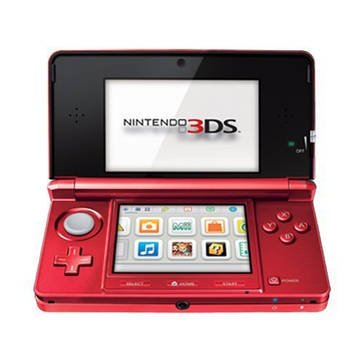
Another fun thing I got.
Nintendo 3DS - Flame Red $140.00.
104
11-8
16
Amazon.com
140.00
One hundred forty dollars and 00

Slide 8
My college
And the name is
University of Alaska Fairbanks And it’s OUT-OF-STATE-TUITION is
$21,354
105
11-8
16
University of Alaska
21,400.00
Twenty one thousand, three hundred-fifty four dollars and 00

