Slide 1
Octaville Documentation and self reflection
By Jaitin P.

Slide 2
Requirements
2 Parallel lines
1 Intersecting line
1 perpendicular line
8 3-D Buildings/structures
Extra’s
Must be colorful/visually appealing
Geometry/math themed names
Is “I have it on my build”
Is “I don’t have it on my build”
KEY

Slide 3
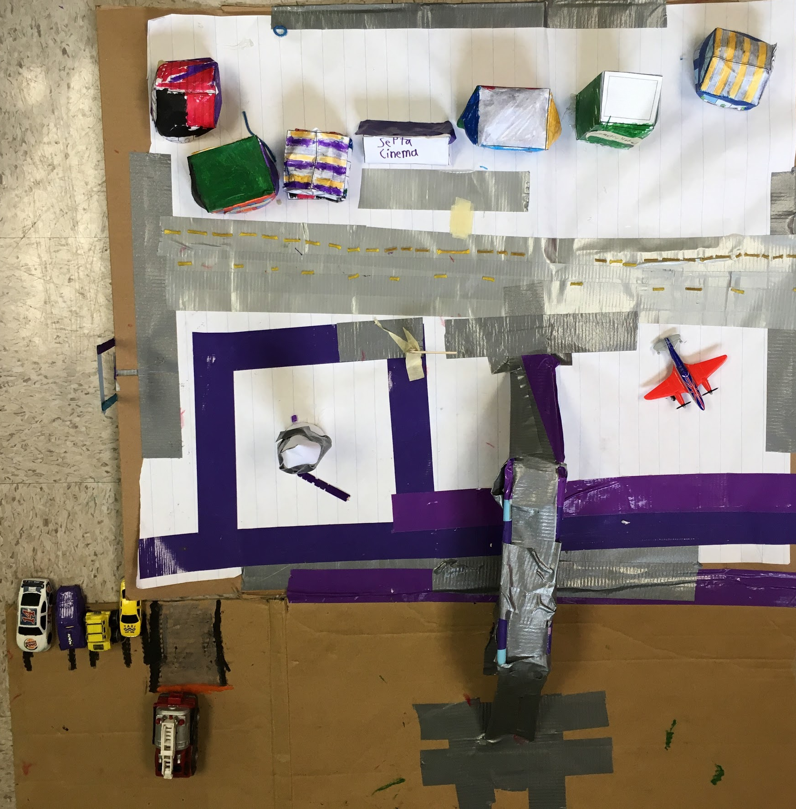
INTERSECTING LINE
Perpendicular line
Parallel Lines
8 3-d buildings
5+ extras

Slide 4
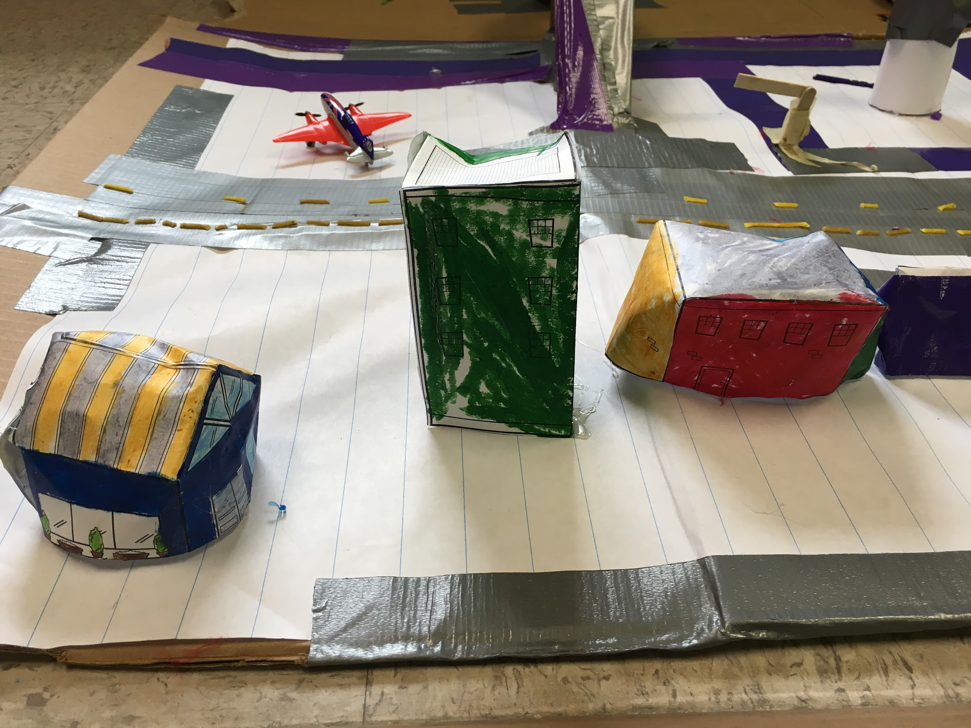
Geometry hotel
Quad-Mart
Septa cinema
Rectangular
Prism
Rectangular
Prism
Pent-way
sandwiches
Rectangular Prism & Triangular Prism

Slide 5
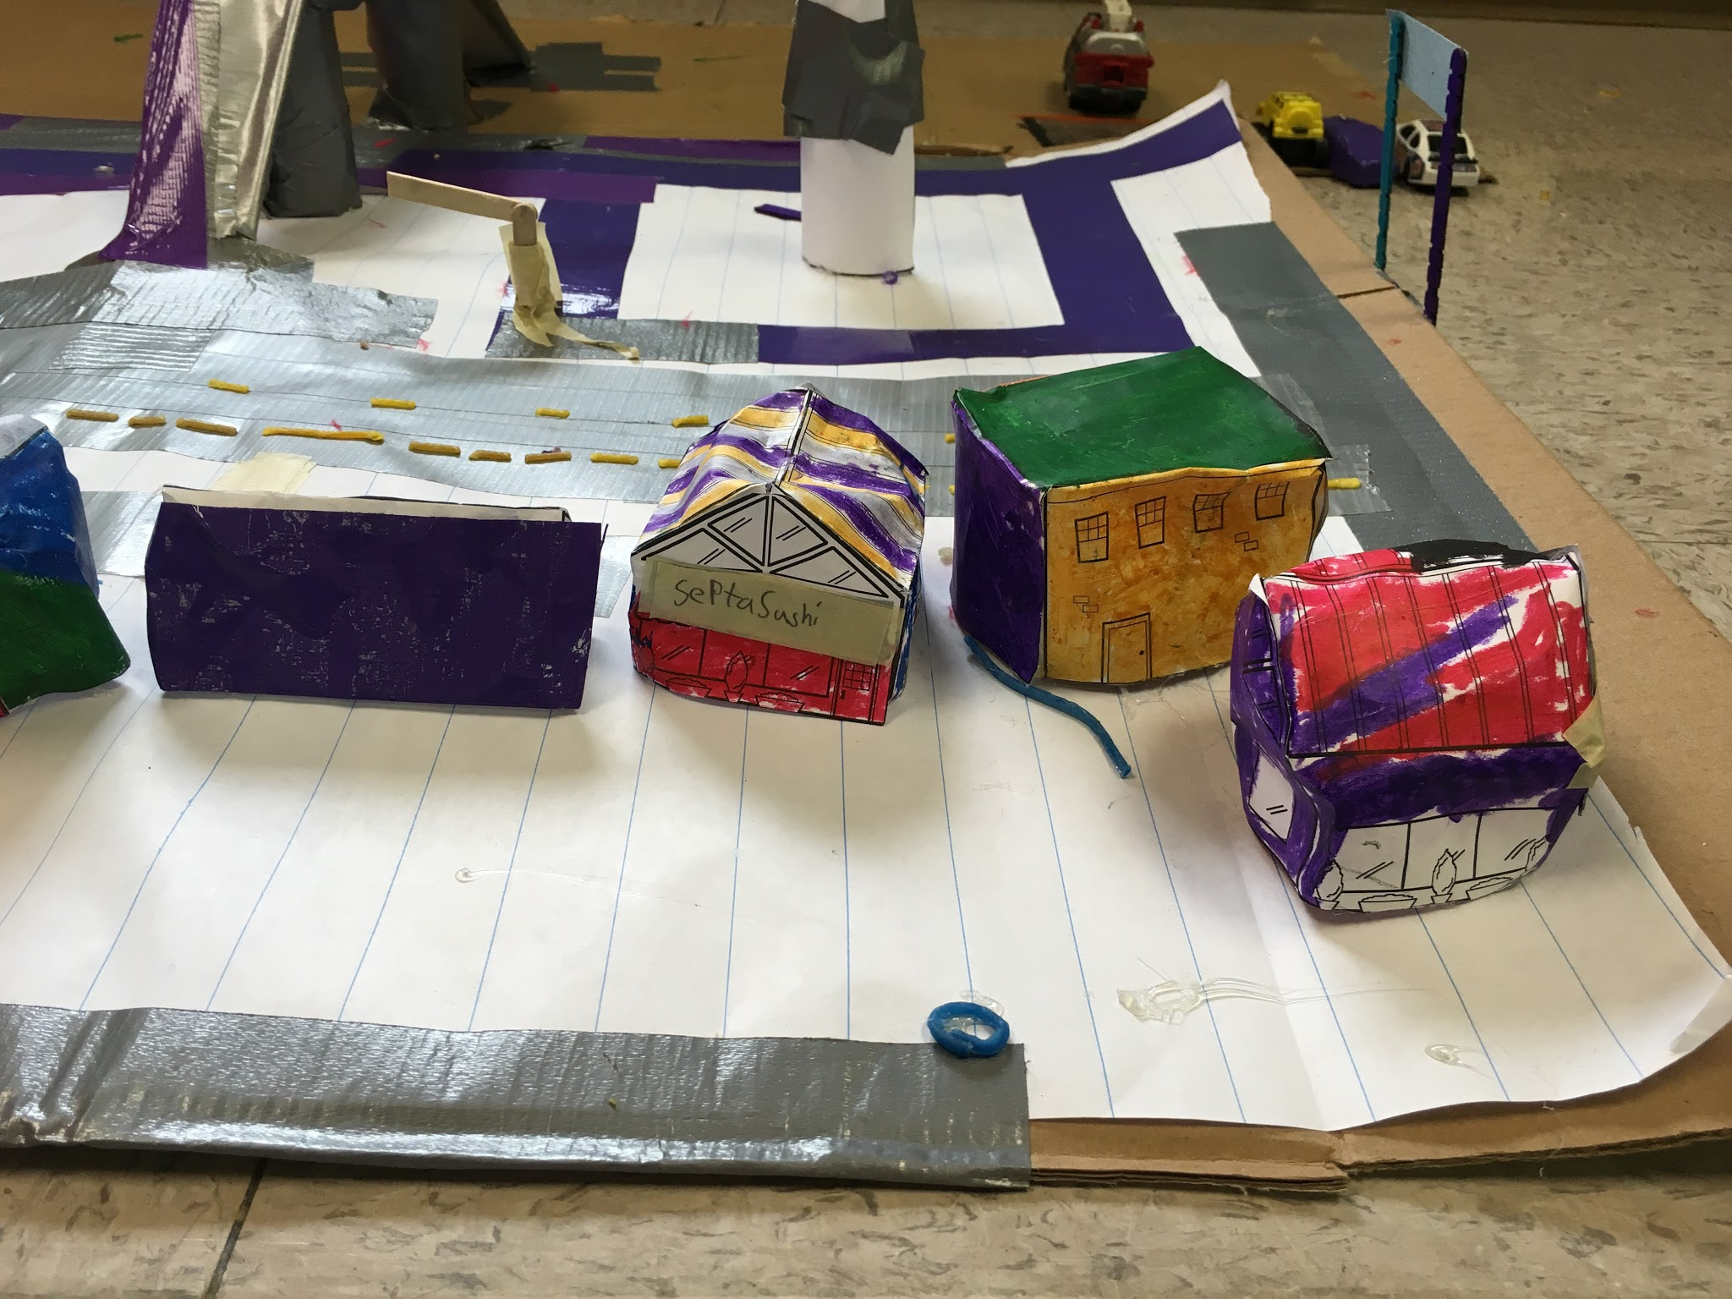
Rectangular Prism & Triangular Prism
Rectangular
Prism
Septa cinema
Triangular Prism
Triget
Septa Sushi
Penta-pets
Rectangular Prism & Triangular Prism

Slide 6
Q #1 Have you done a similar kind of work in the past (earlier in the year or in a previous grade; in school or out of school)? Yes I have and we made games in that previous project.
Q #2 What problems did you encounter while you were working on this piece? How did you solve them? I ran into the space problem. I fixed it by adding more baseplate to get more space.
Q #3 What were your standards for this piece of work? My standards were #1 A large high quality city.
Q #4 Did you meet your standards? At about 70%
Q #5 What grade would you give it? Why? I would give it a B+ for the quality.
Q #6 In what ways did it not meet those standards? I used duct tape for roads when black paper looks more like asphalt.
Q #7 One thing I would like to improve upon is The roads.
Q #8 What would you like to spend more time on in school? Building with boxes.

