Slide 1
SEPTASISCO
BY: PARKER

Slide 2
Reflection
I think I need to improve on focusing on the must haves in the builds rather than the can haves.
Before we started, I thought I was going to be just fine and finish easily, but boy I was wrong.
I had some mistakes and changes while building. My build didn’t turn out the way I wanted.
I think it was a little overwhelming and stressful.
I knew a quite a bit of info about the build before it started. Mostley because Mrs. Devora gave us info.

Slide 3
Checklist
8 buildings
2 parallel roads
1 perpendicular road
1 interesting road
5 other things
Make it visually appealing

Slide 4
Car
Builder of Car: Marc

Slide 5
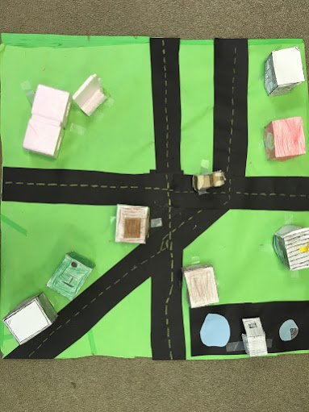
Acute Av.
Penta Playground
Rays Rd.
Parallel roads
Right angle Rd.
Perpendicular roads
Cubic Av.
Intersecting road

Slide 6
Stores
Heptaggens
QuadFC
Microsepta
Rectangular Prisms

Slide 7
Restaurants
McDangles
iHepta
Quad piece McNugget
Rectangular Prisms

