Slide 1
Icosa Island
self reflection.
By Karina.

Slide 2
The requirements.
(Hint:Things that must be on our build.)
2 parallel roads.
1 perpendicular road.
1 intersecting road.
8 3-D shaped building/structures.
5 other things.
Town places &/or town itself must be named math/geometry named.
the town must be visually appealing.

Slide 3
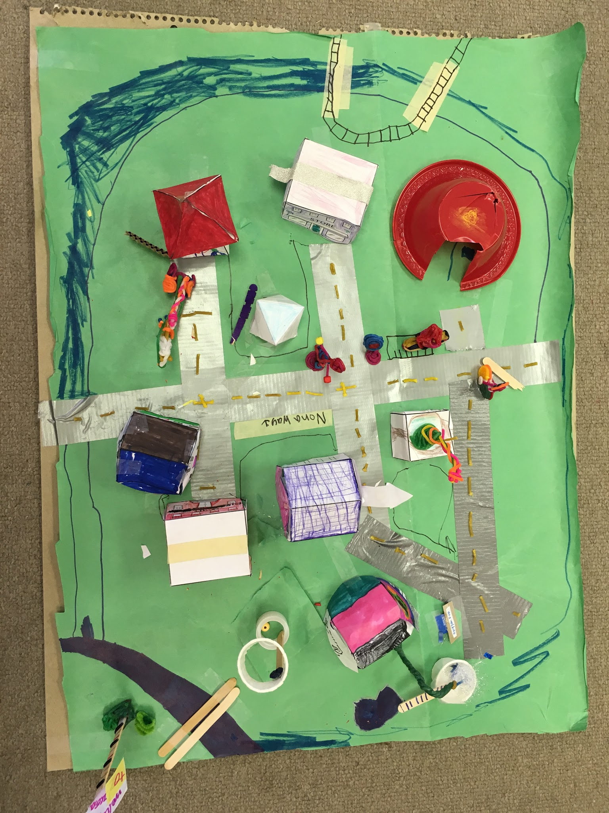
Birds eye view.
Taken by mrs.devora
Keys: blue, polygon pool rest area. Dark red, Acute Elementary. Magenta, the Tri Church. Red, hepta hospital. White, The tetras house. Brown, the straight family house.
Parallel roads!

Slide 4
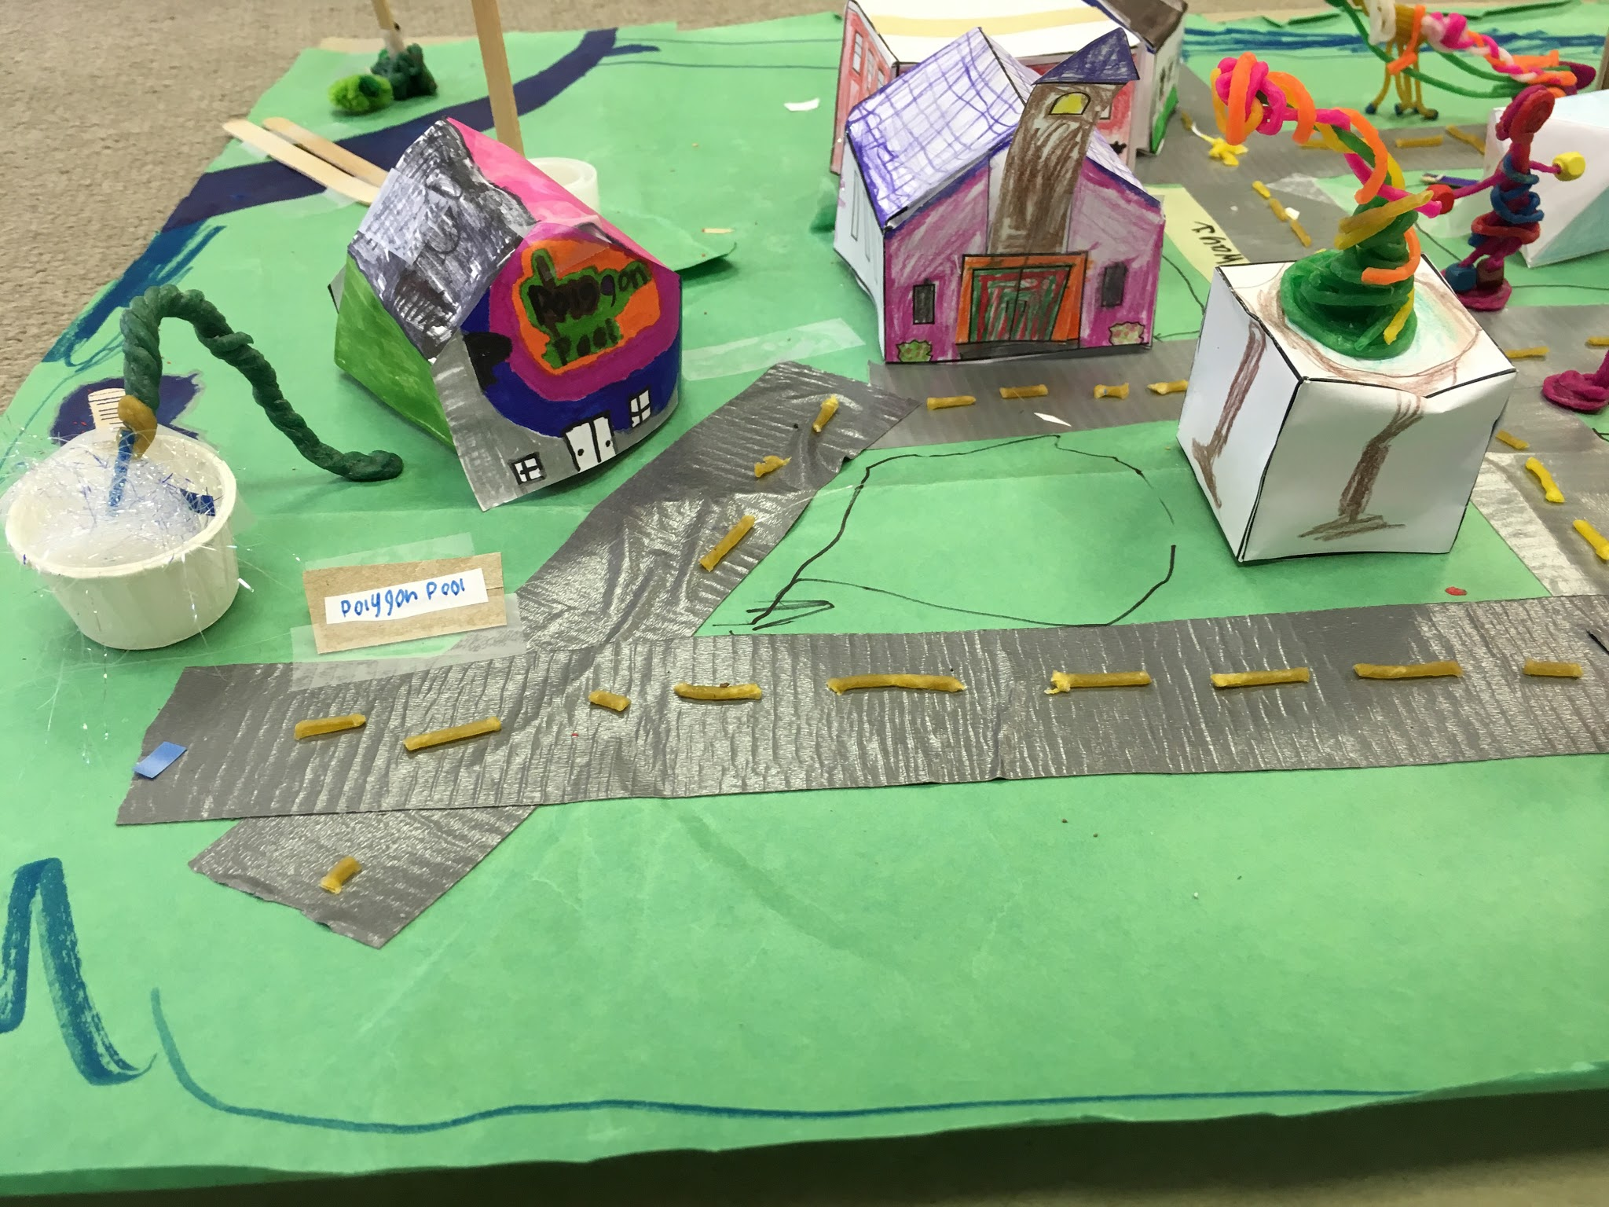
Polygon Pool Changing room & pool.
Taken by Mrs.devora.

Slide 5
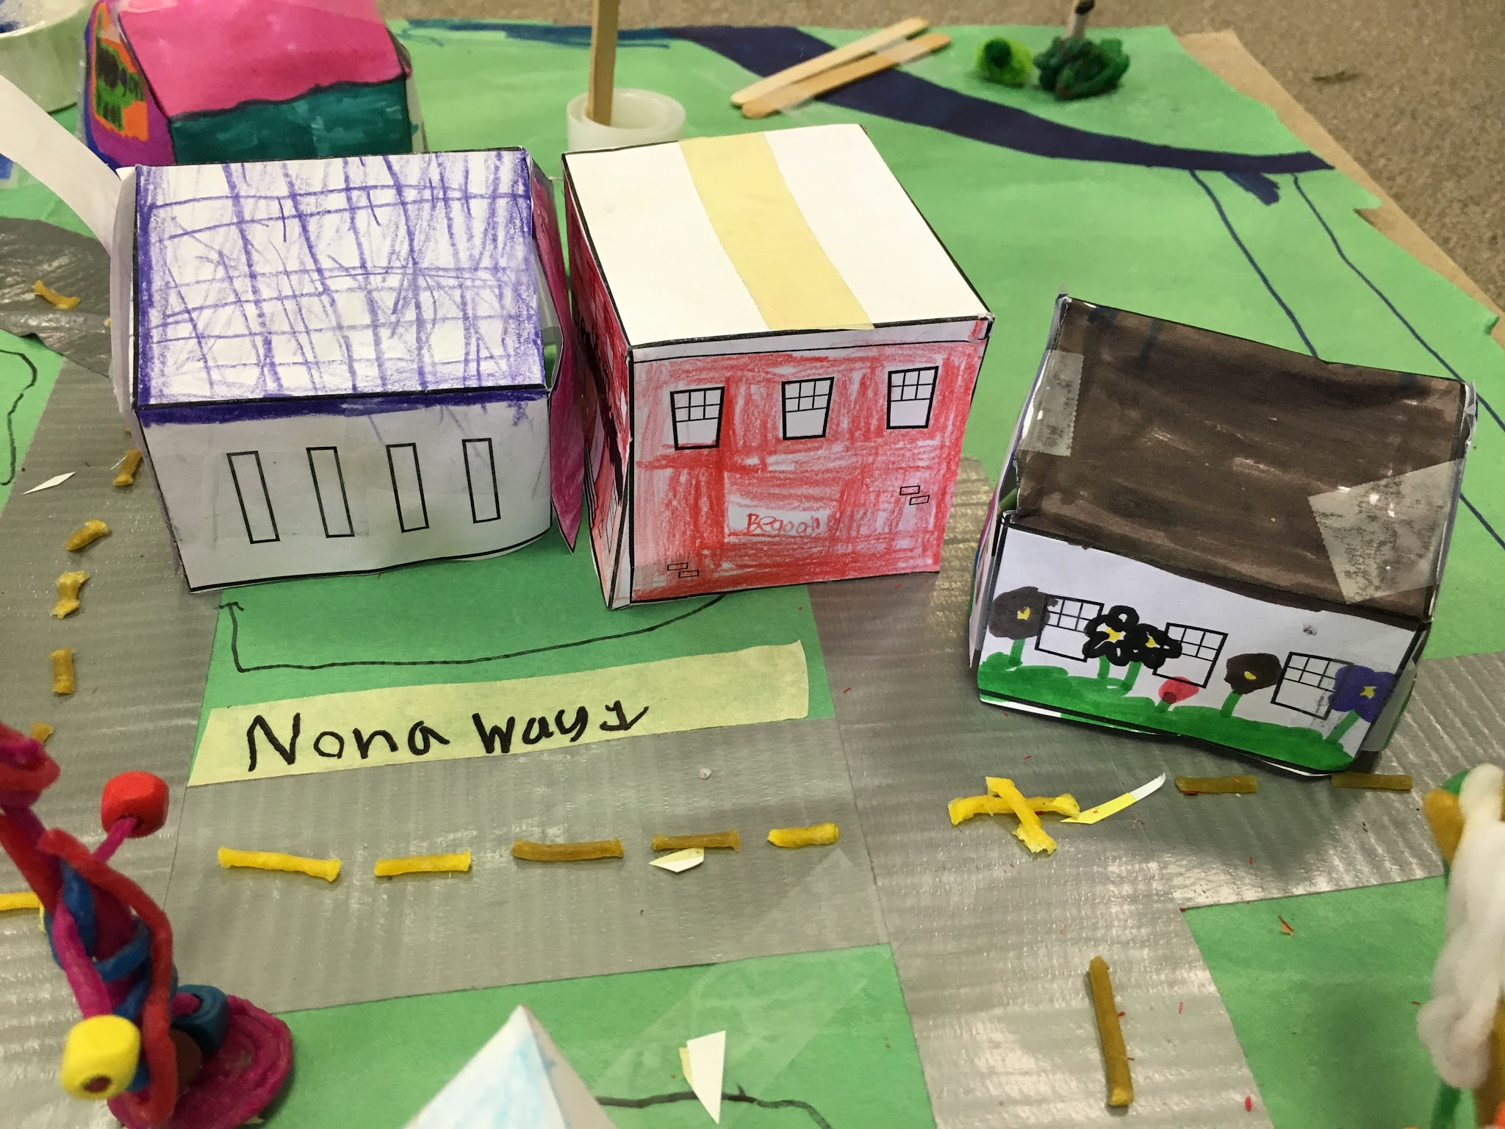
Nona way

Slide 6
The tetra family’s house.

Slide 7
The straight family

Slide 8
Icosa
Island
sign
Made by karina

Slide 9
My self reflection.
1. Q : How much did you know about the subject before we started? Well, I know that it would be really fun and some side tracks would come and go. 4. Q : In what ways have you gotten better at this kind of work? If we did more makerspace before this one, we would make them look like real towns and cities. 11. Q : What did/do you find frustrating about it? Lots of and lots of figuring out where to place buildings and naming all of them. Q : 8. Does this work tell a story? No probably not, ‘cause i’v not ducsussed it with my partner. Q : 13. Did you meet your standards? Yes I did meet my standards. Q : 17. Have you changed any ideas you used to have on this subject? Yes, like the names.

