Slide 1
Spending one million dollars
By: Joseph

Slide 2
Casa
I will send money because I what to help animals that have no food or shelter.
I will send $435,000. 00

Slide 3
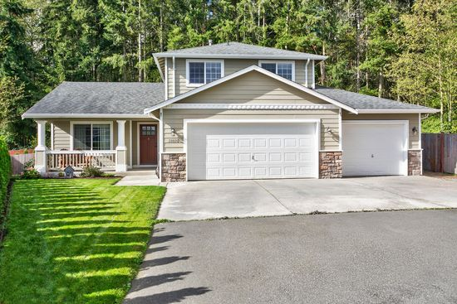
28030 73rd ave nw
I’m going to buy the house so that my family and relatives will have a place to stay in.
It costs $334,950. 00

Slide 4
Savings account
I save money in my bank so I can buy stuff.
I will save $109,851.10

Slide 5
University of WA
I save money because I want to go to college.
I will save $102,500 for college

Slide 6
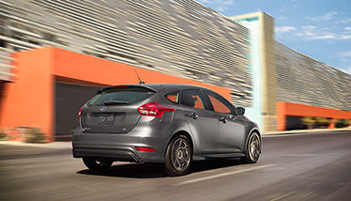
My car
It costs $17,225. 00
I will buy the car so that my family and I can go visit places.

Slide 7
Dragon Ball Xenoverse 2
It costs $50.00
I like this game.

Slide 8
Star Night Laser Shower
I want a night light because I want it for Christmas.
It costs $40.00

Slide 9
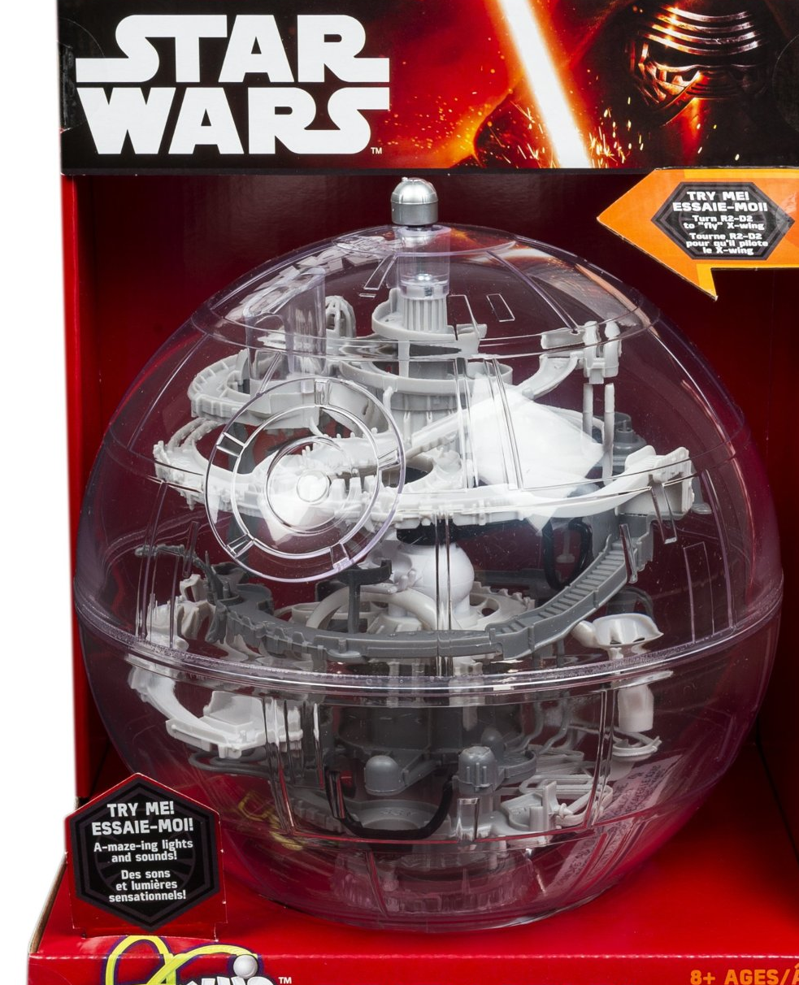
Spin Master Games - Star Wars Death Star Perplexus
It costs $29.10.
I want to play this toy with my dad.

Slide 10
Wii U Precision Screen Filter
It costs $8.00
This will protect my screen.

Slide 11
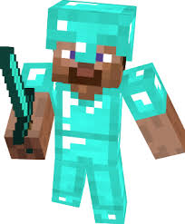
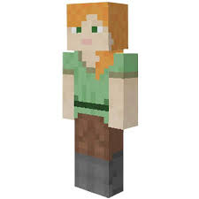
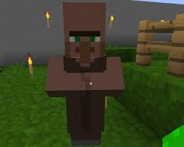
Minecraft pocket edition
I like this game so I can build houses.
It costs $7.00

Slide 12
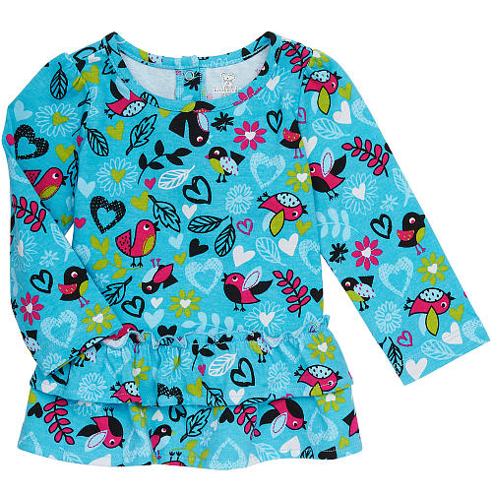
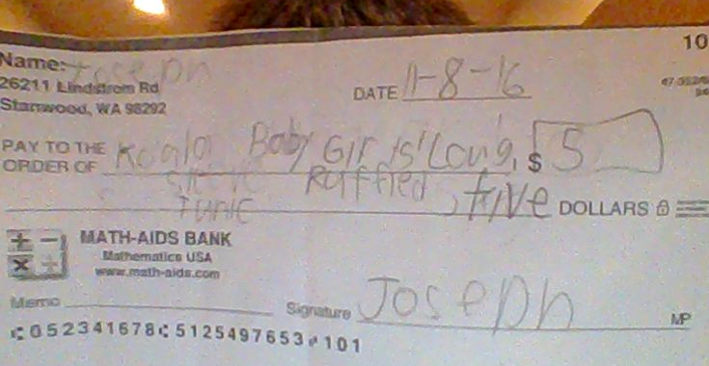
Koala Baby Girls' Long Sleeve Ruffled Tunic
I want to give my baby sister a new dress.
It costs $5.00

