Slide 1
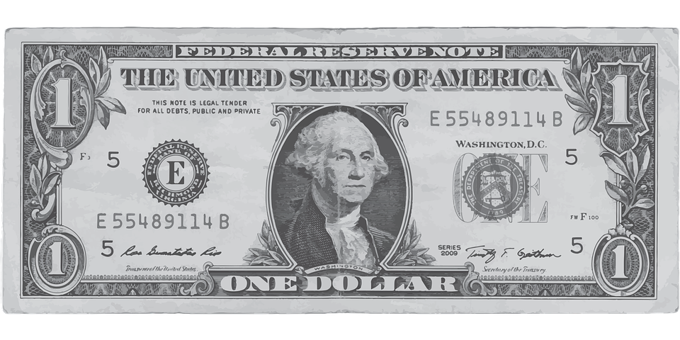
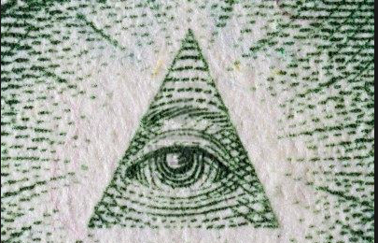
Spending portfolio
By Kameron
Artist: Thomas M and artist helper: Brendon M Assistant: Samantha K

Slide 2
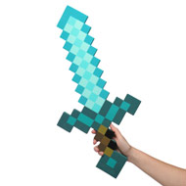
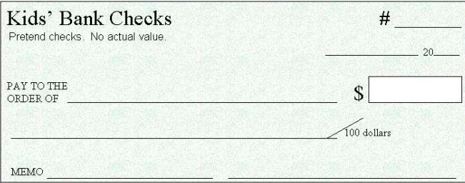
Minecraft diamond sword
I want to get this because I love minecraft
100
11/8/16
Gamestop
15.00
Fifteen dollars and 00

Slide 3
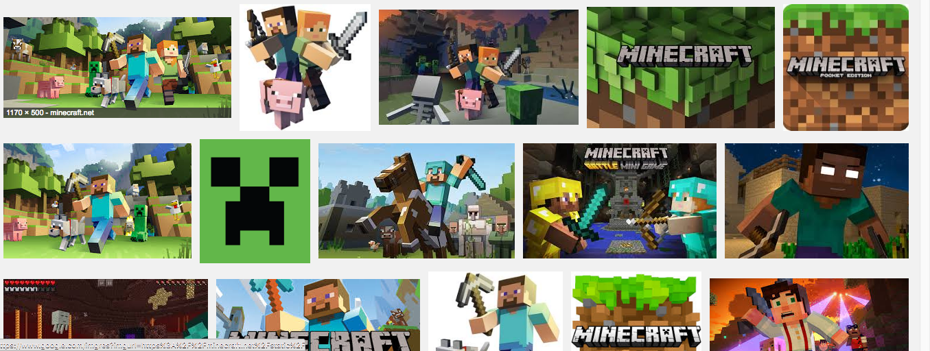
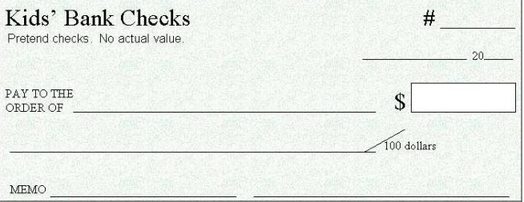
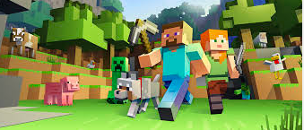
101
11/2
00
16
Toys r us
Toys r us
30.00
29.99
Thirty dollars and 00
I want to get minecraft because I like video games.

Slide 4
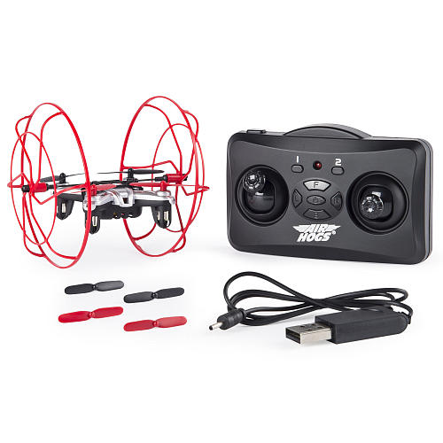
102
11/8/16
Toys r us
35.00
Thirty five dollars and 00
I want to get this because I love toys.
AIR HOG

Slide 5
103
11/8/16
Toys r us
59.99
Fifty Nine dollars and 99
I want to get this because I love sports.

Slide 6
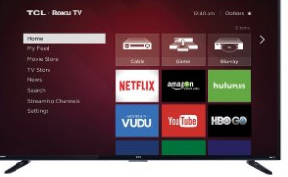
FLAT SCREEN TV
I want to get this because I like waching
Tv with my friends and family
TCL
HBOGO
N
E
T
F
L
I
X
Show Store
VUDU
HULUPLUSE
I don't know
You
Tube
104
11/8/16
amazon
500.00
Five hundred dollars and 00

Slide 7
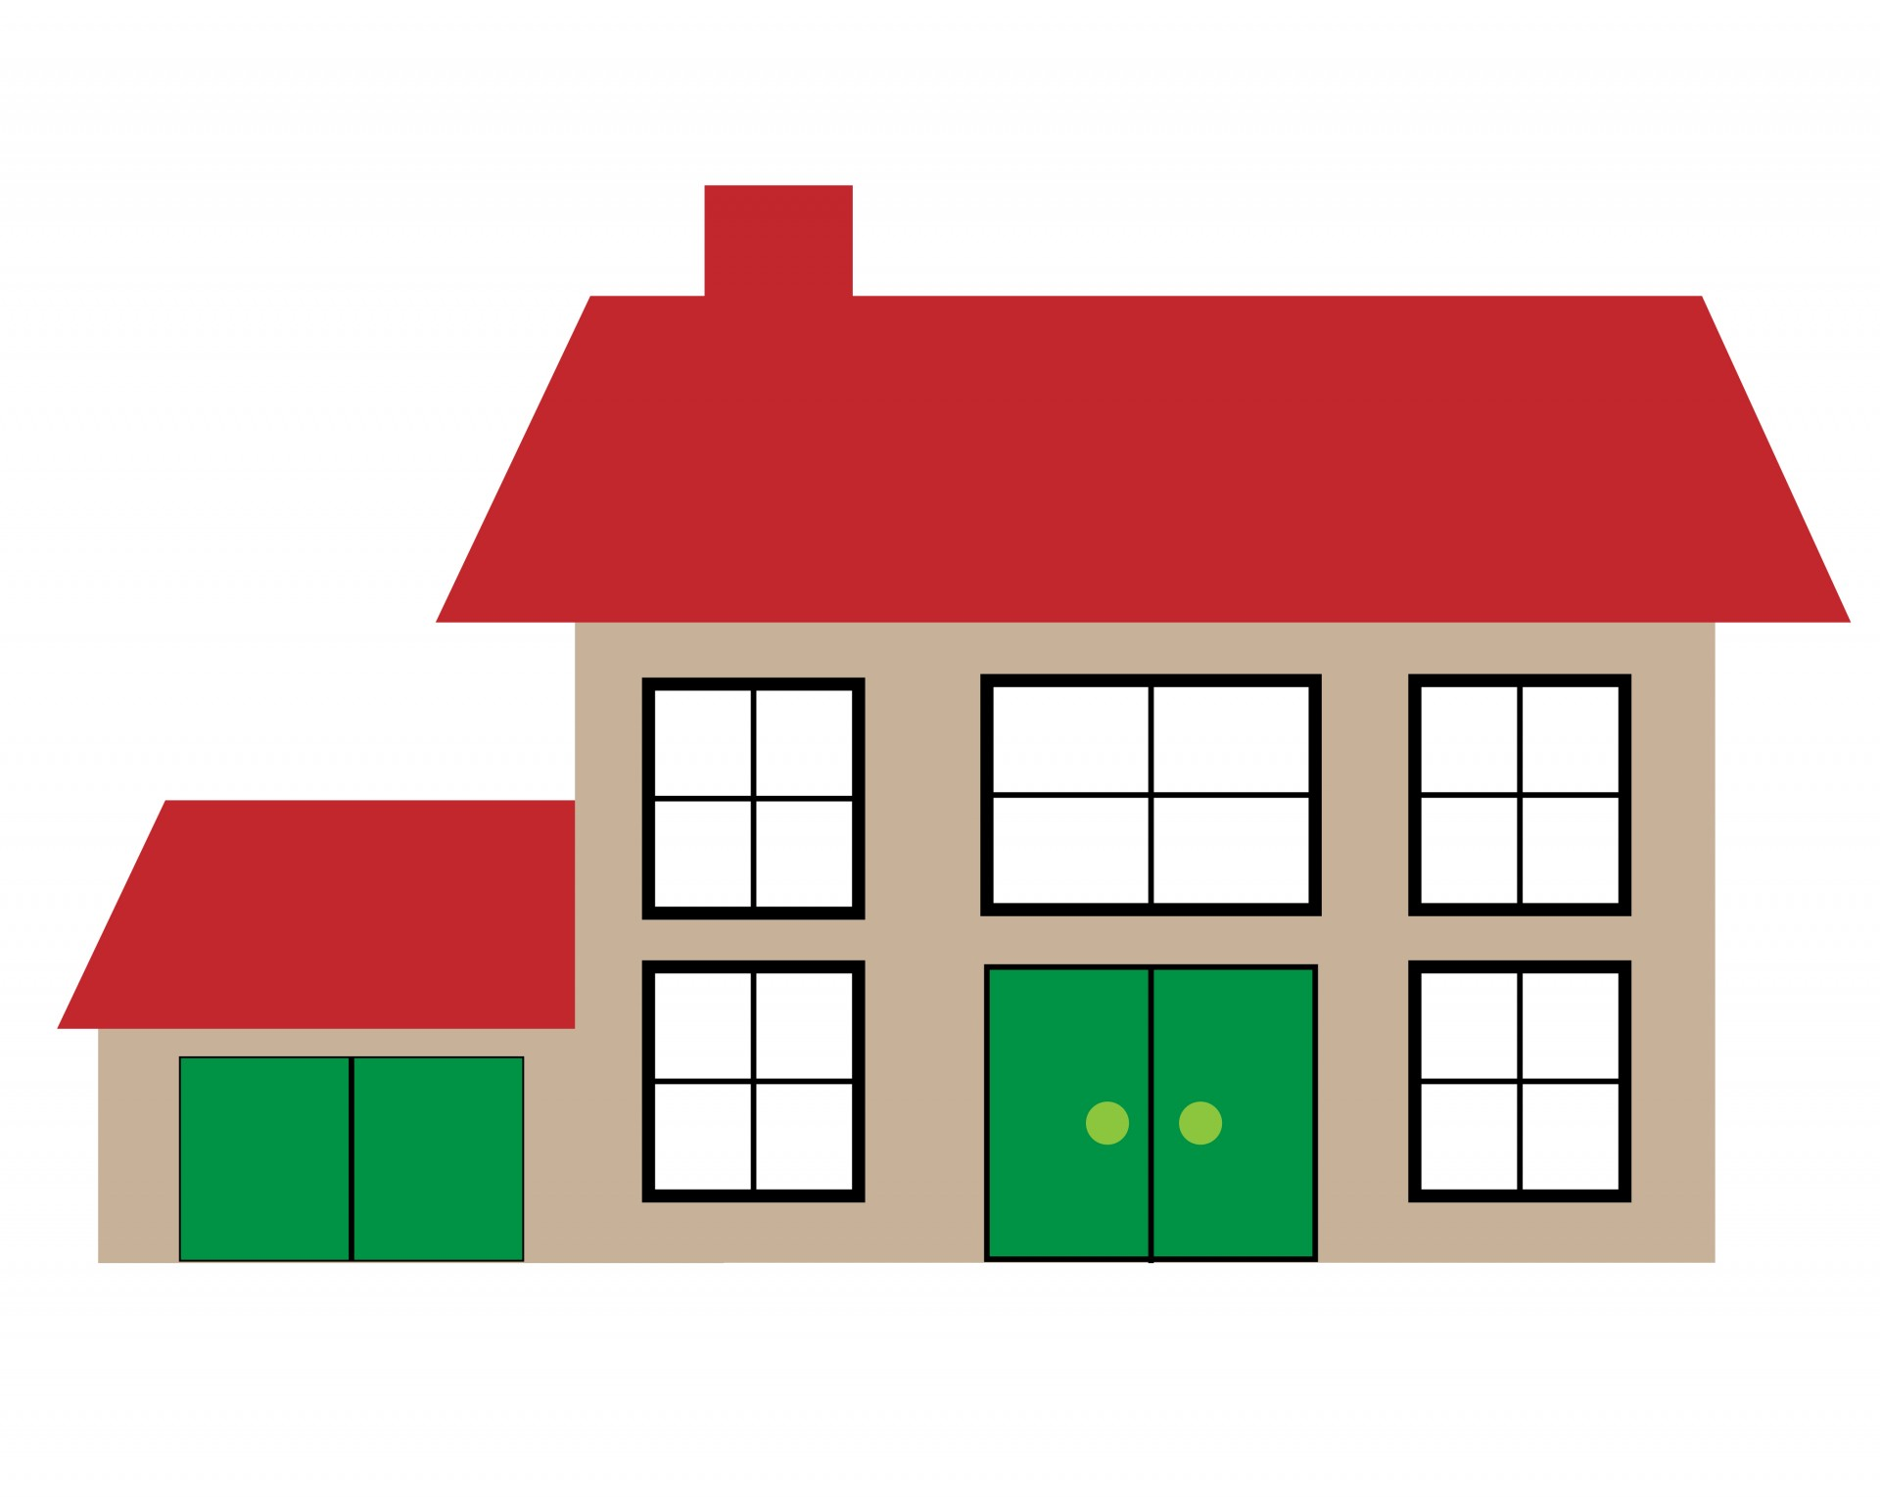
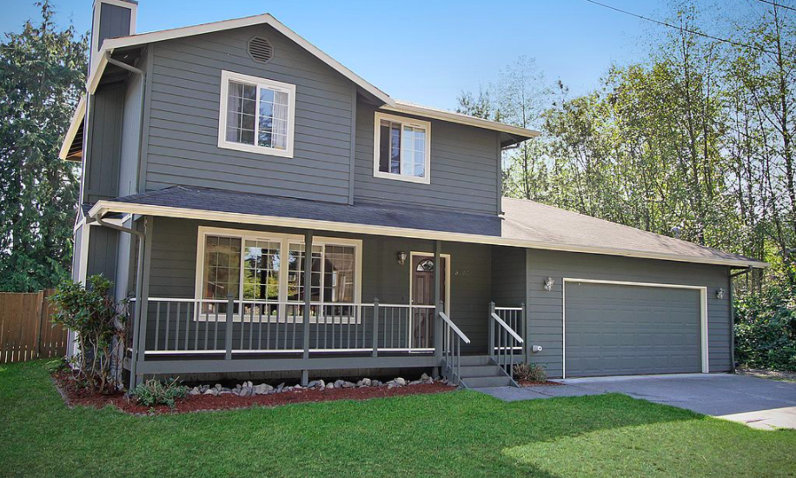
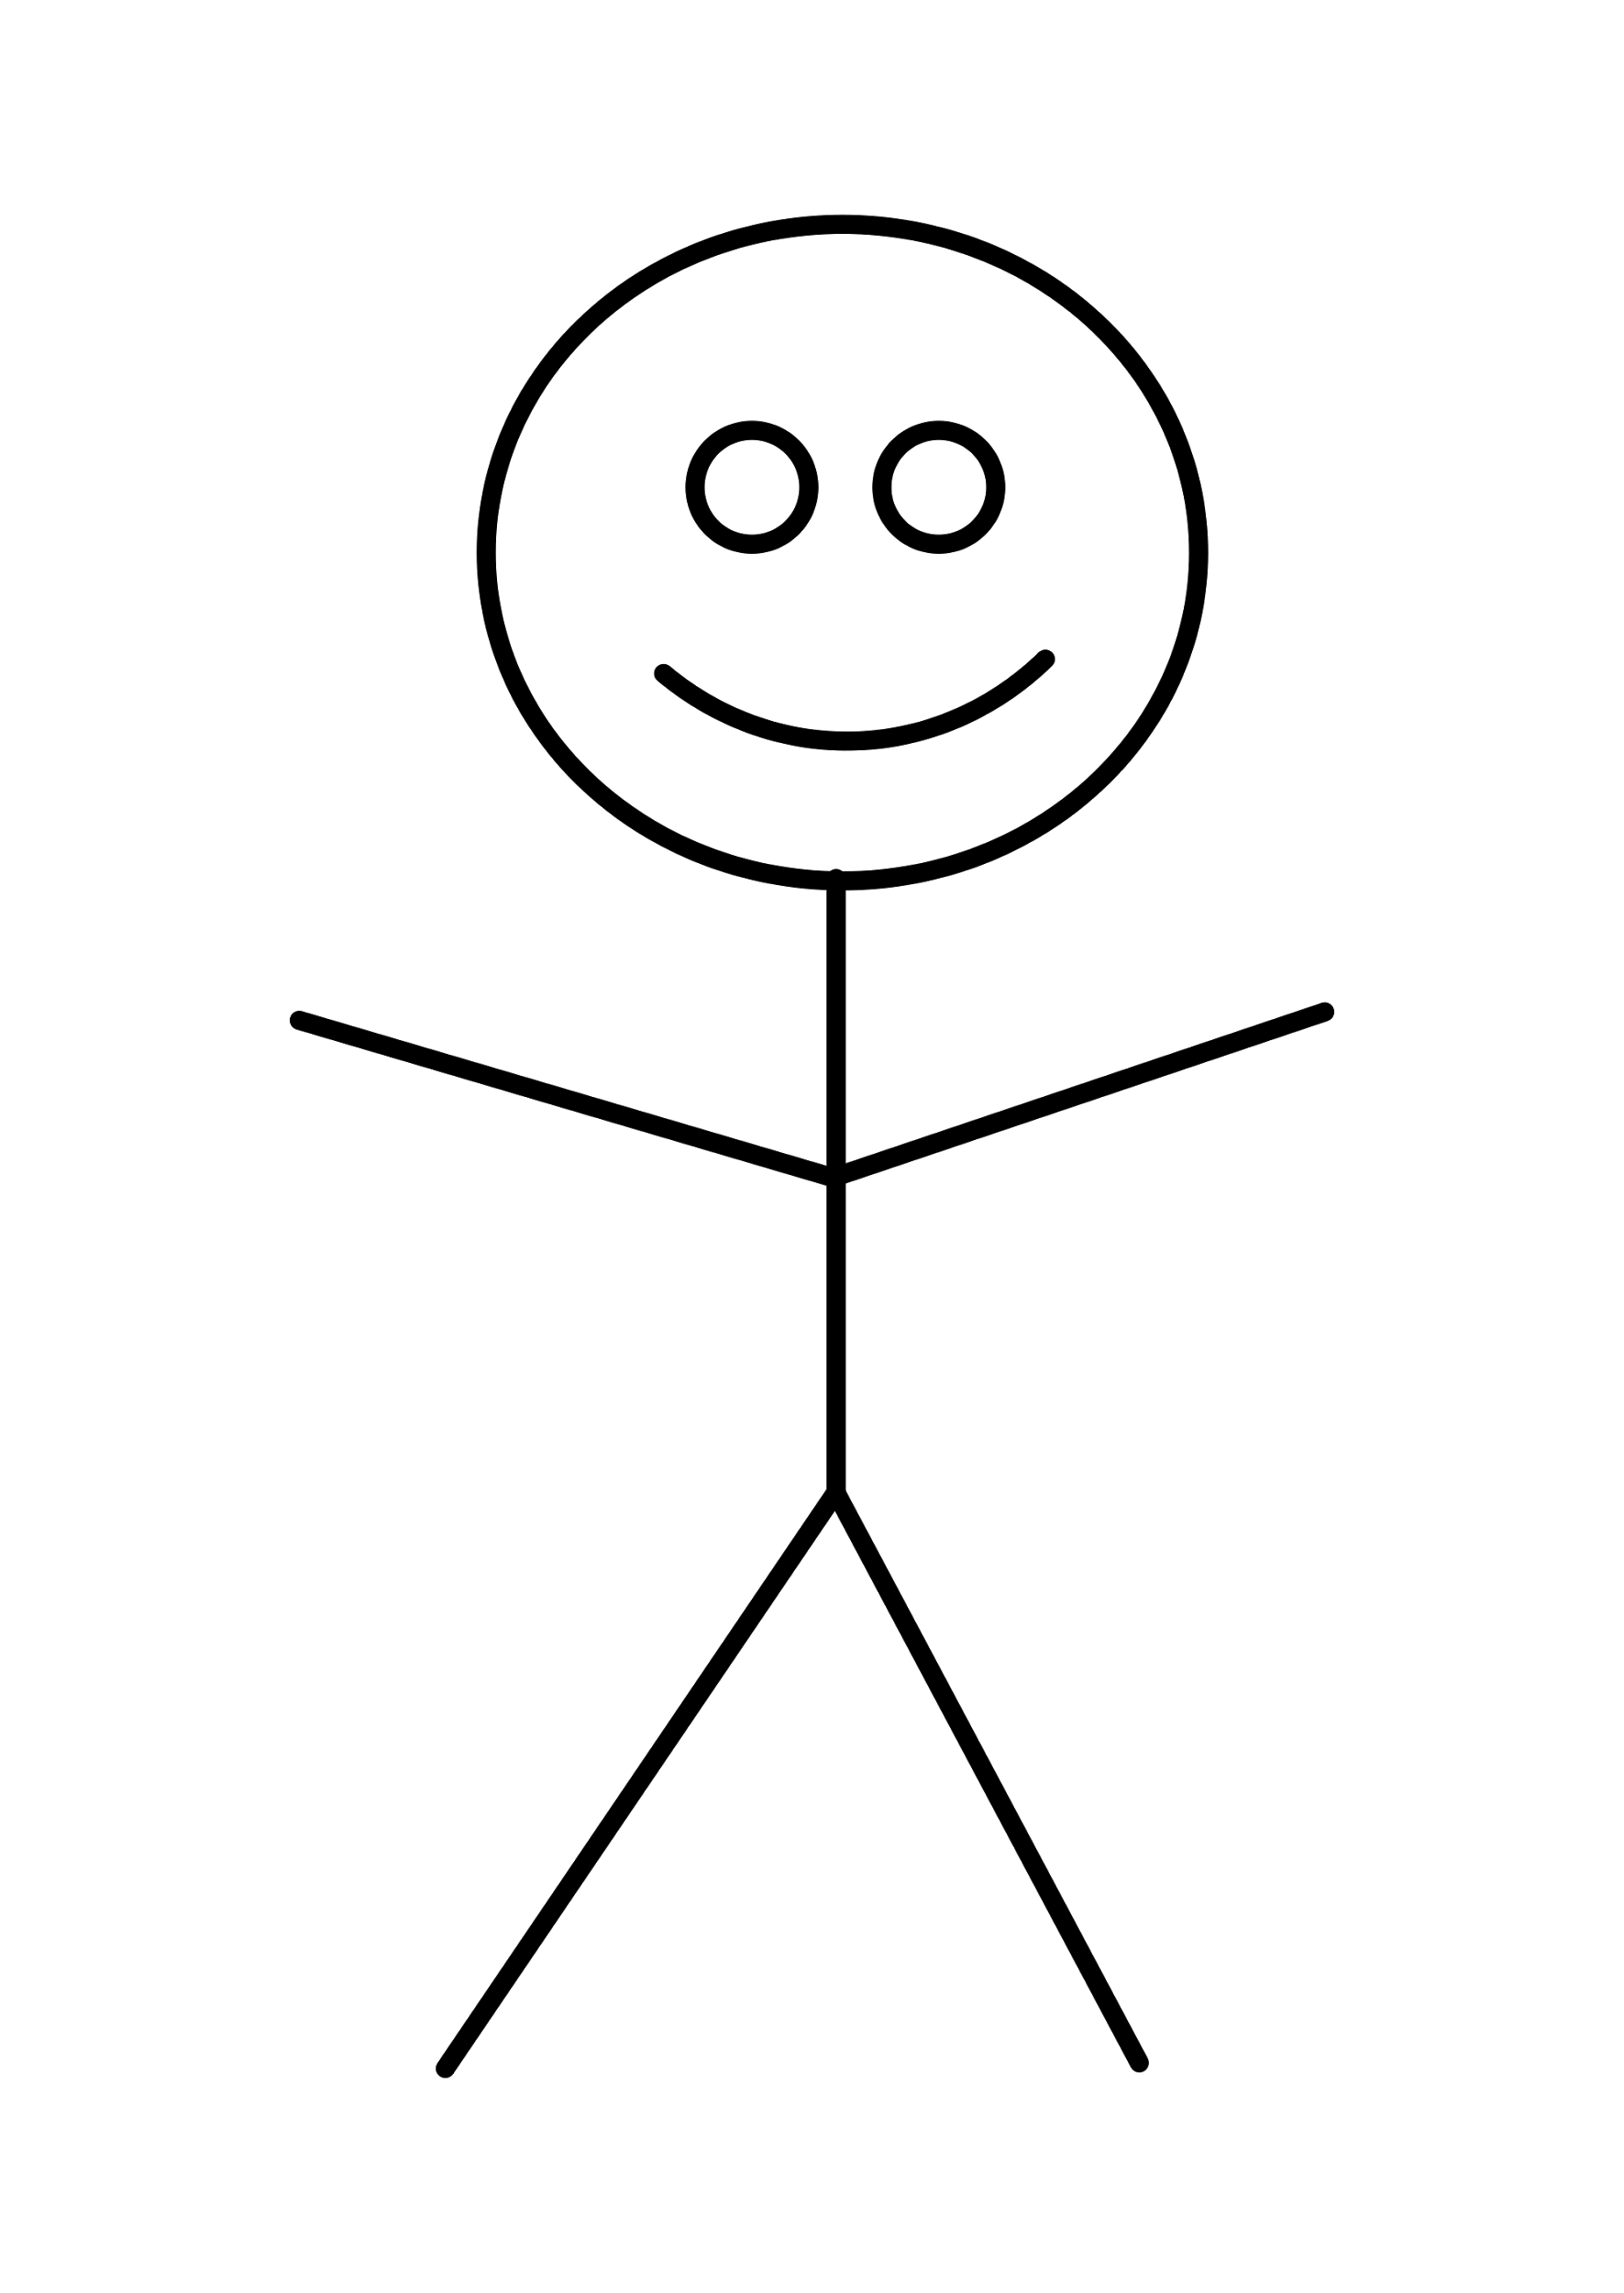
100
11/2
16
Zillow
I want to get this house because I want to live in cooper station
310,000.00
Three hundred, ten thousand dollars and 00
00
hi

Slide 8
Saving account
698,360.01

Slide 9
1,000,000!

