Slide 1
Spending portfolio
By: Willa
I have $1,000,000!!
1
1
1
1

Slide 2
Savings for future things
I saved $496,672.00 from my $1,000,000!! I spent $503,328.00 out of my $1,000,000!
I have some extra money to keep for future stuff!!

Slide 3
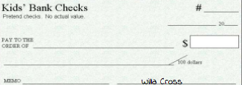
Pet charity donation so I can help pets in need!
Yay! Donations!
Come on, fellow puppies and kittens!
Yorkie
23
CASA
300,149.00
Three hundred thousand, one hundred forty nine dollars and
00
Pet charities

Slide 4
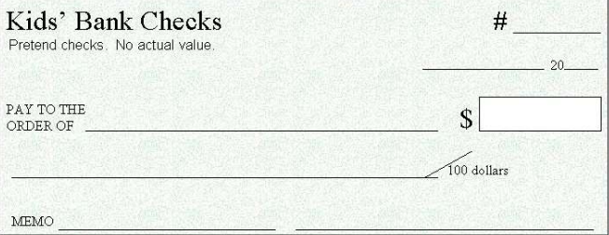
College fund so I can get a PhD!
I have a PhD!
24
University of Washington
102,500.00
00
One hundred-two thousand, five hundred dollars and
College fund (PhD)
Willa Cross

Slide 5
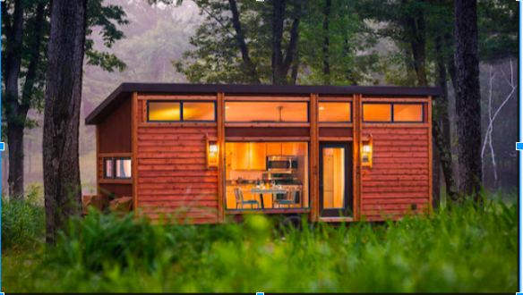
269 square foot tiny house so I can have somewhere to live, not spend too much money, and travel in my own home!
22
11-4
16
Dan George Dobrowolski
66,600.00
Sixty-six thousand, six hundred dollars and
00
House

Slide 6
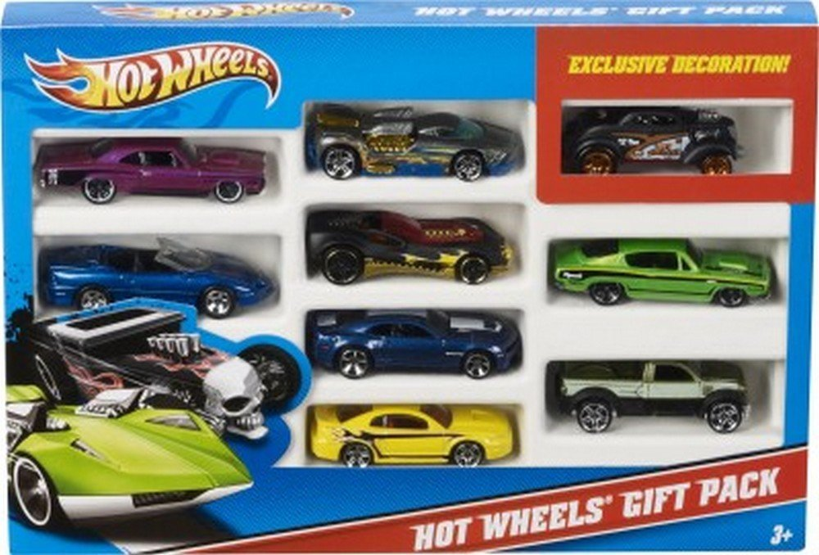
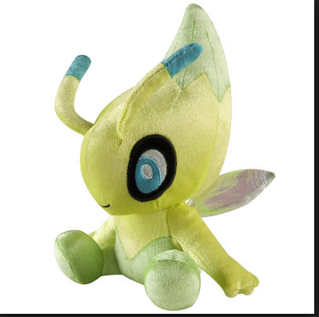
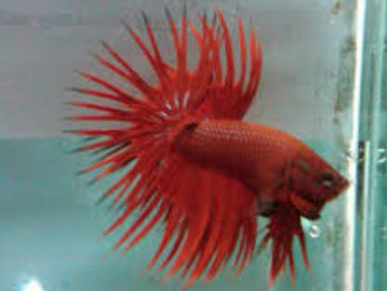
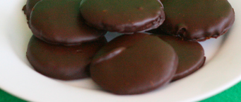
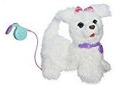
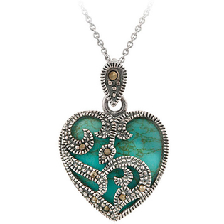
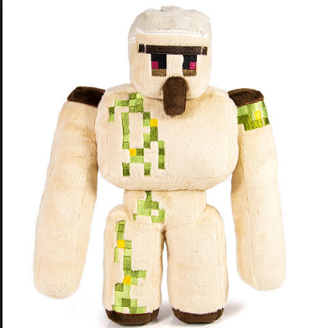
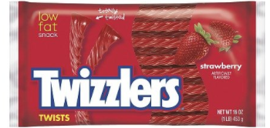
Gifts for friends and family because they deserve presents!
25
Amazon.com and CASA
1,455.00
00
One thousand, four hundred fifty-five dollars and
Gifts for friends & family
Willa Cross

Slide 7
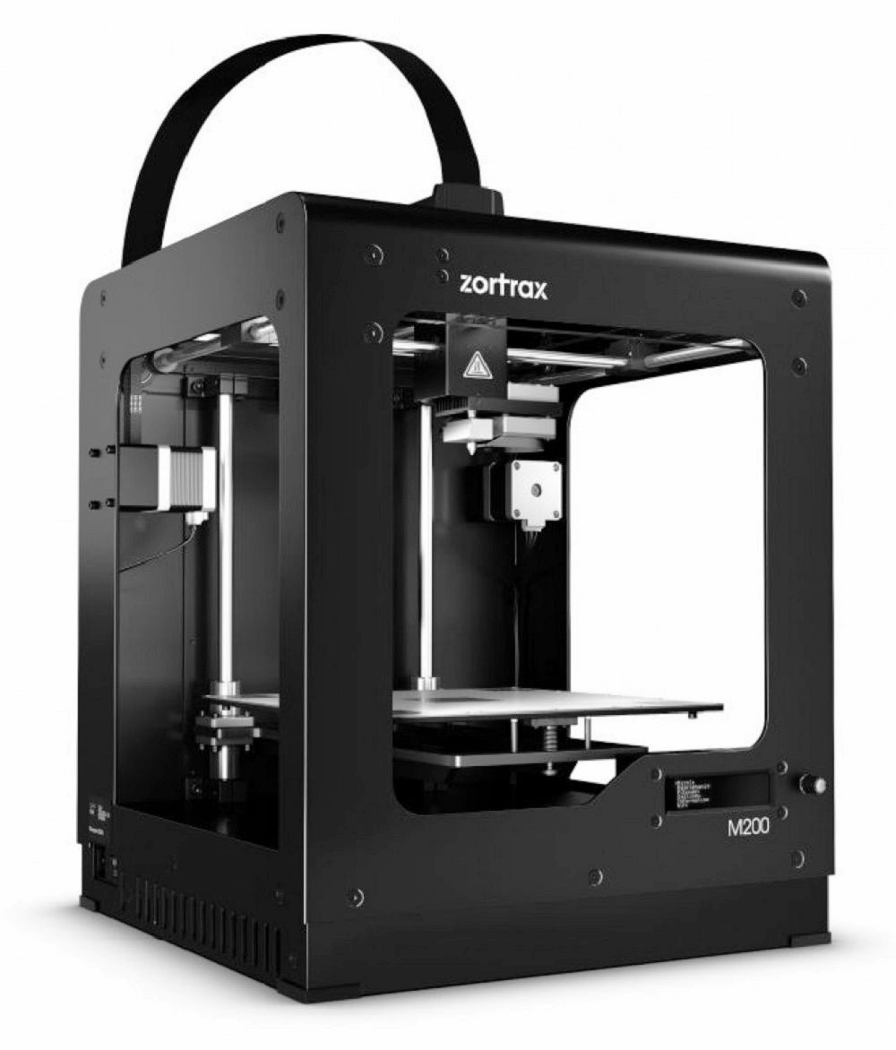
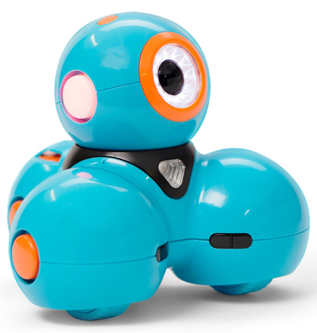
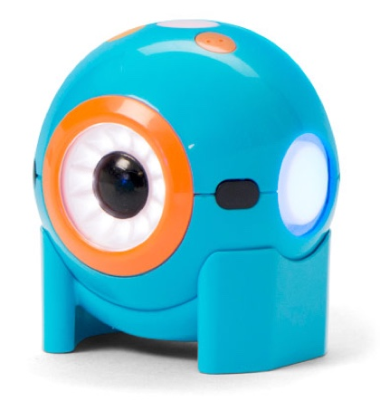
3-d Printer so I can print stuff like Dash and Dot the robots!
Microsoft
1,000.00
00
One thousand dollars and
3d printer

Slide 8
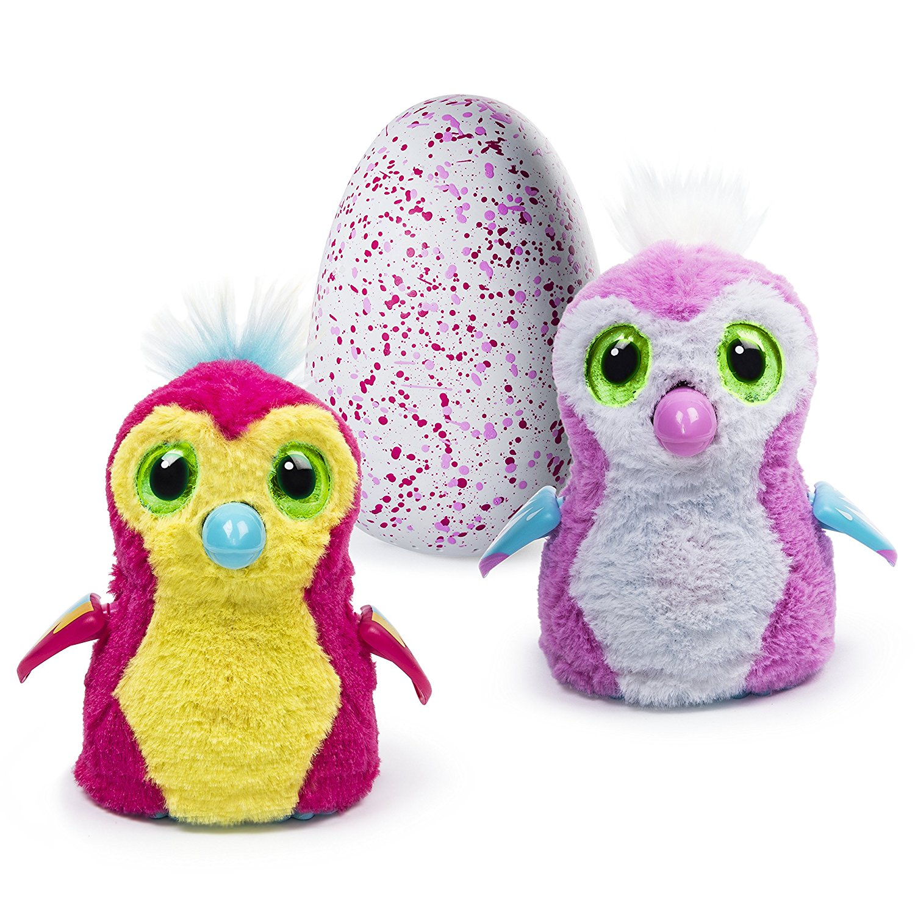
Hatchimal egg so I can play with him/her!
Spin master
$150.00
One hundred fifty dollars and

Slide 9
New 11-piece china tea set so I can have tea parties!
Amazon.com
100.00
00
One hundred dollars and
New china tea set

Slide 10
FurReal Friends My Jumpin Yorkie Plush so I have her to play with!!
23
Amazon.com
40.00
00
Forty dollars and

