Slide 1
St.Patrick’s Day
By Jaren

Slide 2
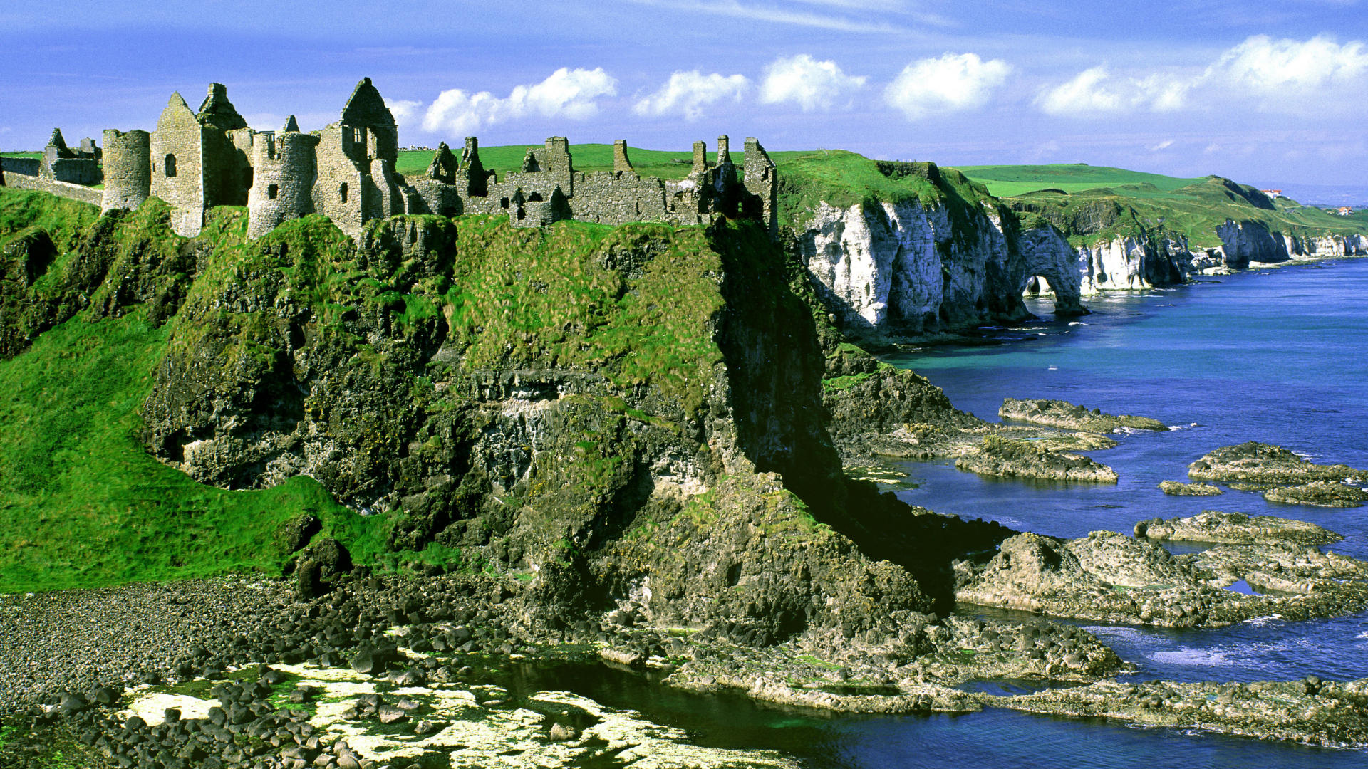
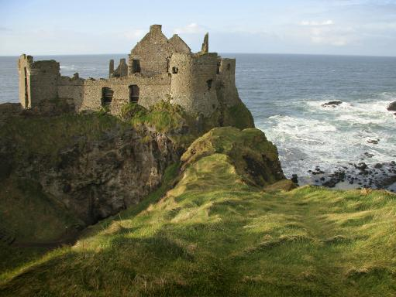
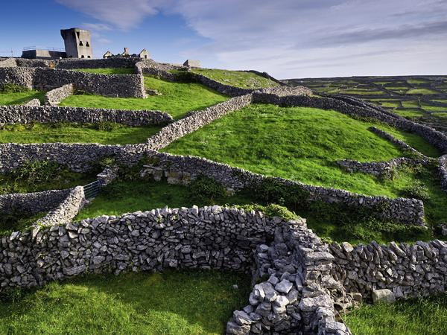
Ireland
Bagpipe music
Ireland is in Europe and was where St.Patrick lived. Bagpipes were played often. This is a news article “While the western part of Ireland is known for its breathtaking mountain scenery, majestic sea cliffs and traditional Irish music and culture, the eastern half of the country, known as Ireland’s Ancient East, harbours a treasure trove of historical highlights ranging from prehistoric passage tombs to lively medieval towns and cities, magnificent monasteries and atmospheric ancient abbeys.”

Slide 3
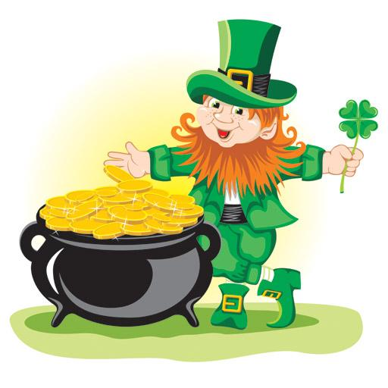
Leprechauns
It has been debated and unexplained if leprechauns exist. If they do, people think they live in Ireland. They have been said to have pots of gold. Also if you catch one, they give you 3 wishes. Finally, if you do not wear green on St.Patrick's day, Leprechauns will pinch you.

Slide 4
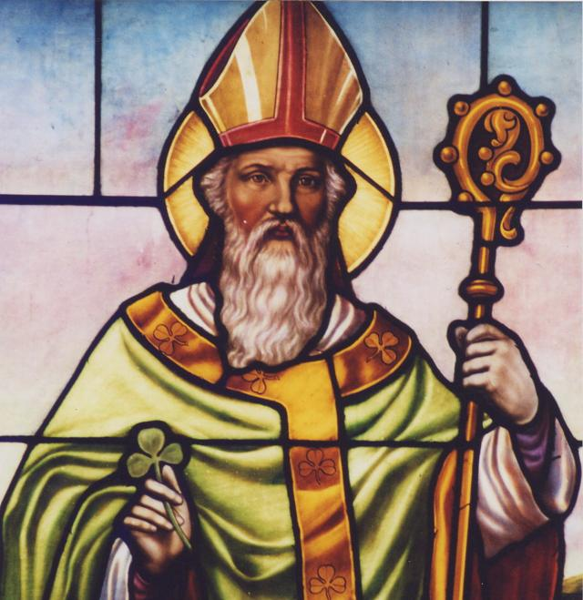
St.Patrick
Saint Patrick was a fifth-century Romano-British Christian missionary and bishop in Ireland. Known as the "Apostle of Ireland", he is the primary patron saint of Ireland, along with saints Brigit of Kildare and Columba.
Born 387 AD, Britannia
Full name Maewyn Succat
Nationality Romanian

Slide 5
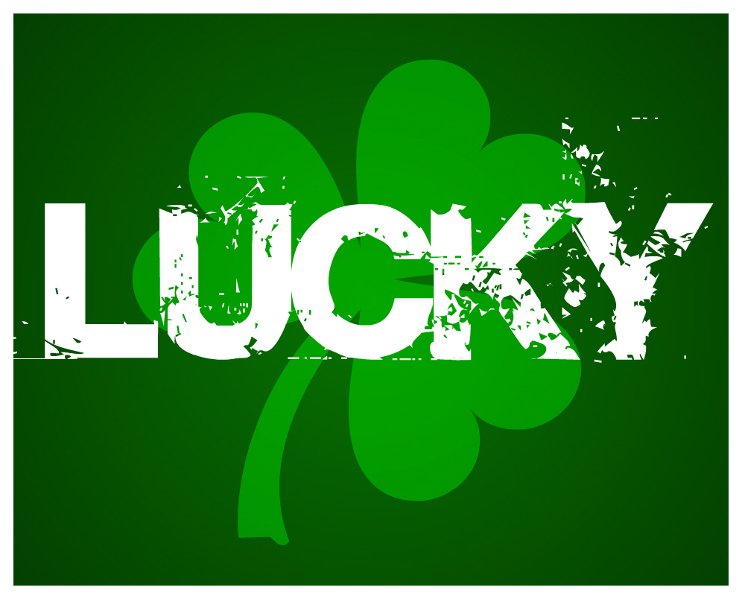
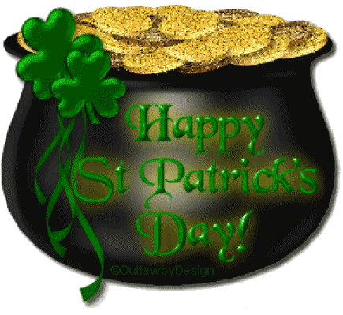
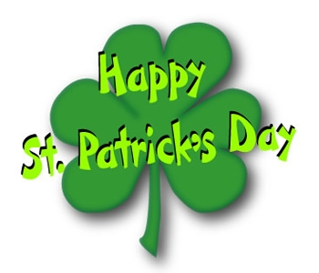
Good bye
THE END

