Slide 1
Geocity Reflection And Documentation
By: Willa

Slide 2
Requirements
2 parallel roads
1 perpendicular road
1 intersecting road
8 3-D Shaped structures: houses, tents, buildings, etc.
5 other things included: extra roads, cars, trucks, traffic lights, traffic signs, railroads, bus stations, river/lake/stream(s), extra buildings, etc.
Town must be colorful, visually appealing

Slide 3
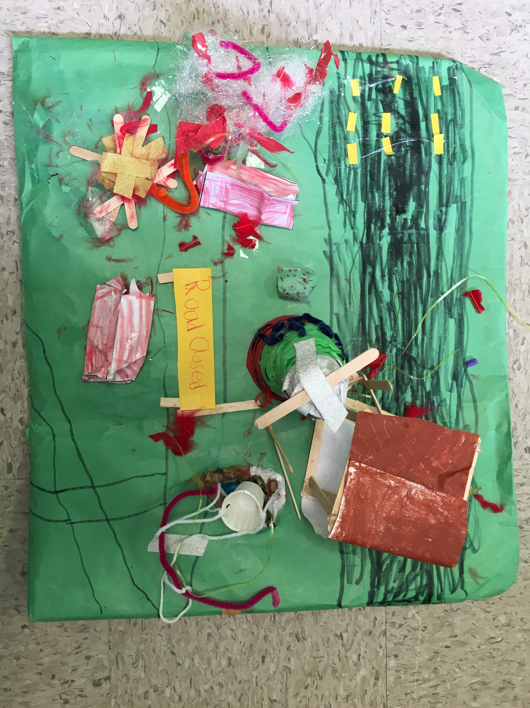
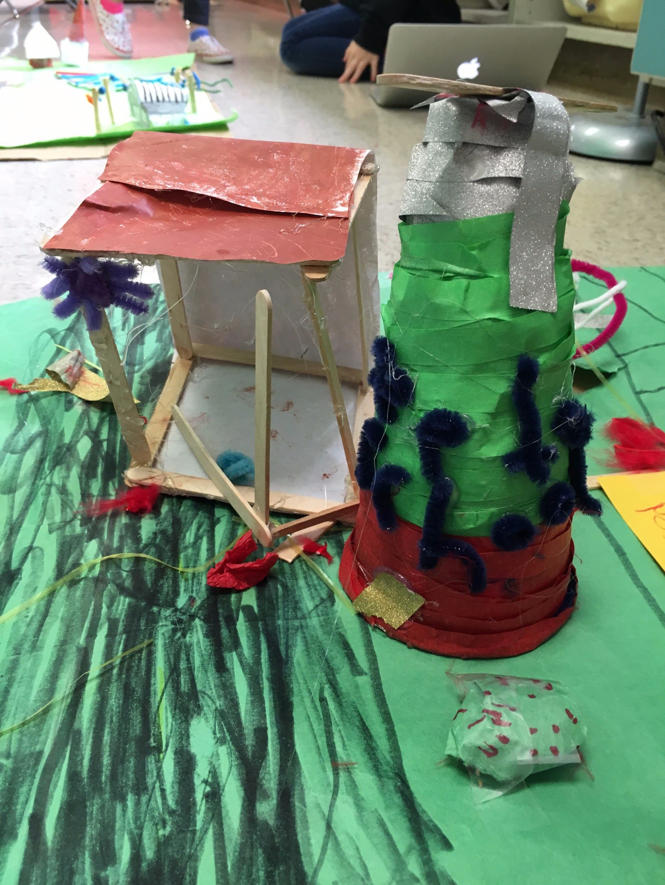
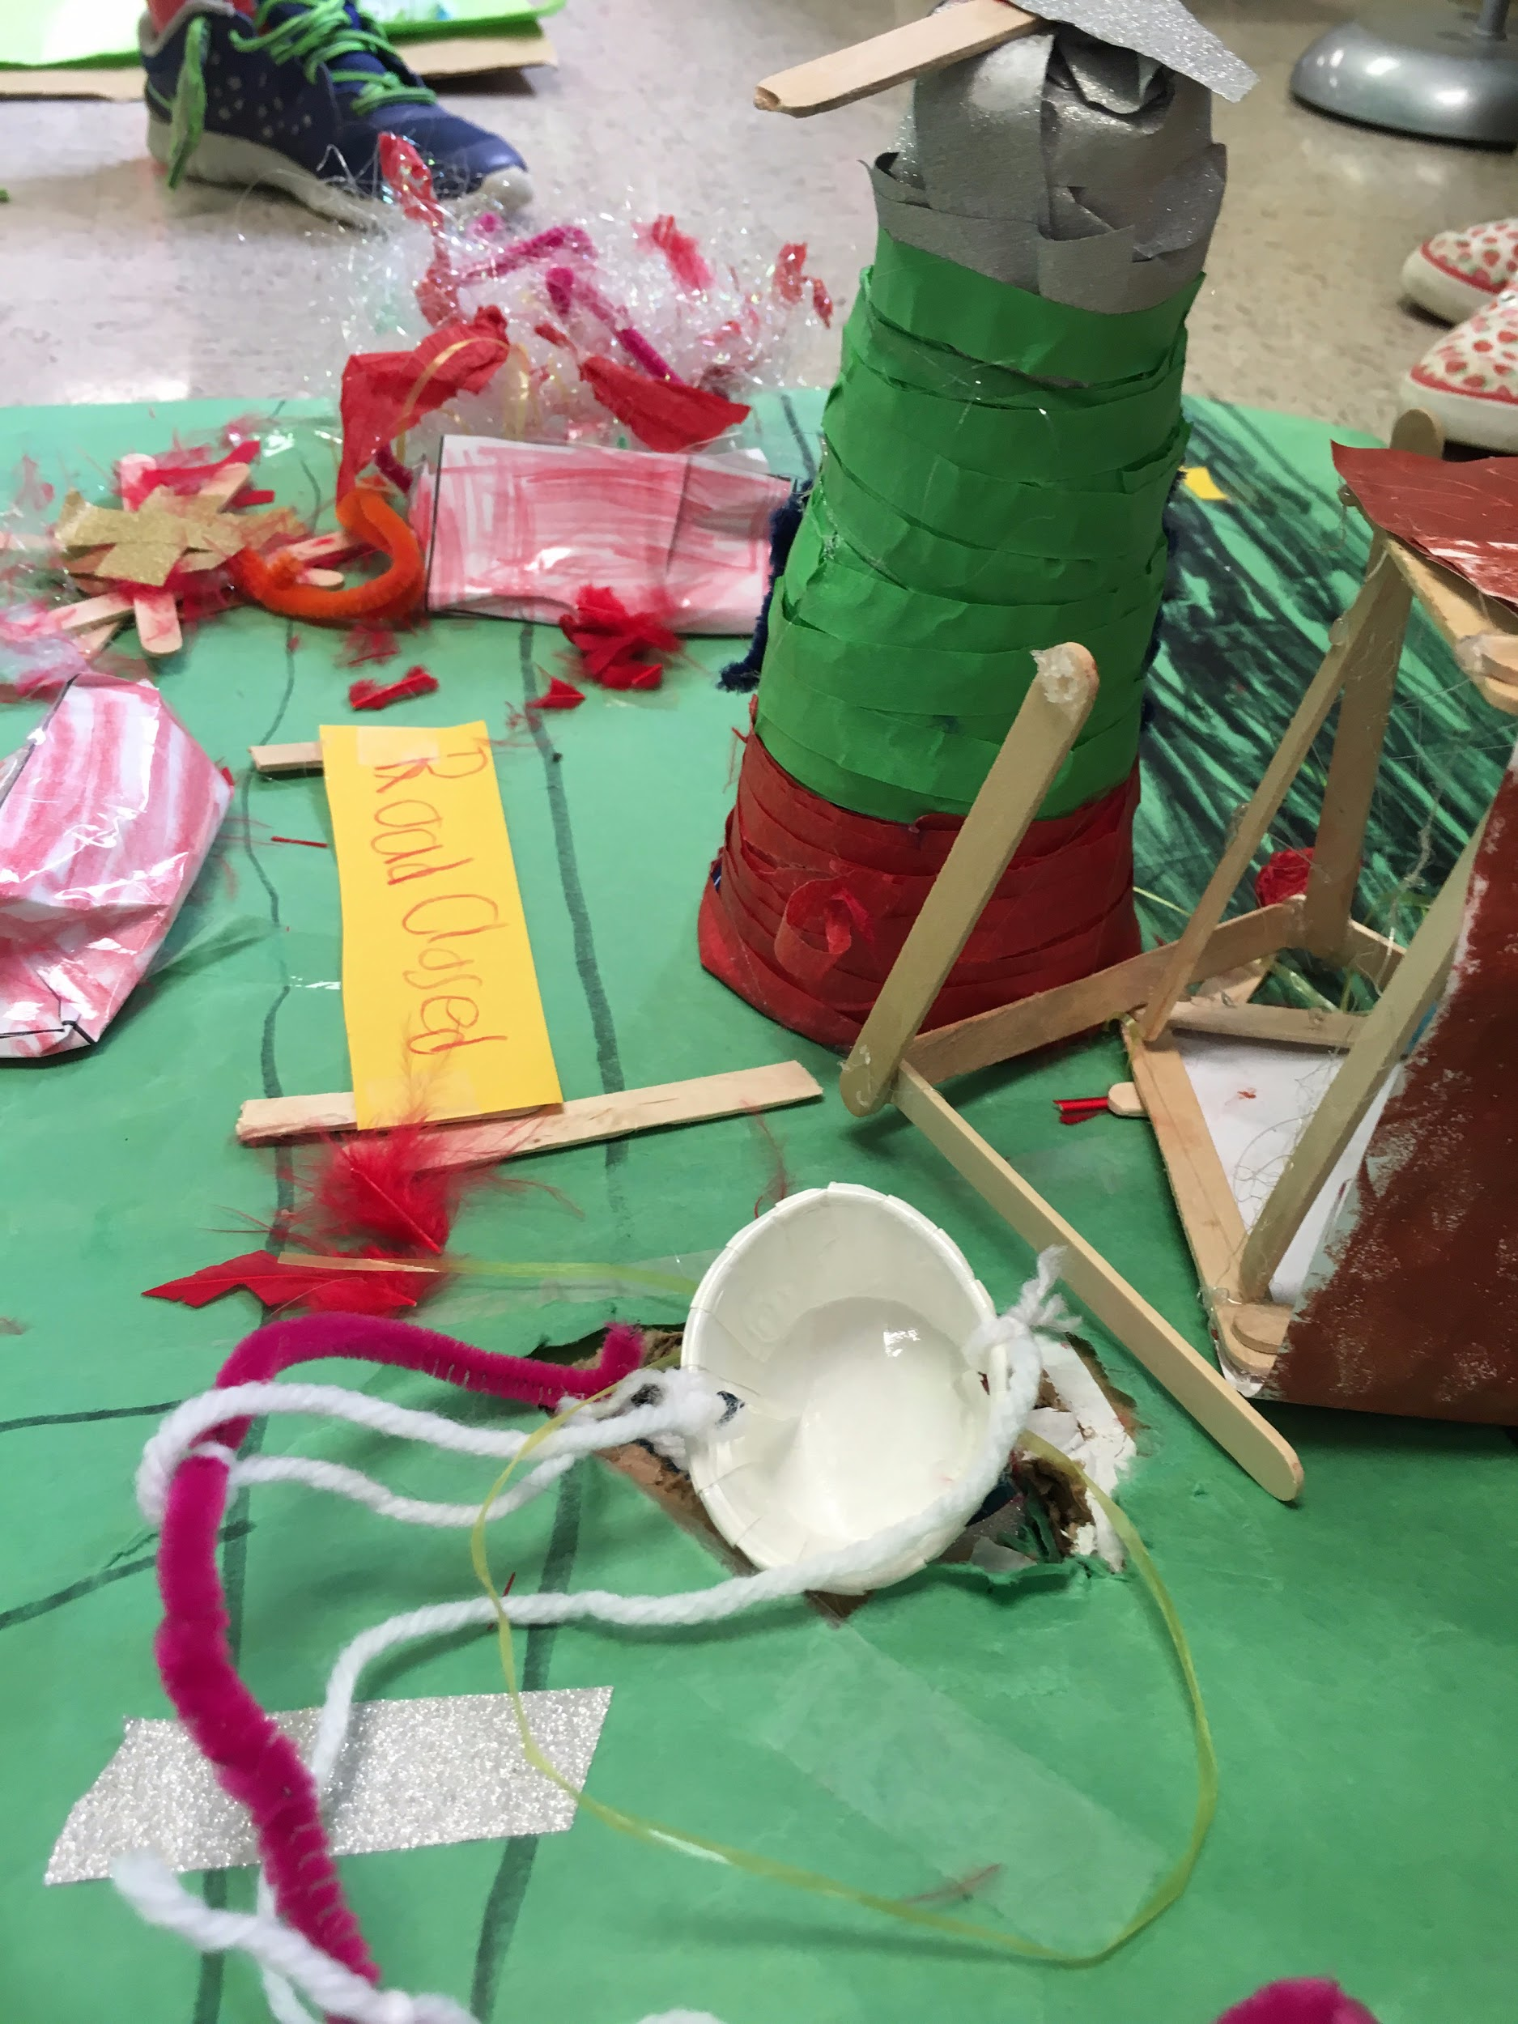
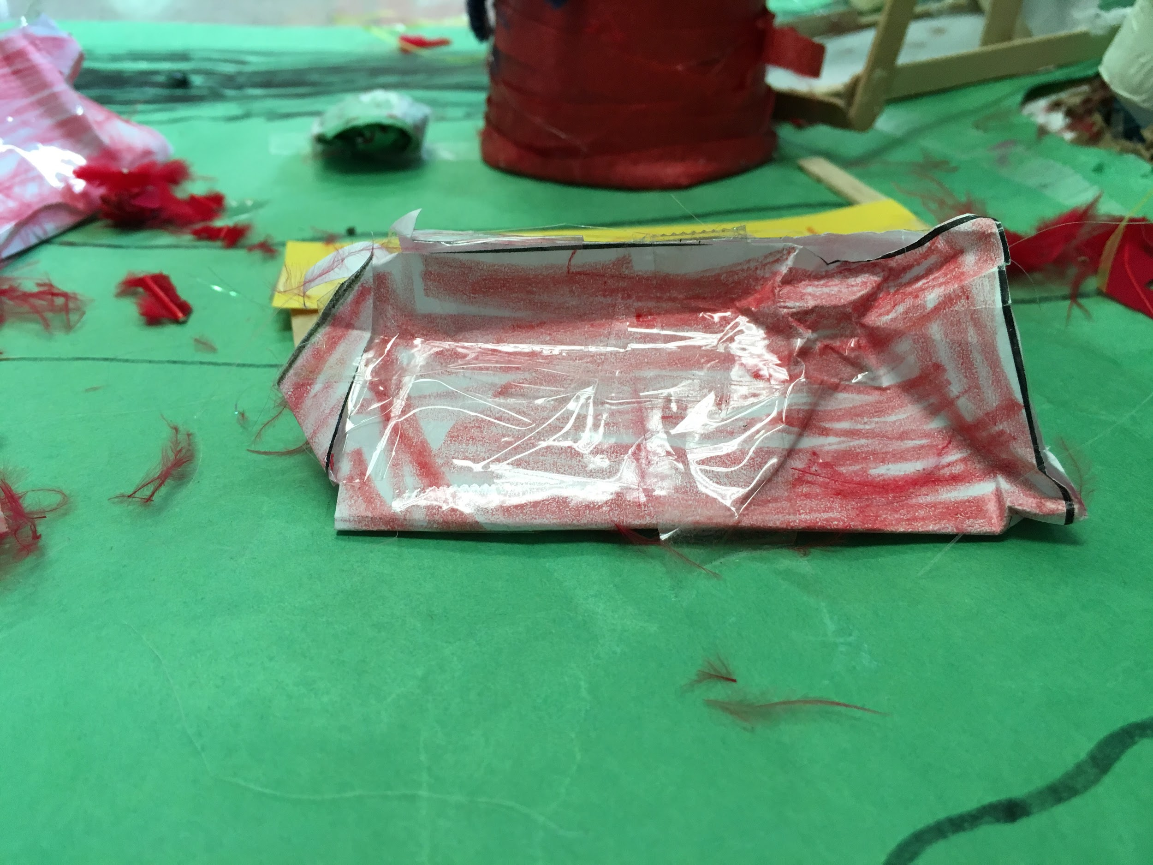
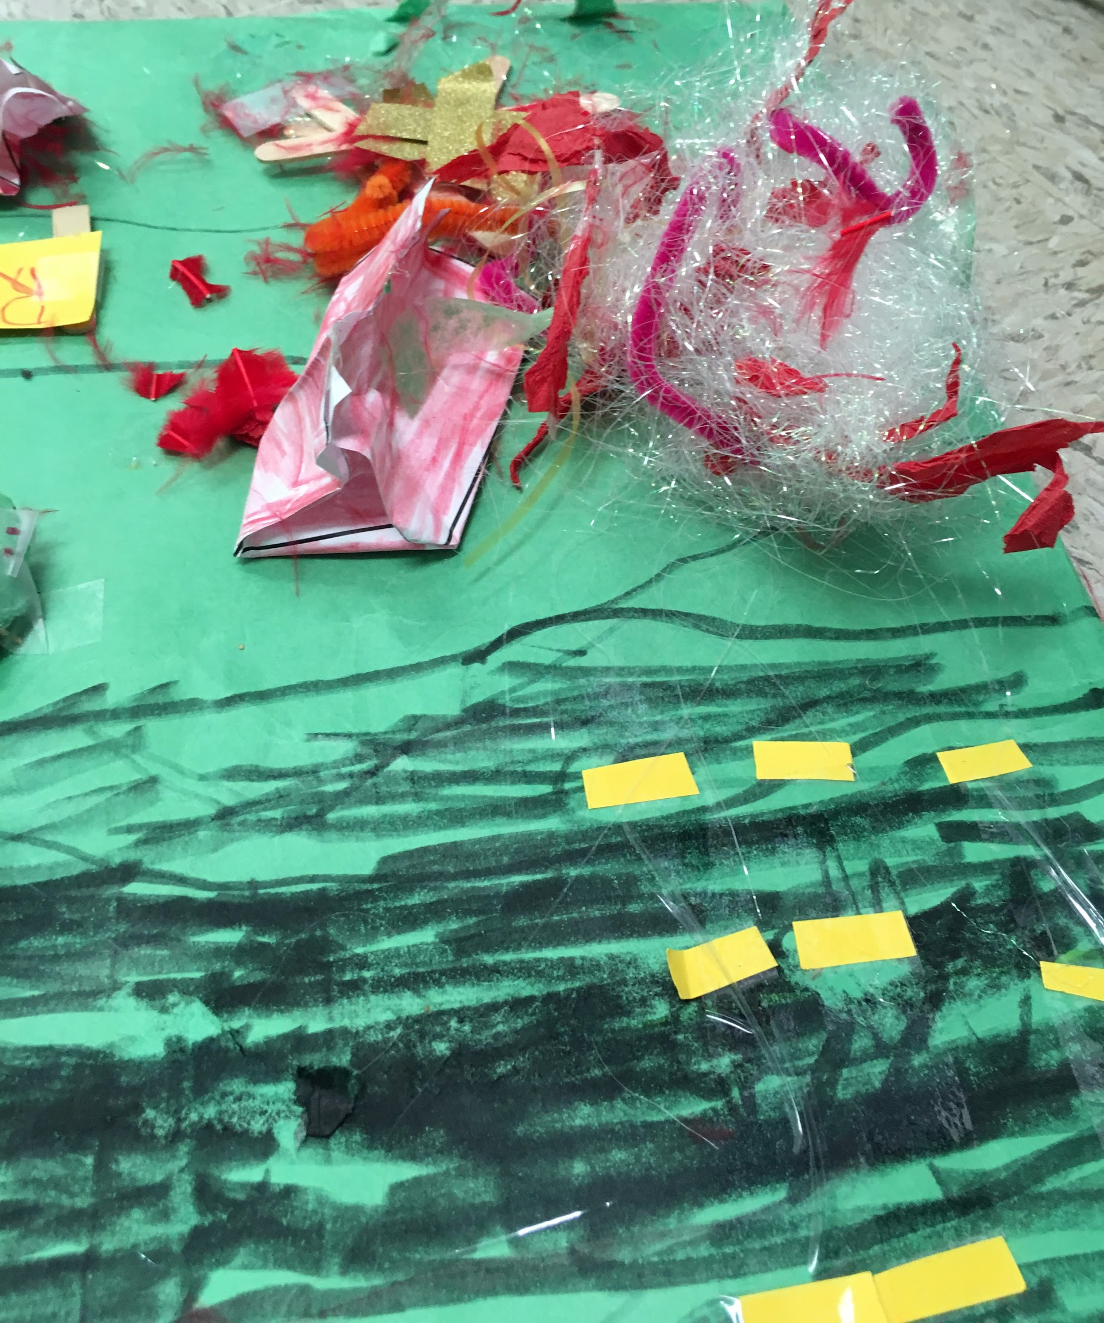
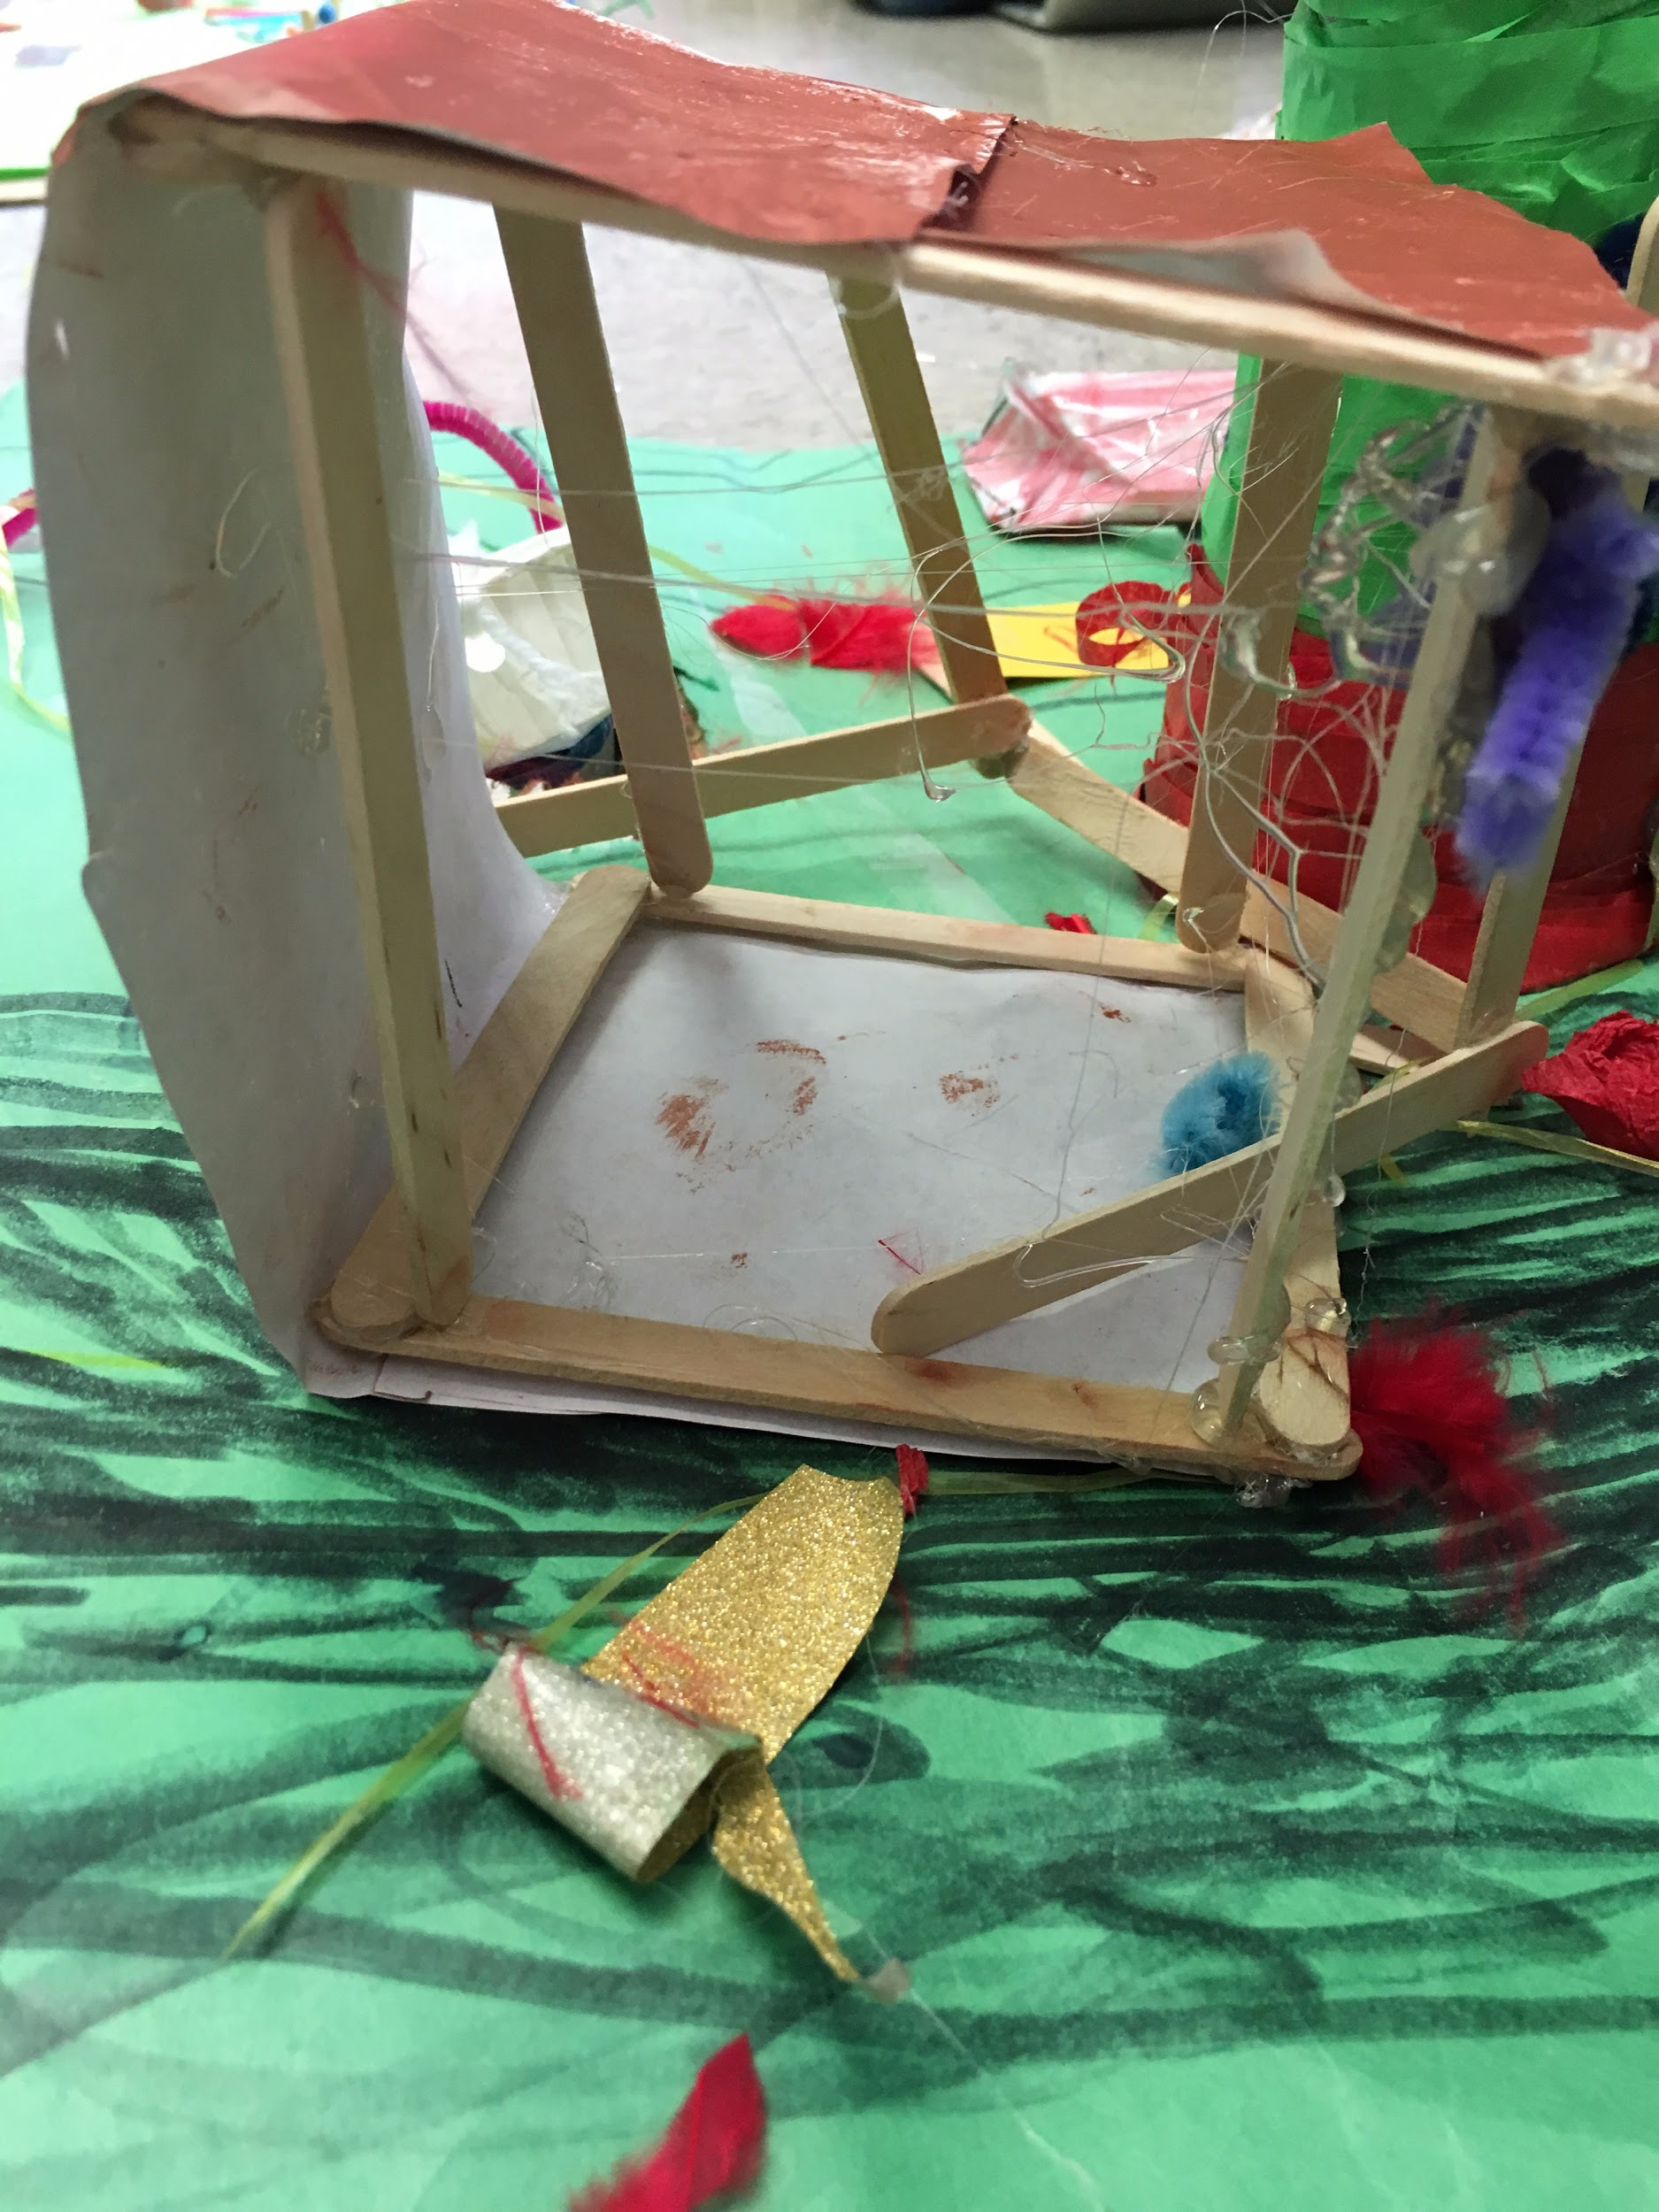
Photos

Slide 4
Photo 1: close-up
Triangular prism

Slide 5
Photo 2: close-up
Flat-top cone

Slide 6
Photo 3: close-up
Open Cube

Slide 7
Photo 4: close-up
Triangular prism

Slide 8
Photo 5: close-up
Open cube
Flat-top cone

Slide 9
Reflection
1: Have you done a similar kind of work in the past (earlier in the year or in a previous grade; in school or out of school)? Yes, in fact I have in school, earlier this year. 2: Does this work tell a story? No, it does not. 3:What were your standards for this piece of work? The text below the word requirements on slide 2. 4:Did you meet your standards? No, I did not. 5: If you were the teacher, what comments would you make about this piece? I would give everyone 2 more weeks. 6:What grade would you give it? Why? I would give mine a D because I didn’t meet all the requirements. 7:What might you want next year's teacher to know about you (what things you're good at)? I would want them to know that I am a very creative girl, I am (not) good at drawing, and I love to imagine. 8:What work would you show her to help her understand those things? I would draw her a picture, I would make her a craft, and I would show her all of the lovely things I imagine in pictures.

